Slide 1
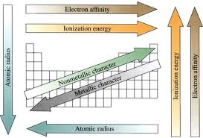

Slide 2
METALS | NON METALS | METALLOIDS
LOW IONIZATION ENERGY…FORM + IONS,…LOSE ELECTRONS. | HIGH IONIZATION ENERGY…DO NOT EASILY LOSE ELECTRONS | MODERATE IONIZATION ENERGY
CONDUCTIVE “SEA OF ELECTRONS” SOLID STATE. | NON CONDUCTORS | SEMICONDUCTORS.
MALLIABLE, DUCTABLE, LUSTER | BRITTLE, CRUSTY, UGLY | INTERMEDIATE
LOW ELECTRO-NEGATIVITY | HIGH ELECTRO-NEGATIVITY-GAIN ELECTRONS…FORM - IONS | INTERMEDIATE
OXIDIZE | REDUCE | VARIES
FROM THE LEFT TO THE METALLOID LINE | TO THE RIGHT OF THE METALLOID LINE | B,Si,Ge,As,Te,Po

Slide 3
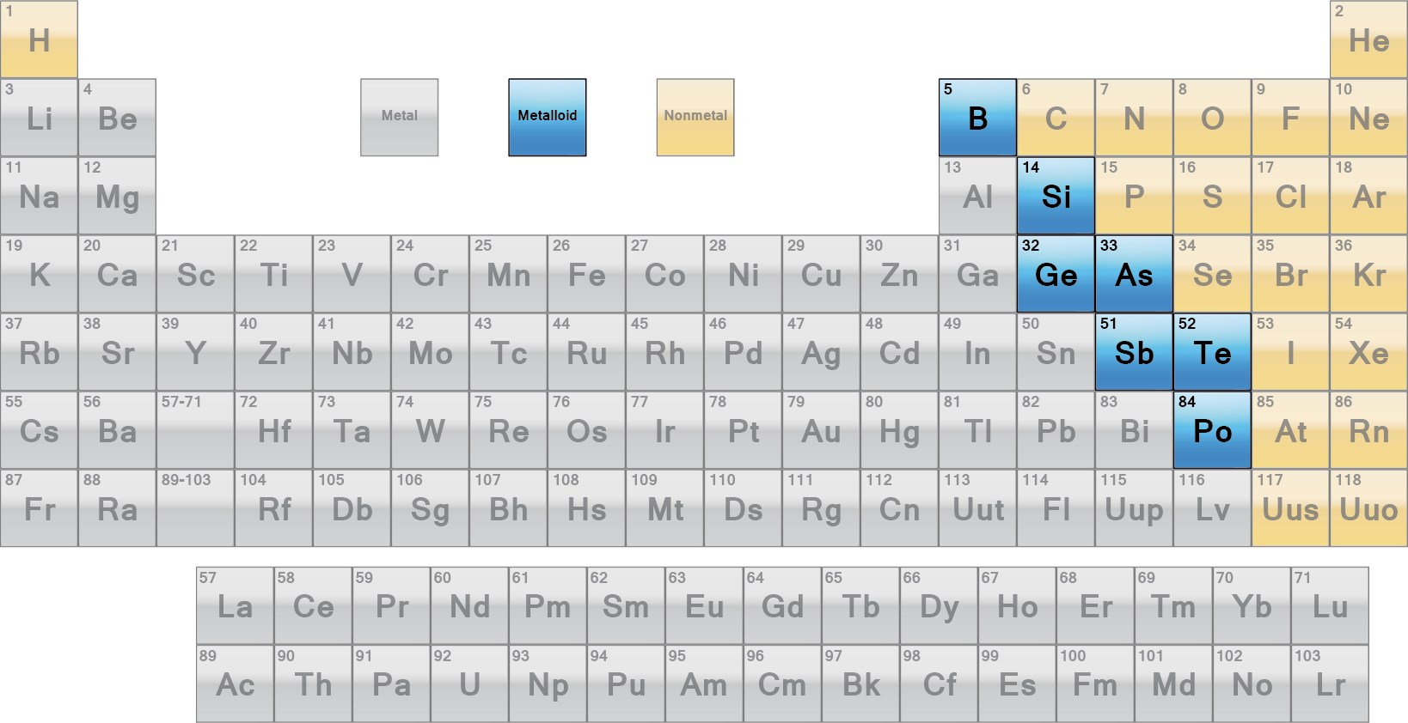
METALLOID LINE
NON METALS (YELLOW)
THE METALS (GREY)

Slide 4
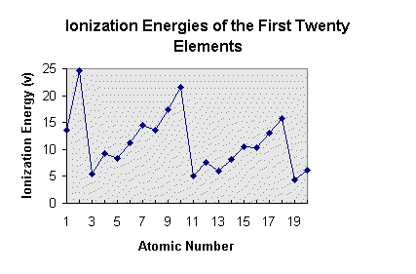
IONIZATION ENERGY: THE MINIMUM ENERGY REQUIRED TO REMOVE THE MOST LOSELY HELD (OUTERMOST) VALENCE ELECTRON.
DECREASES DOWN ANY GROUP.
LOW FOR METALS, HIGH FOR NONMETALS
FIRST IONIZATION ENERGY IS GIVEN ON TABLE “S”
THE TABLE BELOW SHOWS THE TRENDS ACROSS A PERIOD.
BECAUSE OF LOW IONIZATION ENERGY THE METALS FURTHER DOWN A GROUP EASILY LOSE ELECTRONS AND ARE MORE REACTIVE.

Slide 5
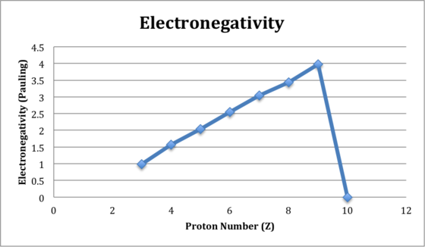
ELECTRONEGATIVITY: THE TENDANCY OF AN ATOM TO ATTRACT AND GAIN ELECTRONS.
DECREASES DOWN ANY GROUP.
LOW FOR METALS, HIGH FOR NONMETALS
ELECTRONEGATIVITY IS GIVEN ON TABLE “S”
THE TABLE BELOW SHOWS THE TRENDS ACROSS A PERIOD.
BECAUSE OF HIGH IONIZATION ENERGY THE NON METALS AT THE TOP OF GROUP ARE MOST LIKELY TO GAIN ELECTRONS AND ARE MORE REACTIVE TWARD THE TOP.

