Slide 1
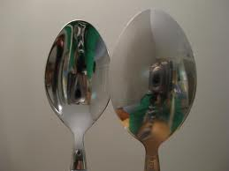
Resources
3.Concave Mirrors (converging)
2.Incident vs. Reflected
&
Object
vs. Image
4.Convex Mirrors (diverging)
1.Reflection
(Plane Mirrors)
Intro
Task
Process
Resources
Evaluation
Conclusion
Teacher Page

