Slide 1
THE SKELETAL/ MUSCULAR SYSTEM
Maame Kwarkye
Joon Bak
Ana Recio
Dalia Simmons

Slide 2
SKELETAL and MUSCULAR SYSTEM
MAIN FUNCTIONS:
SUPPORT
PROTECTION
STORAGE
BLOOD CELL FORMATION
The skeletal/muscular system is responsible for keeping organs away from damage, storing fat as well as certain minerals, and creating blood components.

Slide 3
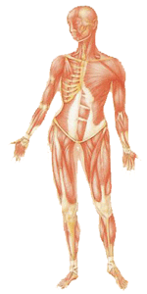
…continued
The human body has about 650 skeletal muscles
All skeletal muscles are attached to the skeleton
There are 206 bones total in the human body
Bone structure provide a flexible and protective frame for vital organs

Slide 4
Skeletons
1) Protection (skull, ribs cage, etc.)
2) Support
3) Movement (lever systems)
In vertebrates:
4) Responsible for blood cell production
5) Store minerals

Slide 5
Three main types of skeletons:
Hydrostatic skeletons
Earthworms
Exoskeletons
Arthropods
Endoskeletons
Vertebrates

Slide 6
…Continued
Hydrostatic skeletons
A skeleton made up of fluid under pressure in closed areas.
Exoskeletons
hard casing on the surface of an invetebrate
Endoskeletons
Found only in Chordates
Composed of cartilage, bone, or combination

Slide 7
Peristaltic locomotion in an earthworm

Slide 8
Exoskeleton of an arthropod

Slide 9
Major Divisions of a Human Skeleton
Axial Skeleton
Cranium, hyoid, vertebral column, sternum and ribs
Appendicular Skeleton
Pectoral girdle & bones of upper appendages
Clavicle, scapula, humerus, ulna, radius, phalanges, metacarpals, carpals
Pelvic girdle & bones of lower appendages
Pubis, ilium, ischium, femur, patella, tibia, fibula, tarsals, metatarsals, phalanges

Slide 10
The human skeleton

Slide 11
Major Joints of Human Skeleton
Ball-and–socket joint
Function: Rotation
Shoulder & hip joints
Hinge joint
Function: Restrict movement to a single plane
Knee & elbow
Pivot joint
Function: Rotation
Ulna, radius & tibia, fibula

Slide 12
Muscles
Moves skeletal parts by contracting
Action of the muscle is always to contract. Muscles only pull. They NEVER push.
Muscles are arranged in antagonistic pairs
each muscle work against the other

Slide 13
Cooperation of muscles & skeletons in movement

Slide 14
Structure & Function of Vertebrate Skeletal Muscle
Skeletal muscle are characterized by smaller and smaller parallel units
They have bundles of long fibers running the length of the muscle
Each fiber is a multinucleated single cell
Each fiber is a bundle of smaller myofibrils
Each myofibril is composed of two myofilaments: Actin (thin) & Myosin (thick)
the functional unit of muscle contraction is a sarcomere,

Slide 15
The structure of a skeletal muscle

Slide 16
Actin & Myosin Filaments
ACTIN
Thin filaments
Composed of many globular actin molecules (beads) assembled in a long chain (necklace)
Two protein chains are wound around one another to produce a single actin filament
Contain troponin & tropomyosin proteins which in the presence of Ca²⁺ “uncover” binding sites on actin
MYOSIN
Thick filaments
Longest known protein chain: 1,800 amino acids
200 or more parallel protein molecules with free globular “heads”
Myosin heads:
1) binding sites for contraction and
2) contain enzymes that
split ATP to power the contraction

Slide 17
Structure of the Sarcomere
M line – connection between
the thick myosin filaments
H zone –the central zone in the relaxed sarcomere containing only myosin filaments
I band – zone around the Z line that contains only actin filaments
A band – marks the extent of the myosin filaments in the sarcomere
Z line – the dark stripe in the center of the I band (bulkhead)

Slide 18
Skeletal Muscle

Slide 19
Other Types of Muscle: Cardiac Muscle
Found in the heart
Its fiber have cross-striations and contain numerous nuclei.
The cardiac muscle causes the rhythmical beating of the heart,

Slide 20
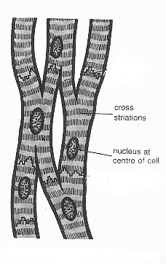

Slide 21
Other Types of Muscle: Smooth Muscle
Found throughout the body
It is responsible for peristalsis
Non-striated because actin & myosin filaments are not regularly arranged
Contracts slowly, but greater range than striated

Slide 22
Negative Feedback Prevents Injuries
Muscle spindles sense muscle length
the greater the density of spindles, the better control over the muscle
If the muscle is being stretched too much, sensory nerves kick off a spinal reflex arc which causes the muscle to contract
Slow stretches allow the apparatus to adapt, and do not kick off the reflex effectively

Slide 23
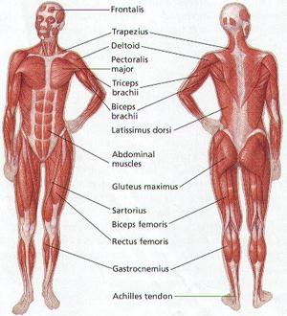

Slide 24
Skeletal and immune systems
“TABOO”
One player will have one card, in this case a power point slide, and must help the other team members guess the word that appears at the top of the “card”. He/She cannot use any of the words given in the card.
Each team will take turns to guess a word, and will have 2 minutes to complete the task.

Slide 25
Word that must be guessed by your team
BONES
Support
Rib Cage
White
Skull
Words not to be used to help your team guess

Slide 26
Word that must be guessed by your team
SPINAL COLUMN
Long
Back
Vertebral
Backbone
Words not to be used to help your team guess

Slide 27
BONY THORAX
Word that must be guessed by your team
Chest
Rib
Lungs
Breastbone
Words not to be used to help your team guess

Slide 28
Word that must be guessed by your team
ARMS
Wrist
Finger
Elbow
Forearm
Words not to be used to help your team guess

Slide 29
Word that must be guessed by your team
LEGS
Running
Walking
Support
Bone
Words not to be used to help your team guess

Slide 30
Word that must be guessed by your team
BONE MARROW
Words not to be used to help your team guess
Blood
Red
Platelets
Within

Slide 31
For further reading…
http://www.ucopenaccess.org/mod/resource/view.php?inpopup=true&id=25021
http://hes.ucfs
http://library.thinkquest.org/2935/Natures_Best/Nat_Best_Low_Level/Muscular_page.L.htmld.org/gclaypo/skelweb/skel01.html
http://www2.estrellamountain.edu/faculty/farabee/biobk/BioBookMUSSKEL.html

Slide 32
References
Information
http://www.human-body-facts.com/muscular-system.html
http://www.ucopenaccess.org/mod/resource/view.php?inpopup=true&id=25021
http://www.bcb.uwc.ac.za/sci_ed/grade10/mammal/muscle.htm#heart
http://hes.ucfsd.org/gclaypo/skelweb/skel01.html
Pictures
http://www.medicalook.com/human_anatomy/systems/Muscular_system.html

Slide 33
That’s All Folks!!
Hope This Web Quest
Was Helpful!!! ☺

