Slide 1
THE IMMUNE
SYSTEM
Maame Kwarkye
Ana Recio
Joon Bak
Dalia Simmons

Slide 2
HOW DOES THE IMMUNE SYSTEM MAINTAIN HOMEOSTASIS?
The immune system helps to attack viruses and diseases that may cause harm to the body
It consist of a series of organs that helps with the process

Slide 3
What is the Immune System and its function?
The immune system is made up of organs, tissues, a network of cells and proteins.
The main function of the immune system is to protect the body from harmful substances.
It defends the body against germs.
The immune system consist of acquired and innate immunity

Slide 4
ACQUIRED IMMUNITY
Acquired means “specific”
Immunity develops with the exposure to antigens
When exposed to an antigen, the body views it as foreign material, and takes steps to neutralize the antigen. Typically, the body accomplishes this by making antibodies, which are intended to defend the body from invasion by potentially dangerous substances.
They provide specific defenses against diseases
Acquired immunity can be active or passive
There are two cells in acquired immunity: B lymphocytes and T lymphocytes
Lymphocytes are white blood cells

Slide 5
…continued
B lymphocytes are also known as B cells.
They are produced in the bone marrow
T lymphocytes can be called T cells
The T cell is produced in the thymus

Slide 6
How do lymphocytes fight infection?
Each type of lymphocyte fights infection differently, the goal of protecting the body from infection remains the same.
The B cells produce specific antibodies to specific infectious microorganisms, while T cells kill infectious microorganisms by killing the body cells that are affected.
T cells release chemicals, called lymphokines, which trigger an immune response to fight cancer or a virus.
There are two types: helper T and killer T.

Slide 7
…continued
Killer T kills cells infected with viruses
Helper T determines which immune responses the body makes to a specific pathogen
Other types of white blood cells, such as phagocytes (engulfing cells) and cytotoxic cells (natural killer cells), actually kill the infectious microorganism by "devouring" it.

Slide 8
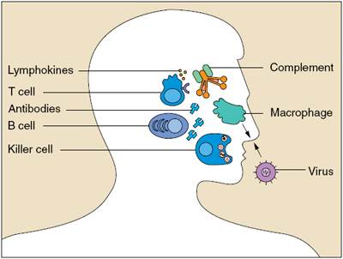

Slide 9
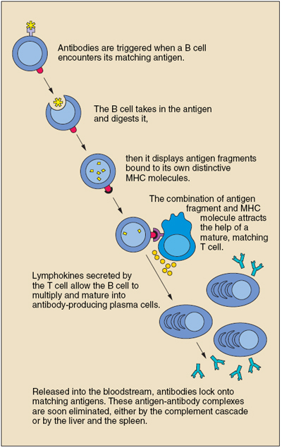
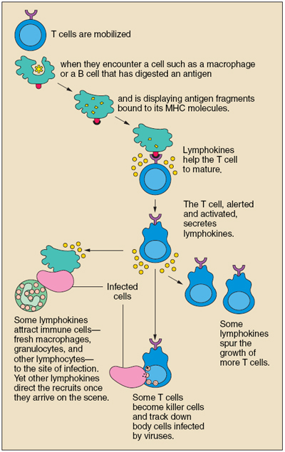
B cell T cell

Slide 10
INNATE IMMUNITY
Innate immunity is “nonspecific”
We are all born with innate immunity
It is a protection against all antigens
It responds to a broad range of microorganisms

Slide 11
…..continued
There are barriers that keeps harmful substances from entering the body. Some of these barriers are: Skin and Mucous membranes, and internal defenses
The skin membrane provides a physical barrier to pathogens
The mucous membrane traps bacteria and small particles that the skin cannot.

Slide 12
…continued
Internal defenses consist of phagocytic cells
Macrophage is a type of phagocytic cell that ingests foreign material
Macrophages are white blood cells that engulf and digest pathogens

Slide 13
Four major organs in the immune system
The bone marrow is responsible for the production of important system cells like the B cells, granulocytes, natural killer cells and immature thymocytes. The bone marrow also produces red blood cells.
The thymus gland is responsible for producing mature T cells. It is located in the upper chest region.
The spleen removes red blood cells and replaces it with white blood cells. It has a thin connective tissue capsule from which short septa that extend inwards. The spleen has two components: the white pulp and the red pulp.

Slide 14
….continued
The white pulp is responsible for the immunological function of the spleen and the red pulp is responsible for the filtration function of the spleen.
The lymph node is composed of T cells, B cells, dendritic cells and macrophages. Lymph nodes deplete fluid from most of the tissues and filter out antigens present in them. The lymph nodes have a fibrous capsule.

Slide 15
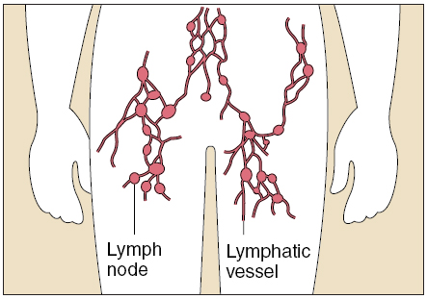

Slide 16
ARE THERE MORE CELLS IN THE IMMUNE SYSTEM?
YES THERE ARE: natural killer cells, granulocytes, and dendritic cells
Natural killer cells destroy tumor cells and viral infected cells
Granulocytes are a type of white blood cells. There are three types of granulocytes: neutrophils, eosinophils and basophils. Granulocytes are responsible for removing bacteria and parasite from the body.
Dendritic cells are responsible for engulfing antigens

Slide 17
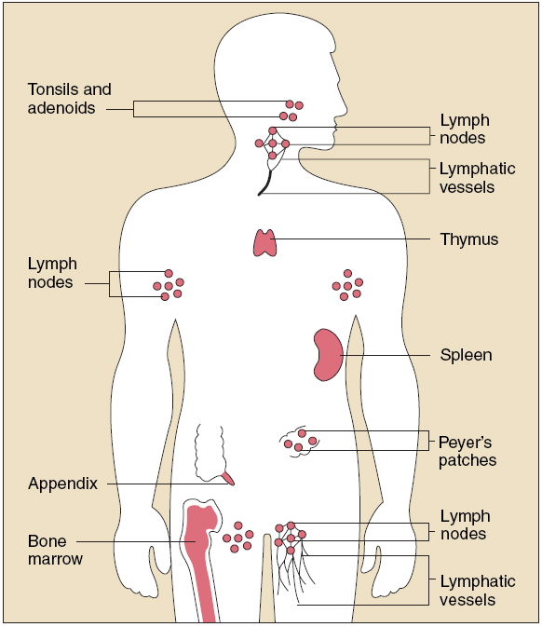

Slide 18
IMMUNE DISORDERS?
Immune disorders can lead to several diseases
Autoimmune disorders- when the immune system attacks healthy cells . EX: Lupus, Addison’s disease
AIDS- immunodeficiency disease that is caused by a virus. EX: human immunodeficiency virus (HIV)
Allergies- responses to certain environmental antigens. There are several allergens that cause allergies such as certain food, drugs, and pollen
Asthma- a lung disorder caused by inflammation of the air passage

Slide 19
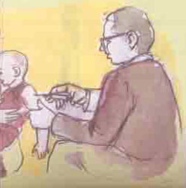

Slide 20
What happens when skin is damaged?!!
Histamine is secreted by basophils, white blood cells found in connective tissue.
Vasodilation(dilation of blood vessels), stimulated by histamine, increases blood supply to the damaged area and allows for easier movement of white blood cells through blood vessel walls. This also causes redness, an increase in temperature, and swelling. The increase in temperature, like a fever, may stimulate white blood cells, and they may make the environment inhospitable to pathogens.
Phagocytes arrive and engulf pathogens and damaged cells.
Complement helps phagocytes engulf foreign cells, stimulate basophils to release histamine, and help lyse foreign cells.

Slide 21
Inhibition by Antibody Feedback
Passively administered antibody can prevent an antibody response
Antibody produced during an immune responses leads to elimination of antigen
Less antigen available to stimulate specific cells
Immune complexes can bind to inhibitory receptors

Slide 22
Let’s Play Yay!!!!!!!!!!!!

Slide 23
Name that Organ!!!
Rules: The class is going to be divided into four groups. Below, there are functions of the major organs in the immune system. The first group to match the correct organ to its function earns 50 points for their group. Pretty easy right??
____1. located in the upper chest region, this organ produces large amounts of lymphocytes
____2. the site of the B cell
____3. this organ removes fluids from most of the tissues in the body
____4. responsible for the removal of red blood cells and the replacement of white blood cells

Slide 24
ANSWERS
Name the Organ
1. Thymus
2. Bone Marrow
3. Lymph Node
4. Spleen

Slide 25
IMMUNE SYSTEM TABOO
One player will have one card, in this case a power point slide, and must help the other team members guess the word that appears at the top of the “card”. He/She cannot use any of the words given in the card.
Each team will take turns to guess a word, and will have 2 minutes to complete the task.

Slide 26
Word that must be guessed by your team
BONE MARROW
Words not to be used to help your team guess
Blood
Red
Platelets
Within

Slide 27
Word that must be guessed by your team
Immune system
Fight
Helps
Prevents
Virus
Words not to be used to help your team guess

Slide 28
Word that must be guessed by your team
LYMPH NODES
System
Fluid
Cell
Macrophage
Words not to be used to help your team guess

Slide 29
Word that must be guessed by your team
SPLEEN
Foreign
Trap
Natural
Killer
Words not to be used to help your team guess

Slide 30
Word that must be guessed by your team
THYMUS GLAND
Words not to be used to help your team guess
Produces
Childhood
Immune
cell

Slide 31
For further reading…
http://uhaweb.hartford.edu/BUGL/immune.htm
http://kidshealth.org/parent/general/body_basics/immune.html
http://www.niaid.nih.gov/topics/immunesystem/Pages/default.aspx
http://www.buzzle.com/articles/immune-system-diseases-list-of-immune-system-disorders.html
http://loki.stockton.edu/~davisn/LNdiseases.html
Neil Campbell & Jane Reece (2005). AP Edition Biology Seventh Edition. Pearson Education Inc. Pg. 898-919

Slide 32
References
Information
http://www.nlm.nih.gov/medlineplus/immunesystemanddisorders.html
http://www.buzzle.com/articles/immune-system-diseases-list-of-immune-system-disorders.html
http://uhaweb.hartford.edu/BUGL/immune.htm
http://www.hellolife.net/explore/immune-system/what-organs-make-up-your-immune-system/
http://medicalcenter.osu.edu/patientcare/healthcare_services/infectious_diseases/immunesystem/Pages/index.aspx
Neil Campbell & Jane Reece (2005). AP Edition Biology Seventh Edition. Pearson Education Inc. Pg. 898-919
Pictures
http://www.niaid.nih.gov/topics/immuneSystem/Pages/immuneResponseImages.aspx
http://www.barrackpore.gov.in/htm/sdobkp_citizencenter_child.htm

Slide 33
That’s All Folks!!
Hope This Web Quest
Was Helpful!!! ☺

