Slide 1
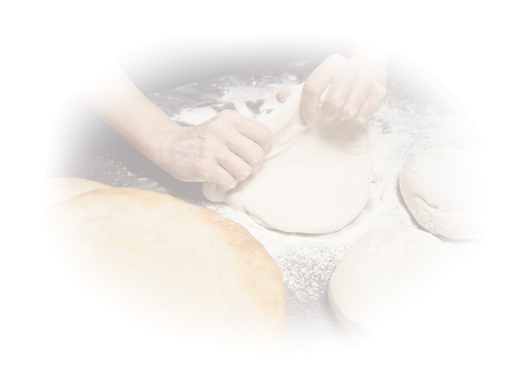
CHAPTER TWO
New Testament World of Jesus

Slide 2
Palestine: The Holy Land
- Palestine has always been a strategic place in World History; the keystone of the fertile crescent
- Bridges two continents, playing a key international commercial, political, and cultural role

Slide 3
Geography
Four major terrain's:
1.) Coastal plain along Mediterranean Sea - Jesus only made a brief visit to this region
2.) Mountain range running north and south (dominant geographical feature) - Bulk of Jesus’ activities took place here
3.) Great Rift Valley where the Jordan River flows - John the Baptist’s ministry took place here
4.) Transjordan - hilly terrain east of the Jordan River and the Dead Sea - Jesus’ transfiguration was here

Slide 4
Regions and Cities
Galilee
• Center of Jesus’ earthly ministry, mainly Jewish
• Cities included Nazareth, Cana, Bethsaida, and Capernaum
- Samaria
• North-central region of the Holy Land
• Samaritans accepted only the Law of Moses and considered only the first five books to be sacred
• Jews looked on Samaritan worship as false

Slide 5
Regions and Cities
- Judea
• South of Palestine - mainly Jews who returned to the Holy Land.
• Cities included Jerusalem, Bethlehem, Bethany, and Jericho

Slide 6
Language and Dialect
- Common language throughout the Roman Empire was Greek
• Gospels were written in Greek but retained several Aramaic sayings
- Latin was used in Palestine because of the Roman occupational forces

Slide 7
Language and Dialect
- Jesus spoke Aramaic which is a Semitic language closely related to Hebrew
- The Bible was read in Hebrew but many people could not understand it
• Scriptures were therefore translated into Aramaic phrases

Slide 8
Feasts and Practices
- Jesus’ practice of his Jewish faith revolved around:
1.) The Synagogue
2.) The Temple
3.) Religious feasts

Slide 9
Feasts and Practices
1.) Synagogue
- Comes from Greek word meaning “assembly”
- Served three main purposes:
• A house of prayer where scriptures were read and Yahweh was worshipped
• A place of discussion for legal settlements
• The local school

Slide 10
Feasts and Practices
2.) Temple
- The one and only Temple was in Jerusalem
- This is where the Jews offered sacrifices to God
- A Holy place where Jews believed God dwelled in a special way
- The Temple standing during New Testament times was the third one constructed in Jerusalem

Slide 11
Feasts and Practices
3.) Religious (Jewish) Feasts
-Major Jewish feasts
• Passover: most important feast because it celebrates the Chosen People’s liberation from Egypt
• Pentecost: held fifty days after Passover - celebrated Yahweh’s giving of the Law to Moses, the Sinai covenant
• Tabernacles: fall harvest celebration - recall the time that Jews spent in the wilderness

Slide 12
Political Climate
-Politics dominated Jewish life
-Hellenism (love of Greek culture) was imposed by the Seleucid ruler, Antiochus IV
-After Herod the Great’s death, Palestine was ruled by his sons Archelaus, Herod Antipas, and Philip. Herod Antipas was king during Jesus’ lifetime

Slide 13
Political Climate
-Slavery was a fact of the ancient world and the Roman Empire but not as much in Palestine
-Christ’s teachings on the fundamental dignity of persons, after centuries, eventually led to the abolition of slavery throughout the world

Slide 14
Beliefs and Practices
- Jews expected the Messiah to come very soon
- They typically interpreted the coming Messiah as a Davidic figure, a military leader who would throw off Roman rule and establish God’s kingdom, restoring Israel’s glory
- Common belief was that Yahweh would judge the dead by rewarding the good and punishing the evil

Slide 15
Beliefs and Practices
- New Testament records the accepted Jewish belief in the existence of angels and demons
- Jews believed in heavenly messengers (angels)
- Important literature produced in this era books (Jubilees, Enoch, and the Dead Sea Scrolls) divided the angels into groups and gave them names and descriptions
-Jews and Christians accepted the existence of demons, but believed they were subject to God

Slide 16
Religious Sects
- Four Main Religious Groups:
1.) Sadducees
2.) Pharisees
3.) Essenes
4.) Zealots

Slide 17
Religious Sects
1.) Sadducees
- Mainly priests and aristocrats who cared for Temple practices and worship
- Centered their activities in Jerusalem
- Theologically conservative
• Accepted only the Torah as inspired scripture
• Did not believe in the resurrection of the dead, the immortality of the soul, or in angels

Slide 18
Religious Sects
1.) Sadducees cont.
- Stressed human freewill and responsibility over trusting Divine Providence
- Collaborated with Romans to stay in power
- Disappeared after the destruction of the Temple in A.D. 70 when they lost their power

Slide 19
Religious Sects
- Many Sadducees, along with a few Pharisees, made up the 71 member Sanhedrin
- The Sanhedrin was a major law-making body and Supreme Court of Judaism

Slide 20
Religious Sects
2.) Pharisees
- Means “separated one”
• Came into existence by separating themselves from ordinary religious practices of the day
- Believed in strict observance of the Law and actively pursued holiness
- Had some Gentile influence

Slide 21
Religious Sects
2.) Pharisees Cont.
- Although there were only around 6000 followers during the first century, they had great influence
- Jesus’ beliefs and spiritual practices most closely paralleled the Pharisees
• Believed in the resurrection of the body and divine judgment of the living and the dead

Slide 22
Religious Sects
3.) Essenes
- An apocalyptic group
• Believed God would usher in his kingdom through a dramatic, even catastrophic event
- Lived strict, pure lives believing that they would be on Yahweh’s side when the great day would come
- Lived in tight-knit religious groups in towns and villages
• Avoided luxuries
• Shared communal meals
• Did work for the poor

Slide 23
Religious Sects
3.) Essenes Cont.
- Possible influence of John the Baptist
-Disappeared after the destruction of the Temple
• Similar to Sadducees

Slide 24
Religious Sects
4.) Zealots
- An organized revolutionary faction
• Came into existence during the First Jewish War (66-70)
- Despised Roman rule and fomented violence to overthrow it
• After their second revolt, they were forbidden to set foot in the holy city of Jerusalem
-Famous stand at Masada is a symbol of Jewish pride today

Slide 25
Other People in New Testament
-Tax Collectors
• Were often cheaters who tried to line their own pockets at expense of fellow Jews
-Common People
• most of Jesus’ contemporaries
-Gentiles
• The nations of people who were not circumcised
-Women
• Had a lowly position in first-century Palestine
• Considered inferior to men; few political rights

Slide 26
Vocabulary
Apocalypse
Pentateuch
Qumran
Sanhedrin
Torah

