Slide 1
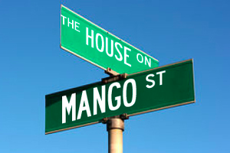
Do Now: take out HOMS

Slide 2
October 5, 2017
Objective: to gain insight into Esperanza’s developing sense of maturity.
Opening: Read chapters/follow along with audio
Work Period: Corresponding worksheet
Closing: Review answers

Slide 3
Homework
Read and annotate:
“Four Skinny Trees”
“No Speak English”
“Rafaela Who Drinks Papaya and Coconut Juice on Tuesdays”
“Sally”
“Minerva Who Writes Poems”

Slide 4
Read: “Edna’s Ruthie”

Slide 5
Listen to: “The Earl of Tennessee”

Slide 6
Watch: “Sire”

