Slide 1
Do Now: sit in groups of 3 and take out HOMS

Slide 2
October 20, 2017
Objective: to analyze Esperanza’s true desires regarding her future on Mango Street
Opening: read “The Three Sisters”
Work period: mini jigsaw, notes
Closing: free write

Slide 3
Homework
None!
(Vocab: 10/25, 26)
(Extra Credit: 10/27)

Slide 4
Read “The Three Sisters”

Slide 5
Mini Jigsaw
1 - Clotho
2 - Lachesis
3 - Atropos
Search on iPad: “Tales Beyond Belief fates”

Slide 6
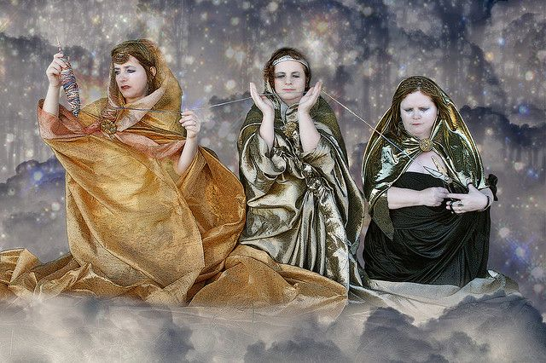
Name | Description
Clotho
Lachesis
Atropos

Slide 7
Free Write
7) Make A Wish
If you were granted one wish, what would you use it on?
Make it relevant to your life right now, the same way Esperanza’s wish is relevant to her current feelings. What aspects of your life would be affected? Are there any possible consequences?

