Slide 1
Do Now:
take out “The Train From Rhodesia”
and a piece of paper

Slide 2
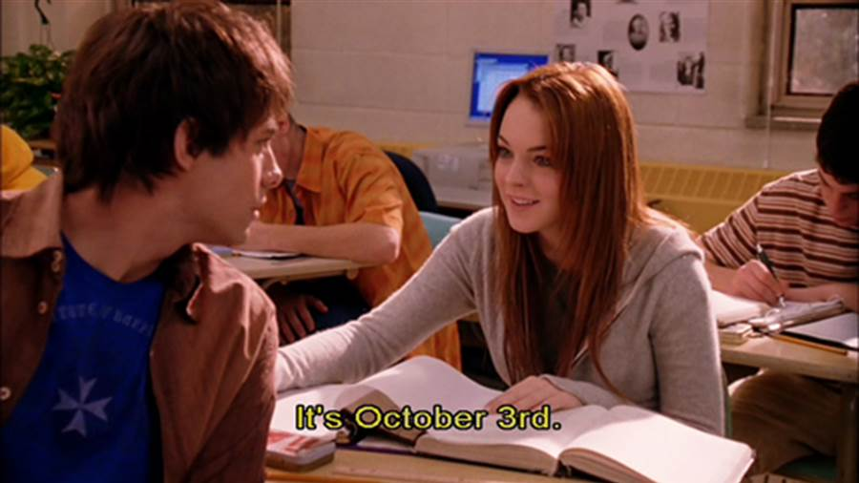
October 3, 2017
Objective: to practice our writing skills and make accurate predictions about the future based on textual evidence
Opening: Instructions
Work Period: Writing
Closing: textbooks for Beowulf

Slide 3
Homework
None

Slide 4
Classwork:
Be a MAN!
Rewrite the story from the man’s perspective
Does not have to be as long as the actual story! However, make sure to include all major events and how you think he may react, things he may say, etc.
Use the same style as Gordimer’s (figurative language, cultural vocab, etc)
10 points

