Slide 1
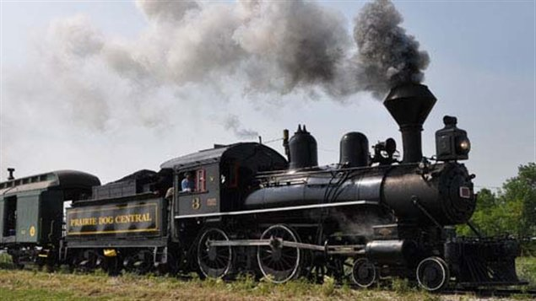
Do Now:
Take out “The Train from Rhodesia”

Slide 2
September 26-27, 2017
Objective: to complete a close-read of the short story, “The Train to Rhodesia.”
Opening/Work/Closing: read

Slide 3
Homework
None

Slide 4
Read “The Train From Rhodesia”

