Slide 1
Intervals
AP Music Theory
Mr. Silvagni

Slide 2
What is an Interval?
An interval is the distance between two notes
There are two parts to an interval name
Quality – major/minor/perfect/augmented/diminished
Distance – numerical (how many letter names away)

Slide 3
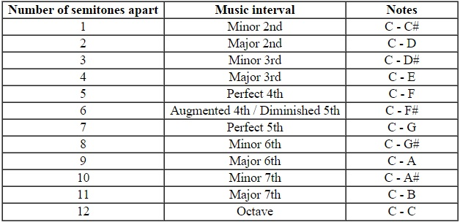
Standard Intervals
Semitone = half steps
All major and perfect intervals come from the major scale
All minor (except m2) and perfect intervals come from the minor scale

Slide 4
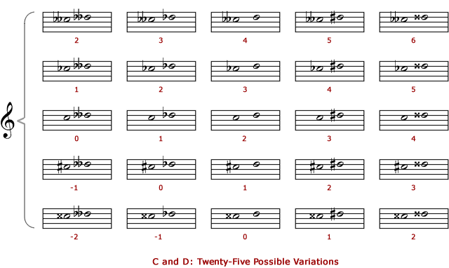
Nonstandard Intervals
double diminished – diminished – minor – major – augmented – double augmented
double diminished – diminished – perfect – augmented – double augmented

Slide 5
Strategies
If accidentals are troubling, remove them first, then add them back and see how they affect the interval
Raising the bottom or lowering the top note makes the interval smaller
Lowering the bottom or raising the top note makes the interval bigger
Remember, do not change the numerical part…any kind of C to any kind of A is still a 6th

Slide 6
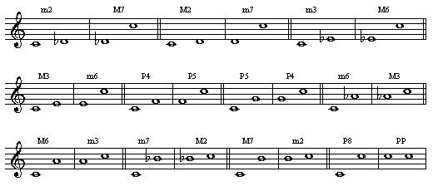
Interval Inversions

Slide 7
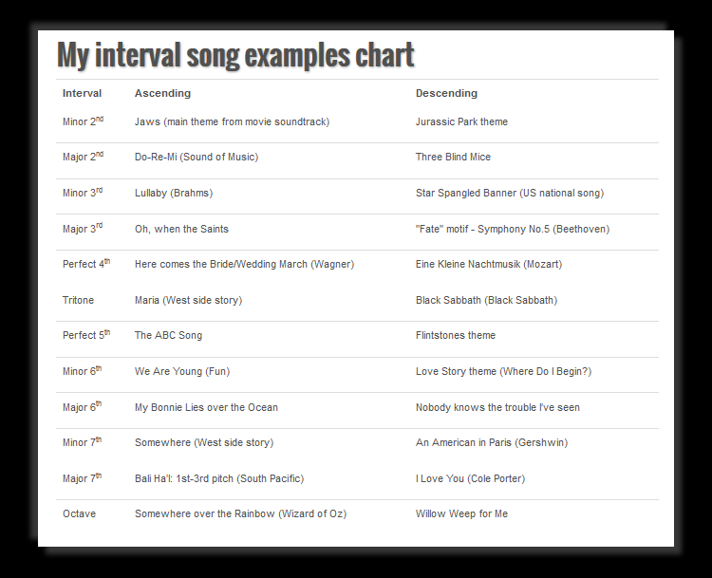
Intervals in Famous Music

Slide 8
Compound Intervals
Intervals that exceed an octave
Typically from 9th to 15th but could theoretically go on forever
Same as simple intervals, but have an octave displacement
Add 7 to the lower interval
9th = 2nd, 10th = 3rd, 11th = 4th, 12th = 5th, 13th = 6th, 14th = 7th, 15th = 8th

