Slide 1
MUGSHOTS
Recognize anyone???

Slide 3
Snooki
Snooki (real name: Nicole Polizzi) was arrested in July 2010 for disorderly conduct. The 22-year-old star of the MTV show “Jersey Shore” was booked into a Seaside Heights jail, where she posed for these mug shots.

Slide 4
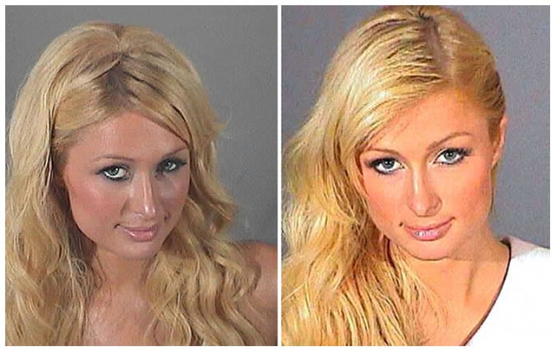
I have three mugshots

Slide 5
Paris Hilton
Paris Hilton is seen here in the third mug shot of her young career. The dopey heiress, 29, was arrested last night (8/27/10) after a bag of cocaine fell out of her purse during a traffic stop on the Las Vegas Strip (her boyfriend’s car was pulled over by a cop who smelled marijuana wafting from the SUV).

Slide 7
Lindsey Lohan
Lindsay Lohan posed for the above Los Angeles County Sheriff's Department mug shot in July 2010 after being booked into the Lynwood Correctional Facility. The actress, 24, was ordered to serve three months in jail after a judge determined that she violated the terms of the probation she was put on following two 2007 DUI arrests.

Slide 9
MARSHALL MATHERS, EMINEM, SLIM SHADY
Marshall Mathers, III (aka Eminem) was arrested twice in June 2000 on gun charges in Michigan, and was hit with probationary sentences in both cases, one in Royal Oak, the other in Warren (above you'll find mug shots from both those arrests). The rapper was nabbed by Warren cops for carrying a concealed weapon and assault after fighting with a man he saw kissing his estranged wife Kim outside of a club. He also got popped for brandishing a weapon during a parking lot beef with members of the rival rap outfit Insane Clown Posse

Slide 11
JOBA Chamberlain
New York Yankees pitching phenom Joba Chamberlain was arrested in October 2008 for drunk driving. The athlete pleaded guilty in April 2009 to a DUI charge and was placed on probation for nine months and had his driver's license suspended for 60 days. After Chamberlain was pulled over for speeding in Lincoln, Nebraska, a state trooper noticed an open bottle of Crown Royal whiskey on the front passenger seat of the BMW the ballplayer was driving. After failing a pair of field sobriety tests, Chamberlain took a Breathalyzer test, which showed his blood alcohol content was .134, above the state's .08 limit.

Slide 13
Jay - Z
Rap star Jay-Z (real name: Shawn Carter) was arrested by New York City cops in December 1999 for allegedly stabbing a record executive at a Manhattan nightclub. Originally charged with felony assault, the performer pleaded guilty in October 2001 to a reduced misdemeanor count and was sentenced to three years probation.

Slide 14
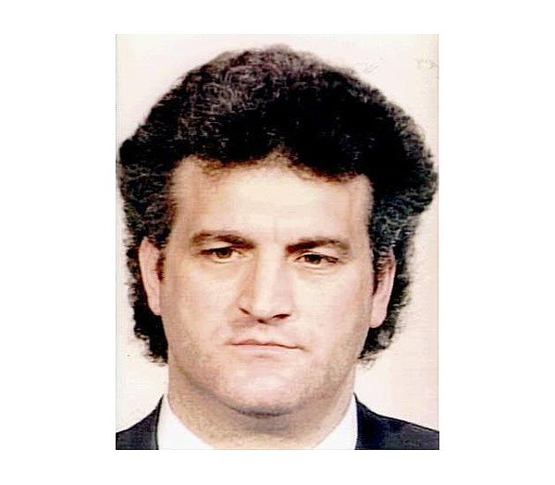
What a couple!!

Slide 15
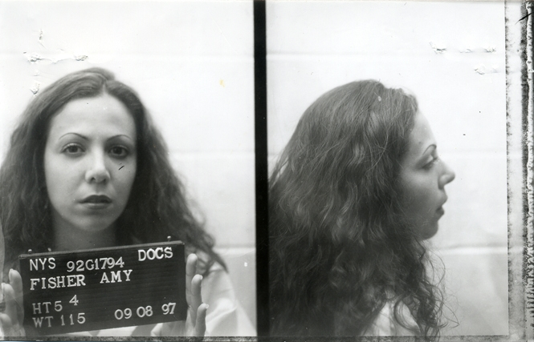
AMY Fisher and Joey Buttafuoco
Amy Fisher posed for this New York State Department of Correctional Services mug shot in September 1997, five years after pleading guilty to shooting her lover Joey Buttafuoco's wife. The so-called Long Island Lolita was paroled from the Albion Correctional Facility in 1999.

Slide 16
JOHN WAYNE BOBBIT
John Wayne Bobbitt, he of the formerly severed penis, was arrested by Las Vegas police seven times for a variety of offenses between 1994 and 2002.

Slide 17
SON of SAM DAVID BERKOWITZ
'Son of Sam' David Berkowitz posed for this New York State Department of Correctional Services mug shot in March 2003. The serial killer received six consecutive sentences of 25 years to life for a late-70s murder spree in New York City that left six people dead and seven others injured. Berkowitz, who claims he does not deserve parole, was denied it in 2002, the first time he had been eligible. He is currently incarcerated at the Sullivan Correctional Facility.

Slide 18
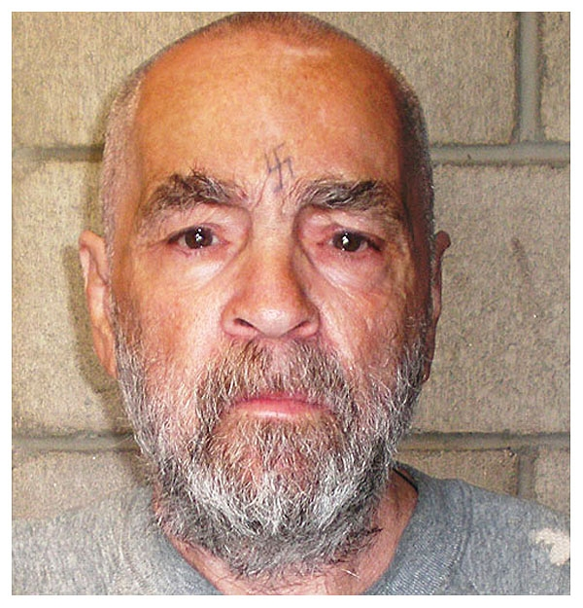

Slide 19
Charles Manson was photographed by the California Department of Corrections in September 2006 at the age of 71. The convicted murderer, serving a life sentence at Corcoran State Prison, will be eligible for parole (for the twelfth time) in 2012.

Slide 21
JAMES BROWN
'Godfather of Soul' James Brown, 70, was arrested by Aiken County cops in January 2004 and charged with domestic violence after allegedly pushing his wife to the floor during an argument at the couple's South Carolina home. Tommie Rea Brown, 33, suffered 'scratches and bruises to her right arm and hip' during the bedroom dispute, according to investigators.

Slide 23
Jeffrey Dahmer
The above mug shot of serial killer Jeffrey Dahmer was taken in August 1982 after he was arrested by Milwaukee cops for exposing himself at a Wisconsin state fair. Dahmer was arrested again in July 1991 and charged with the murder of 17 men and boys over the course of 13 years. In 1992 he was found guilty of 15 counts of murder and sentenced to 15 life terms. In November 1994 the 34-year-old Dahmer was beaten to death by another inmate.

Slide 25
BILL GATES
Microsoft boss Bill Gates was photographed by the Albuquerque, New Mexico police in 1977 after a traffic violation (details of which have been lost over time).

Slide 26
THE KILLER CLOWN
Serial killer John Wayne Gacy posed for the above Des Plaines Police Department mug shot in December 1978. Known as the 'Killer Clown,' Gacy was later convicted of murdering dozens of men and, in May 1994, executed by lethal injection.

Slide 27
Colin Ferguson
Colin Ferguson, whose December 1993 rampage on the Long Island Rail Road left six dead and 19 wounded, posed for this New York State Department of Correctional Services mug shot in April 2003 after being transferred to the Attica Correctional Facility. Ferguson, sentenced to a minimum of 315 years in prison, will not be eligible for parole until 2309.

Slide 28
Dr. Death
Dr. Jack Kevorkian was convicted in April 1999 of murder. Photographed by the Michigan Department of Corrections, Kevorkian is serving a prison sentence of 10 to 25 years. The euthanasia crusader's conviction stemmed from his assistance in the suicide of a 52-year-old man suffering from Lou Gehrig's disease. A videotape of that suicide later aired on the CBS newsmagazine '60 Minutes,' and was used as evidence against him during his Oakland County Circuit Court trial.

Slide 29
BROCK LESNAR
Brock Lesnar, the World Wrestling Entertainment champion, was once arrested for illegally possessing steroids, though the felony charge against the 26-year-old athlete was dismissed four months after his January 2001 arrest. Lesnar, pictured in the above mug shot, was popped by Louisville Division of Police detectives after receiving and opening a parcel that cops said contained a 'large amount of steroids.' Lesnar, a 295-pound former college wrestling champ, was in Kentucky training at a WWE facility. Hit with a trafficking in controlled substances charge, Lesnar was exonerated when tests showed that the seized pills were not, in fact, steroids. While a Louisville detective told TSG that the material was some kind of growth hormone, Lesnar's defense attorney, Scott Cox, characterized the confiscated pills as a 'vitamin type of thing.' According to Cox, officers seemed 'very apologetic' when lab results cleared Lesnar. It is unclear how investigators concluded that the parcel sent to Lesnar may have contained illicit substances

Slide 30
THE ANSWER
NBA superstar Allen Iverson surrendered to Philadelphia police in July 2002 to face gun and assault raps, charges that were all subsequently dismissed by a Municipal Court judge.

Slide 31
NBA star Jason Kidd was arrested by Paradise Valley, Arizona police in January 2001 and charged with domestic abuse. Kidd pleaded guilty and was ordered to attend anger management classes.

Slide 32
Martin Luther King Jr. was photographed by Alabama cops following his February 1956 arrest during the Montgomery bus boycotts. The historic mug shot, taken when King was 27, was discovered in July 2004 by a deputy cleaning out a Montgomery County Sheriff's Department storage room. It is unclear when the notations "DEAD" and "4-4-68" were written on the picture.

Slide 33
NBA superstar Kobe Bryant is pictured in this mug shot taken by Colorado cops on July 4, 2003 following his arrest for allegedly sexually assaulting a 19-year-old hotel employee. Eagle County prosecutors are currently deciding whether to formally file charges against the 24-year-old Los Angeles Laker.

Slide 34
Oklahoma City bomber Timothy McVeigh was arrested by the Oklahoma Highway Patrol in April 1995 for carrying a loaded firearm after he was stopped for having no license plates on his car. Days later, McVeigh, 26, was identified as the person responsible for the bombing of the Alfred P. Murrah Federal Building that killed 168 and injured more than 850 people. In June 1997 he was found guilty and was executed by lethal injection in June 2001 at the U.S. Federal Penitentiary in Terre Haute, Indiana.

Slide 35
MICHAEL JACKSON
Michael Jackson was photographed by the Santa Barbara County Sheriff's office following his November 2003 arrest for child molestation. The 45-year-old "King of Pop" was released after posting $3 million bail.

Slide 36
MIKE TYSON IRON MIKE
Former heavyweight champion Mike Tyson was arrested in December 2006 on drunk driving and cocaine possession charges following a police stop outside an Arizona nightclub. Tyson, 40, was pulled over when his BMW nearly struck a sheriff's cruiser after he left a Scottsdale bar. When he failed field sobriety tests, the pugilist was arrested for driving under the influence. A subsequent search turned up two small bags of cocaine in Tyson's pocket and another bag in his car. He was booked into the Maricopa County Sheriff's lockup, where the above mug shots were snapped.

Slide 37
JACK BAUER
This Kiefer Sutherland mug shot was snapped by the Gelndale Police Department in December 2007 after the actor surrendered to serve a 48-day jail sentence. Sutherland, 40, pled no contest in October to driving while over the legal limit of .08. It was the second time in three years that the star of '24' was busted for DUI.

Slide 38
TERRY Nichols
Terry Nichols was convicted of being an accomplice to Timothy McVeigh in the Oklahoma City bombing of the Alfred P. Murrah Federal Building in April 1995. Nichols, 40 at the time of the bombing, is now serving life at the federal supermax prison in Florence, Colorado.

Slide 39
MICK JAGGER
Mick Jagger posed for the above mug shot in 1967 after being arrested in England on a narcotics charge. Jagger, 23, was busted after police, acting on a tip, raided the country home of fellow Rolling Stone Keith Richards, who was also collared. Jagger, photographed at a Brixton jail, spent a few nights in custody before making bail.

Slide 40
Former 'Lost' star Michelle Rodriguez was booked into a Los Angeles County jail in December 2007 to begin a six-month sentence for failing to complete her community service and alcohol monitoring that was ordered as part of her probation from a drunk driving arrest. Rodriguez, 29, admitted violating her probation by failing to provide proof of community service and by drinking alcohol while wearing a monitoring device.

Slide 41
OJ
Former NFL star O.J. Simpson was arrested by the Los Angeles Police Department in June 1994 and charged with murdering his ex-wife Nicole Brown Simpson and her friend Ronald Goldman. A jury found him not guilty in October 1995.

Slide 42
Joran van der Sloot, the Dutch man suspected in the 2005 disappearance of Alabama teenager Natalee Holloway, posed for the above Peruvian mug shot in June 2010. According to police, van der Sloot, 22, has admitted to murdering 21-year-old Stephany Flores in his hotel room after meeting her in a Lima casino.

Slide 43
The UNIBOMBER
Unabomber Ted Kaczynski was arrested in April 1996 by the FBI at his Montana cabin after carrying out a three-decade-long bombing campaign that killed three and wounded 23. In January 1998 Kaczynski avoided the death penalty by taking a guilty plea and was sentenced to life in prison without parole. He is currently locked up in a federal supermax prison in Florence, Colorado.

Slide 44
WHAT YOU TALKIN BOUT WILLIS?
Actor Gary Coleman was arrested in January 2010 on a warrant stemming from a prior domestic assault charge. The 41-year-old "Diff'rent Strokes" star, collared by police in Santaquin, Utah, was booked into the Utah County jail in lieu of $1725 bail.

Slide 45
OLD BlUE EYES
Frank Sinatra was arrested by the Bergen County, New Jersey sheriff in 1938 and charged with carrying on with a married woman (yes, you could get popped for that back then). The charge was later changed to adultery, and eventually dismissed.

Slide 46
PEE WEE HERMAN
Paul Reubens (aka Pee-wee Herman) turned himself in to Los Angeles police in November 2002 after being charged with misdemeanor possession of kiddie porn. It was not the first run-in with the law for the 50-year-old actor, who was arrested by Florida cops in July 1991 and charged with indecent exposure. Pee-wee, who was nabbed at an adult movie house, later pleaded no contest to the charge. He was fined, had to pay court costs, and ordered to produce an anti-drug public service announcement.

Slide 47
ROUGH NIGHT OUT NICK?
Actor Nick Nolte was arrested by the California Highway Patrol on September 11, 2002 and charged with driving under the influence.

Slide 48
BRAVEHEART
This mug shot of Mel Gibson was taken following the Hollywood star's slur-spewing drunk driving bust in July 2006. Considering some of the booking photos previously snapped by Los Angeles sheriff's deputies, the 50-year-old actor looks downright dapper.

Slide 49
BERNIE
Swindler Bernard Madoff was convicted in March 2009 of orchestrating the largest Ponzi scheme in history, a decades-long scam that bilked investors of more than $50 billion. In pleading guilty to 11 felony counts, Madoff claimed to be "deeply sorry and ashamed." Madoff is pictured in a United States Marshals Service mug shot.

Slide 50
SHAM WOW!!!
Vince Shlomi, better known as The ShamWow Guy, was arrested in February 2009 after he got into a bloody hotel room fight with a Miami hooker. According to the TV pitchman, he paid Sasha Harris $1000 for "straight sex," but when he tried to kiss the working girl, she bit his tongue and would not let go. Shlomi responded by repeatedly punching Harris in the face in a bid to free his tongue. While both combatants were arrested for felony battery, prosecutors eventually decided not to pursue charges.

