Slide 1
Flashcards for Atomic Structure II

Slide 2
Dalton’s Model
Billiard Ball Model

Slide 3
Thomson’s Model
Plum Pudding Model
-
+
-
+
-
+
+
-
+
-

Slide 4
Rutherford’s Model
Nuclear Model
-
-
+
-

Slide 5
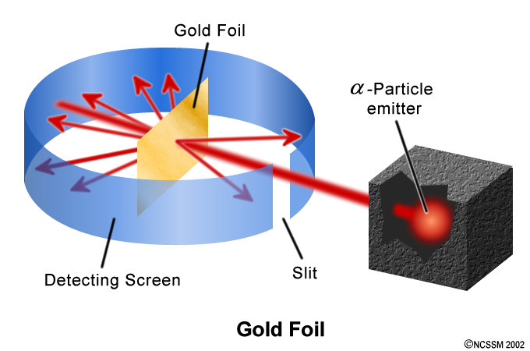
Rutherford’s Experiment
Source: http://www.dlt.ncssm.edu/TIGER/chem1.htm#atomic

Slide 6
Rutherford’s Experiment: Results
Most of the alpha particles went straight through. → Most of the atom is empty space.
Some of the alpha particles were deflected back. → The nucleus was tiny, but contained most of the mass of the atom.

Slide 7
Bohr’s Model
Planetary Model

Slide 8
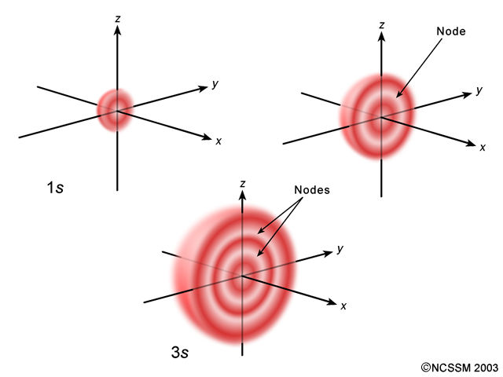
Schrodinger’s Model
Modern or Quantum Mechanical Model
Source: http://www.dlt.ncssm.edu/TIGER/chem1.htm#atomic

Slide 9
Modern Model (Schrodinger or Quantum Mechanical Model)
Electron treated as a wave.
Never know exactly where it is.

Slide 10
Bohr Configuration
Ground state configurations found in reference tables.
Cannot be predicted.

Slide 11
Bohr Configuration of Na = 2-8-1
2 electrons in energy level 1
8 electrons in energy level 2
1 electron in energy level 3

Slide 12
Bohr Diagram of Na
+11

Slide 13
Valence Electron(s)
Electron(s) in outermost orbit or shell

Slide 14
Kernel
Nucleus + all innershell electrons: Everything except the valence electrons

Slide 15
Bohr Model
Electrons are restricted to specific orbits or shells or principle energy levels.
Each shell holds a specific # of electrons.
Each shell has a specific energy & radius.
Energy of electron must match energy of shell.

Slide 16
Maximum Capacity of Bohr Levels
Shell # | Max # of electrons
1
2
3
4
n
2
8
18
32
2n²

Slide 17
Ground State
Bohr model
Every electron is in the lowest available orbit.

Slide 18
2-8-7
Ground state configuration of Cl

Slide 19
2-6
Ground state configuration of O

Slide 20
Ground state configuration of Kr?
2-8-18-8

Slide 21
Principle Energy Level?
Shell #

Slide 22
Excited State
Bohr model
An electron has absorbed heat, light, or electrical energy and moved to a higher energy level.
Unstable. Returns to ground state quickly by emitting a photon.

Slide 23
2-5-1
An excited state of O

Slide 24
2-0-1
An excited state of Li

Slide 25
Continuous Spectrum
Spectrum produced by holding a prism in sunlight. Contains light at every wavelength.
Rainbow

Slide 26
Bright Line Spectrum
Visible light produced by electrons in atom returning to ground state: light of only a few wavelengths is present.
Each element has a unique bright line spectrum. Used to identify elements.
Wavelengths of bright lines correspond to difference between energy levels.
Source: http://www.dlt.ncssm.edu/TIGER/chem1.htm#atomic

Slide 27
Absorbtion of Energy
Excited state
E₃
E₂
Ground state
hν
E₁

Slide 28
Emission of Energy
Excited state
hν
E₃
E₂
Ground state
E₁

Slide 29
Orbital
Modern Model
Region of space that holds 2 electrons.
Has a specific energy. Shapes vary.

Slide 30
Represents an electron dropping to a lower energy level, releasing energy in the process.
E₂
E₁
The energy of the photon matches the difference, E₂ – E₁, between the levels.

Slide 31
Ion
Atom that has gained or lost electrons and so carries a charge.

Slide 32
Positive Ion
Atom that has lost electrons.

Slide 33
Negative Ion
Atom that has gained electrons.

Slide 34
Lewis Diagram
Shows the valence electrons.
Arranged as dots around the symbol. Max of 2 per side. Don’t double up until they have to.

Slide 35
Lewis Diagram of Ca
.
.
Ca
Bohr configuration is 2-8-8-2.

Slide 36
Lewis Diagram of Ca²⁺
[Ca]²⁺
No dots because the 2 valence electrons were removed.
Bohr configuration is 2-8-8-0.

Slide 37
Lewis Diagram of K
.
K
Bohr configuration is 2-8-8-1.

Slide 38
Lewis Diagram of K⁺¹
[K]⁺¹
No dot because the valence electron was removed.
Bohr configuration is 2-8-8-0.

Slide 39
Lewis Diagram of Cl
:
.
Cl:
:
Bohr configuration is 2-8-7.

Slide 40
Lewis Diagram of Cl⁻¹
:
[:Cl:]⁻¹
:
Bohr configuration is 2-8-8.

Slide 41
Lewis Diagram of S
:
.
S:
.
Bohr configuration is 2-8-6.

Slide 42
Lewis Diagram of S²⁻
:
:
[ S:]²⁻
:
Bohr configuration is 2-8-8.

Slide 43
Exothermic
Process that releases energy.

Slide 44
Endothermic
Process that absorbs energy.

Slide 45
Which Bohr orbit has the lowest energy?
n = 1, the orbit closest to the nucleus.

Slide 46
The characteristic bright-line spectrum of an atom is produced by its
A) Electrons absorbing energy
B) Electrons emitting energy
C) Protons absorbing energy
D) Protons emitting energy

