Slide 1
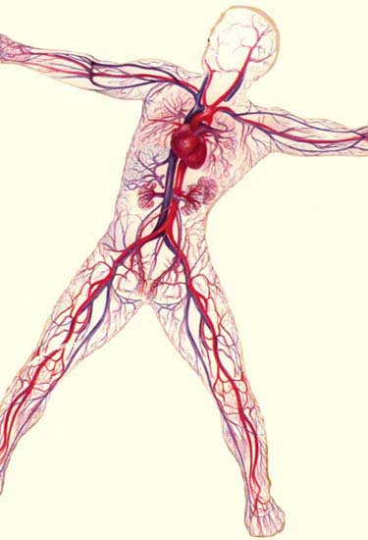
Circulatory and Respiratory Systems
By Monika Shpokayte, Andrea Lattanzio, and Christopher Tenorio

Slide 2
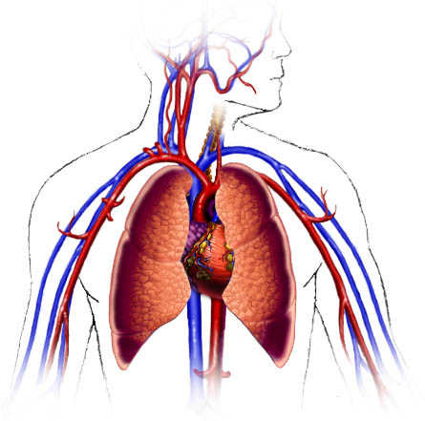
The Circulatory System
Transports:
blood and oxygen from the lungs to the
various tissues of the body
O₂ from the lungs to the cells; CO₂ (a waste)
from the cells to the lungs.
other nutrients to cells (ex: glucose throughout the body)
other wastes from cells (ex: ammonia to the liver)
Hormones
Also:
Contains cells that fight infection (the lymphatic system)
Stabilizes the pH and ionic concentration of the body fluids

Slide 3
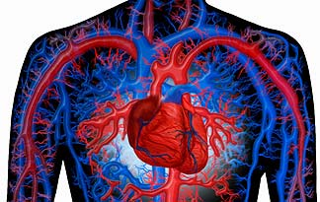
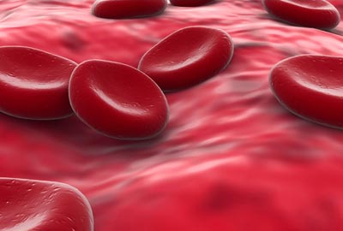
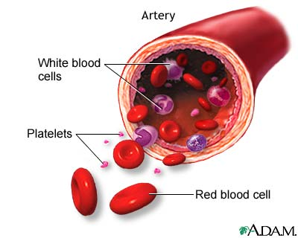
The components of the human circulatory system include the heart, blood, red and white blood cells, platelets, blood vessels, and the lymphatic system.

Slide 4
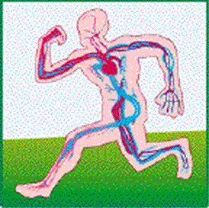
How The Circulatory System Maintains Homeostasis
All of the organ systems in the body contribute to homeostasis, but the circulatory system--the heart and blood vessels--is especially important. The heart pumps blood through the body to each of the other organs. Blood delivers the oxygen and nutrients these organs require. Without the cardiovascular system, none of the other systems in the body can function. In the Circulatory System, the heart, lungs, and blood vessels have to work together to maintain homeostasis.

Slide 5
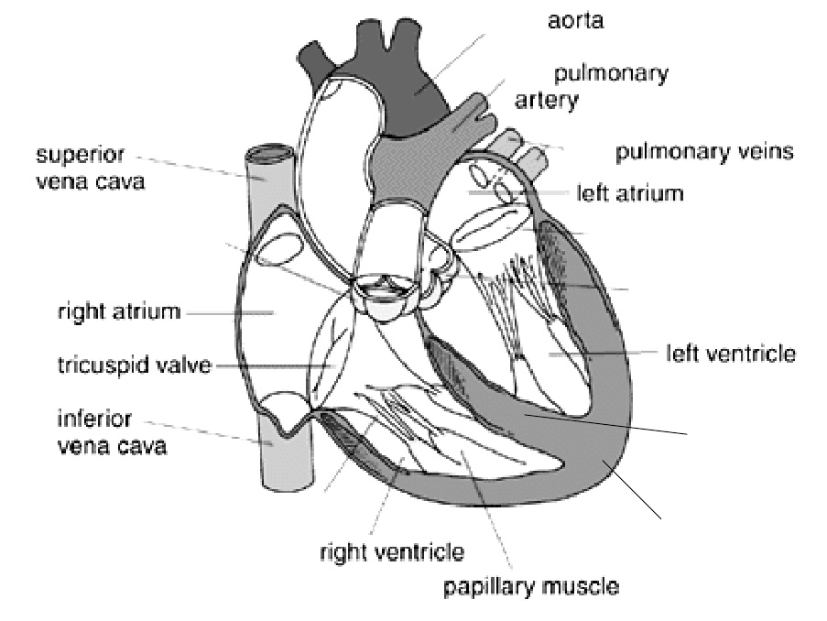
The Heart: pumps oxygen rich blood, nutrients, hormones, and other things the body needs to maintain health, to organs and tissues.

Slide 6
Part of Heart | Function
Pulmonary artery | Carries blood from heart to lungs
Pulmonary vein | Carries blood from lungs
Superior vena cava | Carries blood from upper body back to heart
Inferior vena cava | Carries blood from lower body back to heart
Aorta | Pumps blood from left ventricle to the whole body
Semilunar valves | Prevent backflow of blood from arteries into ventricles

Slide 7
Part of heart | Function
Tricuspid and bicuspid valves | Prevent backflow of blood from ventricles into atria
Chordae tendonae | Anchor the valves; stop them from opening in the wrong direction
Septum | Muscle dividing the heart into 2 sections
Atria | Pumps blood into ventricles
Ventricles | Pumps blood into arteries
Apex | Contains cells that stimulate contractions; sends electrical pulses to ventricles from right atrium

Slide 8
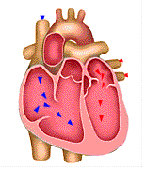
Parts of the Heart
The heart is made up of 4 different blood-filled areas. There are 2 chambers on each side of the heart. One chamber is on the top and the other is on the bottom.
The 2 chambers on top are called the atria. The atria are the chambers that fill with the blood returning to the heart from the body and lungs. The heart has a left atrium and a right atrium.
The two chambers on the bottom are called the ventricles. The heart has a left ventricle and a right ventricle. Their job is to squirt out the blood to the body and lungs.
Running down the middle of the heart is a thick wall of muscle called the septum. The septum's job is to separate the left side and the right side of the heart.

Slide 9
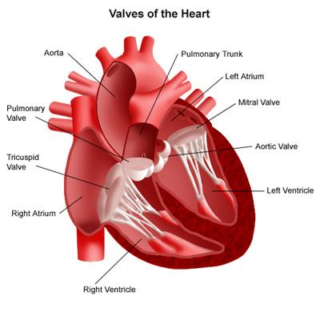
Parts of the Heart
There are 4 valves inside the heart.
Mitral Valve & Tricuspid Valve - let blood flow from the atria to the ventricles
Aortic Valve & Pulmonary Valve – control the flow of blood as it leaves the heart
These valves all work to keep the blood flowing forward. They open up to let the blood move ahead, then they close quickly to keep the blood from flowing backward.

Slide 10
Blood Vessels
Blood moves around many tubes called blood vessels. These blood vessels are attached to the heart.
There are 3 types of blood vessels:
 | Function | Structure | Pressure of Blood
Arteries (arterioles) | Carry blood away from the heart (except for pulmonary arteries which carry blood) | Large to small, flexible, collect cholesterol; largest blood vessels and thickest walls | Increases as ventricles contract; decreases as ventricles relax but still relatively high
Veins (venules) | Carry blood to the heart (except for pulmonary veins which carry blood) | Small to large, valves to prevent backflow | Constant, relatively low
Capillaries | Carry blood between cells; link arterioles to venules | From arteries to veins, one cell wide | High

Slide 11
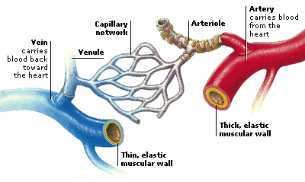
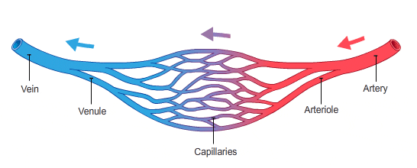
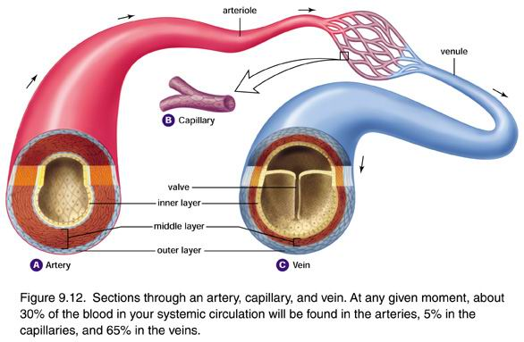
Blood Vessels

Slide 12
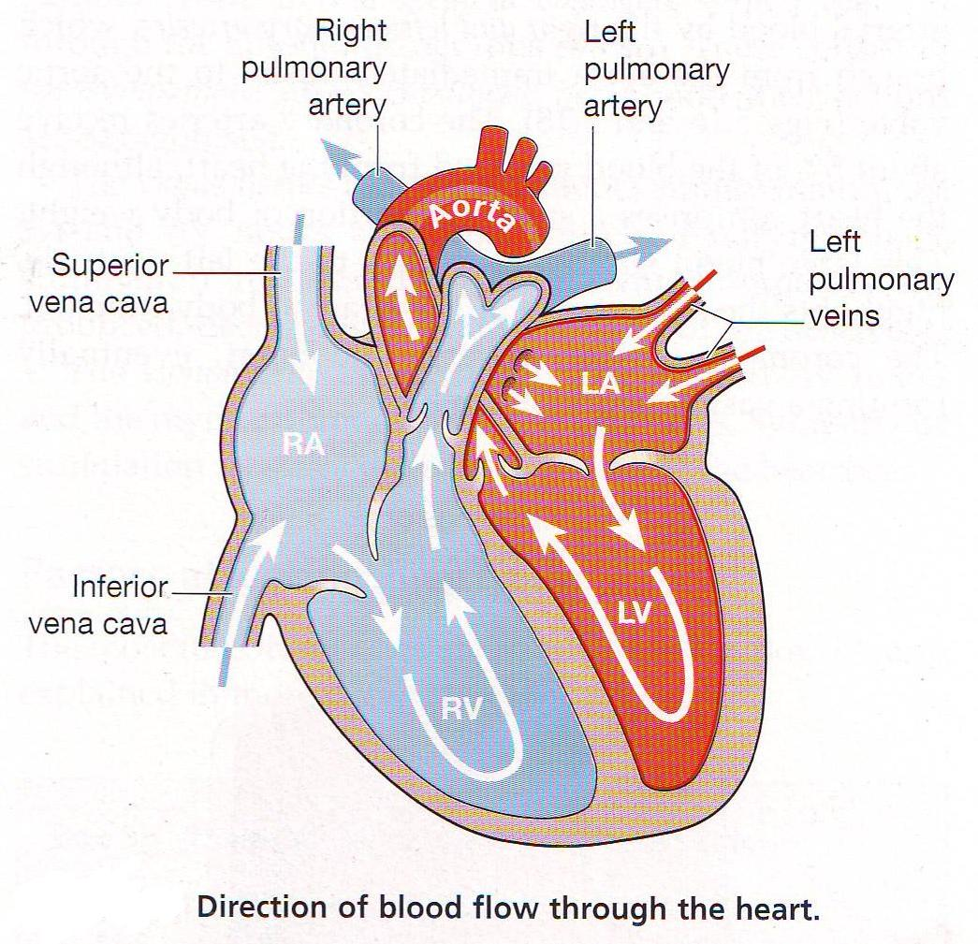
Blood Flow Through The Heart
Watch the animation:
Click Here

Slide 13
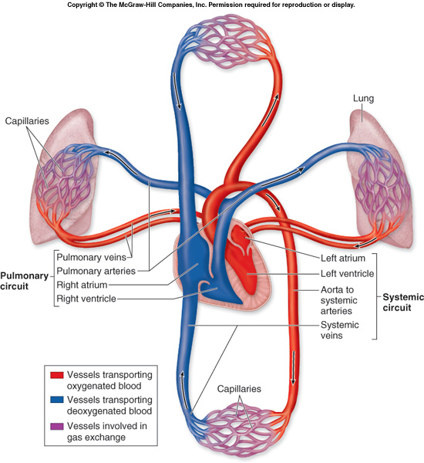
Types of Circulation
1. Pulmonary circulation
-this is the path of blood between the heart and the lungs
-blood from the body has little oxygen in it and carries carbon dioxide, a waste product from cells
-it enters the right atrium and is pumped to the right ventricle
-the right ventricle pumps blood through the pulmonary artery to the lungs
-in the lungs, the blood releases carbon dioxide and picks up oxygen
-the blood returns to the heart through the pulmonary veins and enters the left atrium
2. Systemic circulation
- this is the path of blood between the heart and the rest of the body
- from the left atrium blood is pumped to the left ventricle
- the left ventricle is the strongest of the four chambers because it must pump blood throughout the entire body
- from the left ventricle blood enters the aorta, the largest artery in the body
- the aorta branches into smaller and smaller arteries to reach all parts of the body
- blood returning from the body enters the right atrium

Slide 14
Composition of Blood
55% Plasma
-Mainly 90-92 % water.
-The straw-colored fluid that contains blood cells
-Consists of:
-Dissolved substances including electrolytes such as sodium, chlorine, potassiun, manganese, and calcium ions
-Blood plasma proteins (albumin, globulin, fibrinogen)
-Hormones
45% Blood Cells
Includes:
Red Blood Cells or Erthryocytes: (99%)
carry oxygen and
carbon dioxide; no nucleus; red from hemoglobin (iron-containing protein) and O₂, produced in red bone marrow
The other 1%
B) White Blood Cells: help fight disease; many different types; major part of immune system
C) Platelets: help blood clot when there is
an injury

Slide 15
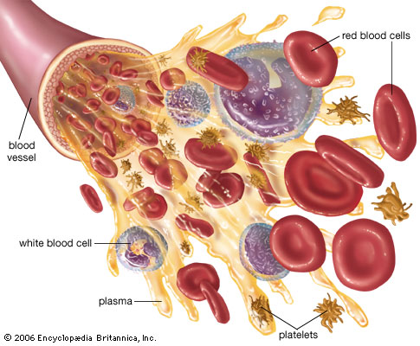
Composition of Blood

Slide 16
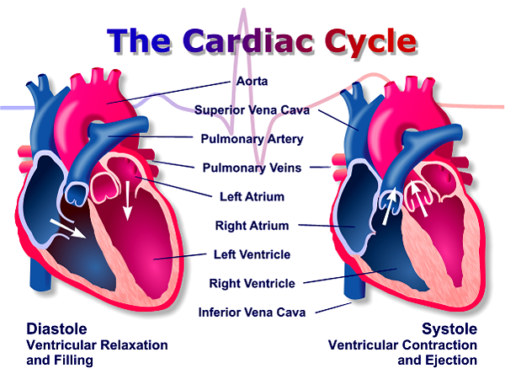
Cardiac Output/Pulse
The human heart is composed mostly of cardiac muscle. The atria have relatively thin muscular walls, whereas the ventricles have thicker walls. The cardiac cycle consists of systole, during which the cardiac muscle contracts and the chambers pump blood, and diastole, when the heart chambers are relaxed and filling with blood.
The cardiac output, or volume of blood pumped per minute into the systemic circuit, depends on heart rate and stroke volume, or quantity of blood pumped by each contraction of the left ventricle.
Heart rate can be measured by taking the pulse, which is caused by the rhythmic stretching of arteries as the left ventricle contracts and pumps blood through them.

Slide 17
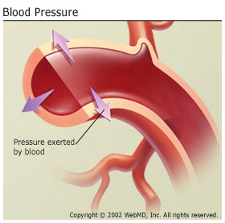
Blood Pressure
-Is the hydrostatic force exerted against the wall of a blood vessel
-Drives blood from the heart to the capillary beds
-Much greater in arteries than in veins and is greatest during systole.
-Results from combination of cardiac output and peripheral resistance
-Measured with sphygmomanometer
-When the heart relaxes between beats (diastole) the arterial pressure drops to about 80 mm Hg. This is called diastolic pressure. The pressure does not drop to 0 because the arterial walls are elastic and squeeze the blood. The 80 mm Hg diastolic pressure keeps blood flowing between beats.
-When the ventricles contract (systole) the pressure in the arteries leaving the heart rises to about 120 millimeters of mercury (mm Hg). This is called systolic pressure.
-Normal values: systolic/diastolic = 120/80 mm Hg.

Slide 18
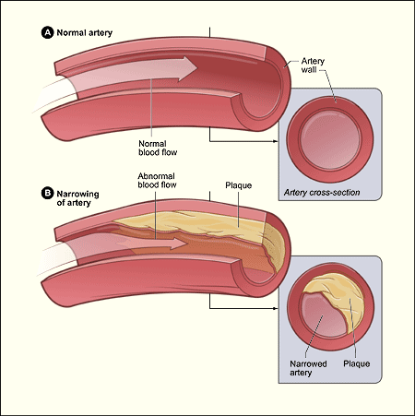
Diseases of the Circulatory System
Heart disease is a major leading cause of death in the United States.
Hypertension – aka high blood pressure
-damages the endothelium and initiates plaque formation
-promotes atherosclerosis; increases risk of heart attack or stroke
-caused by stress, poor diet, genetics, and smoking
-easily treated by drugs, diet, and exercise
Atherosclerosis
-a diet high in cholesterol can result in the deposit of fatty material in the wall of the artery.
-the diameter narrows which increases pressure and decreases flow.
-if the artery is blocked completely it can cause a heart attack or stroke.
-can be improved by decreasing fat and cholesterol in the diet and with exercise.
Blockage of coronary arteries leads to the death of cardiac muscle in a heart attack; blockage of arteries in the head leads to a stroke, the death of nervous tissue in the brain.

Slide 19
Feedback Mechanism
An example of a feedback mechanism in the human circulatory system would be the increase in heart rate and respiratory rate which occurs in response to increased exercise or other increased muscle cell activity.
Heart rate is controlled via a bio-feedback loop in which special receptors located in the brain known as chemo-receptors monitor blood oxygen levels. As oxygen levels fall, the chemo-receptors sense falling oxygen levels and the brain sends electrical signals with increasing frequency to the heart. This causes the heart to beat faster as well and produce more cardiac contractions. As oxygen-rich blood reaches the brain, the chemo-receptors sense this restored oxygen level and the rate at which the heart beats slows. In this way, oxygen levels to the brain remain relatively constant and homeostasis is achieved.

Slide 20
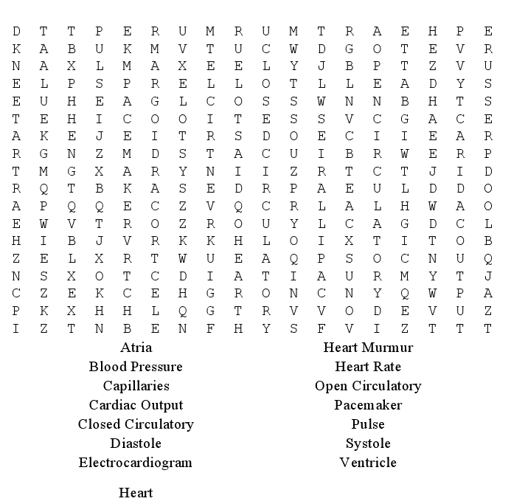
Activities

Slide 21
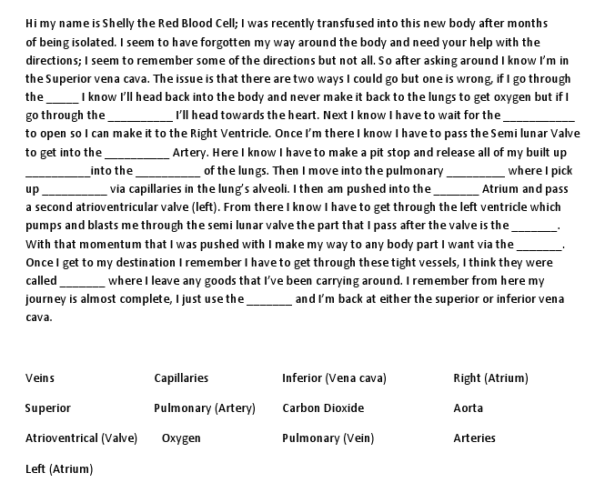
Activities

Slide 22
Fun Facts about the Circulatory System
-One drop of blood contains a half a drop of plasma, 5 million Red Blood Cells, 10 Thousand White Blood Cells and 250 Thousand Platelets.
-The heart beats about 3 billion times during a lifetime.
-You have thousands of miles of blood vessels in your body - you could wrap your blood vessels around the equator TWICE!
-10 million blood cells die in the human body every second, the same quantity is produced at the same time.
-Blood circulates the entire body in 20 seconds.
-An average heart pumps about 450 gallons of blood everyday.
-An average adult's body has about 5 liters of blood in it and a baby's body has about 1 liter of blood in it.
-A human heart is a muscle which is the size of a clenched fist.

Slide 23
Source Page
Animation of the heart:
http://www.innerbody.com/anim/heart.html
Heart and Circulation Game:
http://www.e-learningforkids.org/Courses/Liquid_Animation/Body_Parts/Heart_and_Circulation/index.htm
Circulatory System Quiz:
http://www.quia.com/rr/30450.html
Complete Review of Circulatory System:
http://www.biology-questions-and-answers.com/the-circulatory-system.html
Circulatory System Flash Cards:
http://quizlet.com/798593/circulatory-system-flash-cards/

Slide 24
References
http://kvhs.nbed.nb.ca/gallant/biology/biology.html
http://kidshealth.org/kid/htbw/heart.html
http://regentsprep.org/regents/biology/units/homeostasis/feedback.cfm
http://www.ivy-rose.co.uk/HumanBody/Blood/Blood_StructureandFunctions.php
http://www.fi.edu/learn/heart/systems/circulation.html
http://www.nlm.nih.gov/medlineplus/ency/article/003398.htm
http://www.buzzle.com/articles/circulatory-system-facts.html
Next up is the RESPIRATORY SYSTEM……

Slide 25
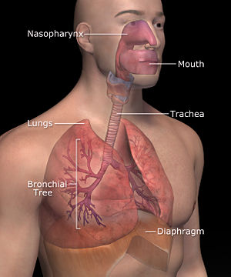
What Is The Respiratory System?
It functions in the exchange of oxygen and carbon dioxide between the cells of the body and the external environment.
In humans, this system includes the lungs and the passageways that carry air to the lungs.

Slide 26
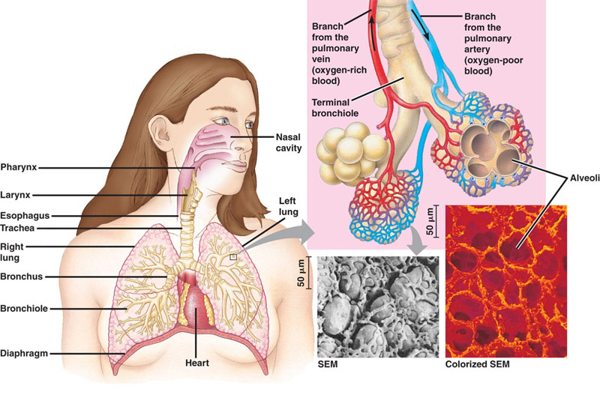
Anatomy Of The Respiratory System
The respiratory system is composed of numerous organs used to carry air into and out of the lungs.
The system includes the nose and its nasal cavities, pharynx, larynx, trachea, bronchi, bronchioles, and the lungs.

Slide 27
The Nose and Nasal Cavities
The nose is considered the normal route by which air enters the respiratory system. The external position of the nose is composed of cartilage and skin.
The internal portion is called the nasal cavities, which is lined with a mucous membrane. The openings of the nasal cavities to the external environment are called external nares or nostrils.
The nasal cavity is divided medially by the nasal septum. The cavity is then further divided into passageways by bony extensions called superior, middle, and inferior nasal conchae.
The nose has three main functions: (1) an intake for oxygen and outlet of carbon dioxide; (2) a dust and germ filter of air, using the cilia and mucus of the nasal passages; and (3) adding water vapor (moisture) to the air so that the lungs are not dried out.

Slide 28
Pharynx
The pharynx is also known as the throat. This region extends from the nasal cavities to the larynx.
The pharynx serves as a passageway for both the digestive system and respiratory system.
At its distal end, the pharynx branches into two tubes: the esophagus, which leads to the stomach; and the larynx, which leads to the lungs.
The pharynx, or throat, is an air passage leading from the mouth and nose to the lungs. Mucus from the nasal passages drains down the throat to the stomach, where trapped germs are killed by stomach acid. The throat is also a passageway for food, leading to the esophagus.

Slide 29
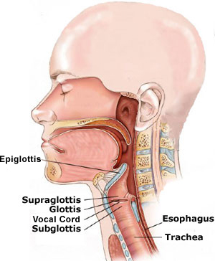
Larynx
The larynx is a cartilaginous structure connecting the pharynx and trachea at the level of the cervical vertebrae. It is composed of connective tissue containing nine pieces of cartilage in boxlike formation.
The largest piece of cartilage in the larynx is called the “Adam’s apple”, or thyroid cartilage.
A third cartilage is called the epiglottis. It is a leaf-shaped “lid” at the entry to the larynx. The function of it is to seal of the respiratory tract when food or liquids pass into the esophagus.
The epiglottis closes off the trachea when we swallow. Below the epiglottis is the larynx or voice box. This contains 2 vocal cords, which vibrate when air passes by them. With our tongue and lips we convert these vibrations into speech. The area at the top of the trachea, which contains the larynx, is called the glottis.

Slide 30
Trachea
The trachea furnishes an open passageway for incoming and outgoing air. Its ciliated cells also filter the air before it enters the bronchi, brushing mucus-entrapped particles to the pharynx to be swallowed.
The trachea is about four to five inches long in the middle of the neck and is supported by a series of C shaped rings of cartilage stacked one upon another and open at the dorsal aspect.
The trachea branches into two primary bronchi, which both have the same structure as the trachea.
The trachea, or windpipe, is the air passage through the neck that connects the nose and throat with the lungs, and allows the free flow of air between the lungs and outside. When entering air leaves the throat, it first passes through the epiglottis, the flap that prevents food from entering the windpipe and lungs. It then passes through the larynx, or voice box, which contains the vocal chords when sound vibrations are formed. Only then does the air pass through the windpipe.

Slide 31
Bronchi
They become smaller and smaller as they as they extend into the lungs, and eventually their diameter is reduced to about one millimeter.
The bronchi that are at about one millimeter are called the bronchiole, which are composed of entirely smooth muscle that is supported by connective tissue.
The function of this part of the respiratory system is to bring air into the lungs.
The bronchi are the main distribution air passages that branch off the windpipe to carry air to all parts of the lungs.

Slide 32
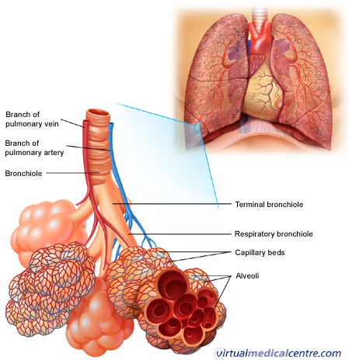
Bronchioles
Bronchioles are small airways of the respiratory system extending from the bronchi into the lobes of the lung.
There are two divisions of bronchioles:
The terminal bronchioles that passively conduct inspired air from the bronchi to the respiratory bronchioles and expired air from the respiratory bronchioles to the bronchi.
The respiratory bronchioles function similarly, allowing the exchange of air and waste gases between the alveolar ducts and the terminal bronchioles.
Each bronchiole ends in a grape-like cluster of tiny air sacs called alveoli.

Slide 33
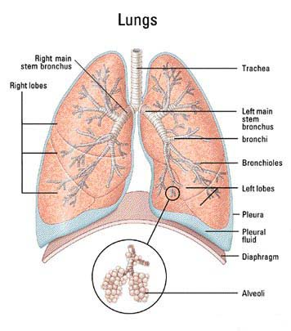
Lungs
The lungs are paired organs occupying most of the space of the thoracic cavity. They consist of millions of small cup-shaped out-pockets or sacs called alveoli.
Each of the pair of organs are situated within the rib cage, consisting of elastic sacs with branching passages into which air is drawn, so that oxygen can pass into the blood and carbon dioxide be removed.
The lungs’ function is to exchange oxygen (O2) from the air into the blood stream, and to take carbon dioxide (CO2) out of the blood stream and back into the air.

Slide 34
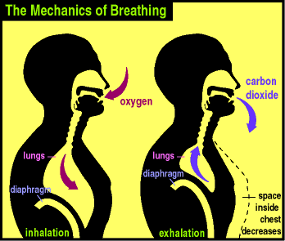
The Breathing Process
Breathing is the mechanism by which mammals ventilate their lungs (bring air in and out).
Breathing brings oxygen to the respiratory surface (lung) and rids the body of waste (CO2) by expelling it to the outside
In the process of breathing, air moves into and out of the alveoli. Breathing takes advantage of the principle that air flows from a region of higher pressure to a region of lower pressure.
Breathing occurs in two stages: exhalation and inhalation.

Slide 35
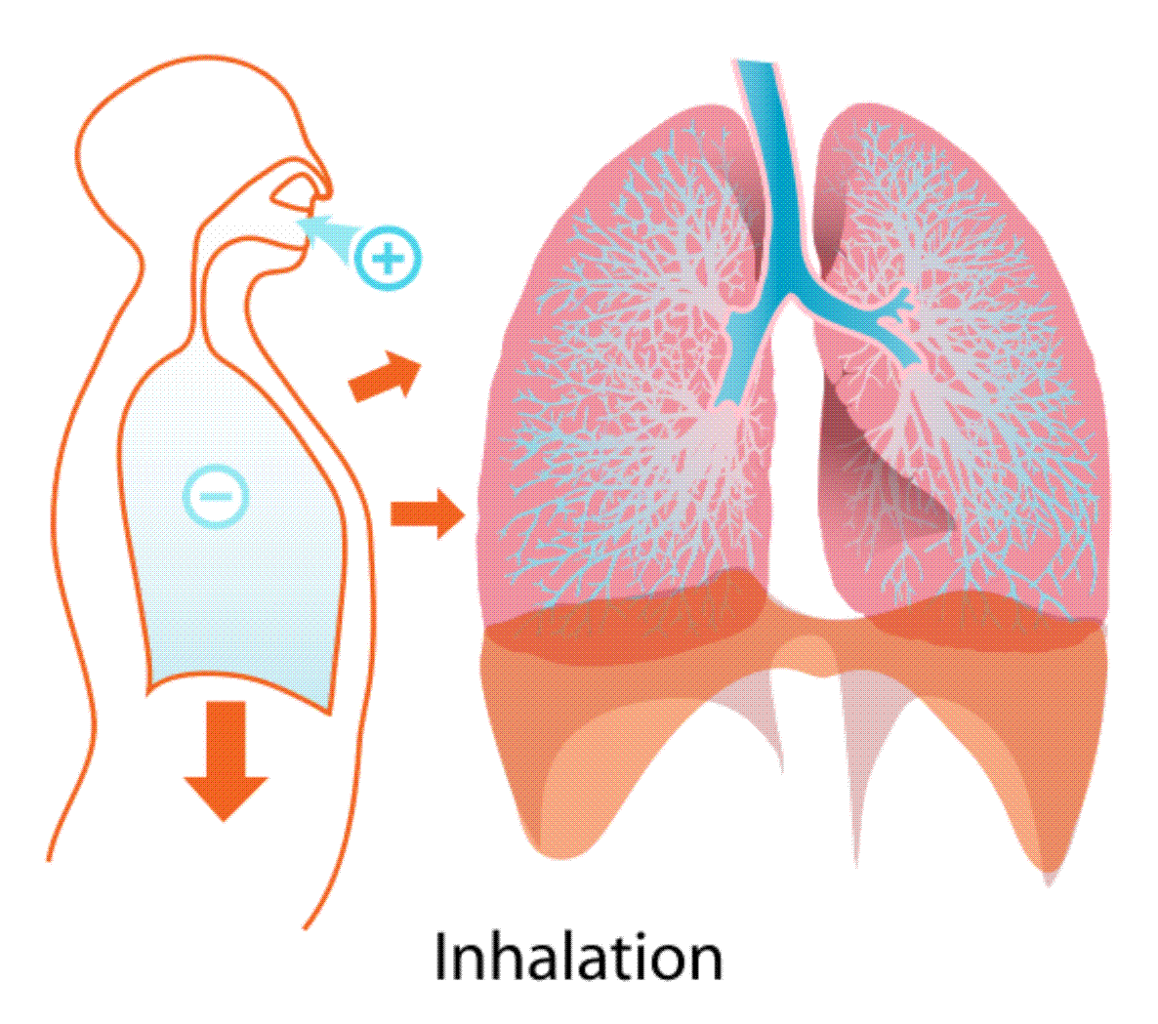
Inhalation
Inhalation is the process of bringing air INTO the lungs.
During inhalation, the following events occur:
1) The ribs move up and out
2) The diaphragm moves down.
3) The intercostal muscles contract
When the above happens it increases the volume of the chest cavity. This creates a low pressure inside the chest. The pressure inside the chest is less than the pressure outside the body.
Air “rushes” into the lungs from the outside causing the lungs to inflate.

Slide 36
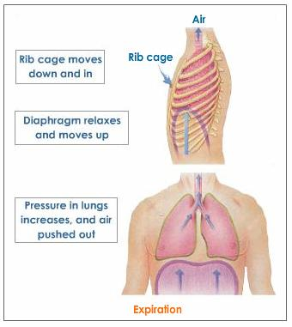
Exhalation
The process of removing air FROM the lung.
During Exhalation, the following events occur:
1) The ribs move down and in.
2) The diaphragm moves up
3) The intercostal muscles relax.
When this happens, it decreases the volume of the chest cavity. This creates a high pressure inside the chest. The pressure inside the chest is greater than the pressure outside the body. Air is forced out of the lung. The lungs deflate.

Slide 37
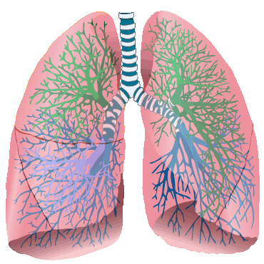
Volume for the Lungs
Under resting conditions and during a normal breath, about 500 milliliters of air enter and leave the lungs. This air volume is called resting tidal volume.
The largest volume of air that can be exchanged in the lungs is the vital capacity of the lungs. Because this requires maximum inspiration and expiration producing exhaustive effort on the effort on the part of the muscles, the vital capacity of the lungs is hardly ever reached for long.

Slide 38
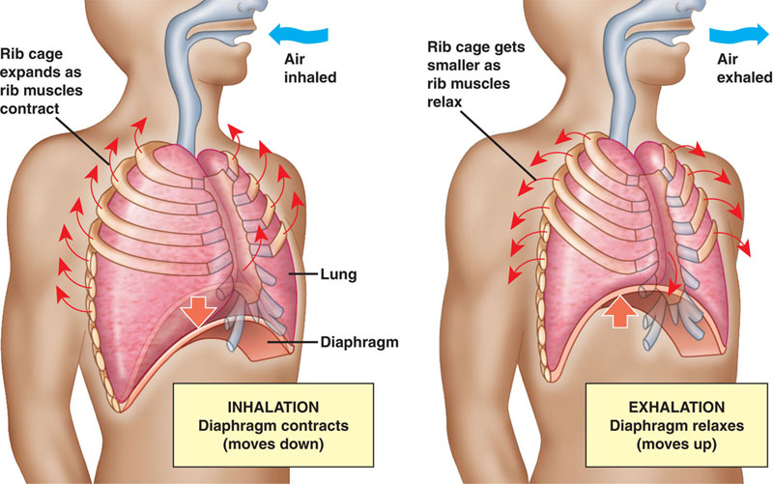
Control of Breathing
Breathing is controlled by contractions of the respiratory muscles , which are controlled by nerve stimulations.
The main area for respiratory muscle control is a portion of the brain called the respiratory control center. Its located in the brain stem and includes parts of the medulla oblongata and pons.
Deep and rapid breathing is called hyperventilation.

Slide 39
Gas Exchange
Oxygen and carbon dioxide are transported to and from the lungs by slightly different mechanisms.
At the alveoli, oxygen in the air is exchanged for carbon dioxide in the blood. The driving force behind this exchange is a passive process called diffusion.
At the alveoli, red blood cells pass through a microscopic capillary at the surface of the alveolar sac. Oxygen from the alveolar sac diffuses across the respiratory membrane into the plasma and then into the interior surface of the red blood cells.

Slide 40
Respiratory Disorders
The five major respiratory disorders:
LUNG CANCER
PEUMONIA
ASTHMA
BRONCHITIS
EMPHASYEMA

Slide 41
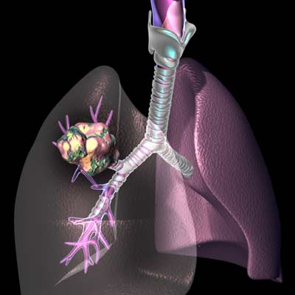
Lung Cancer
The uncontrolled and invasive growth of abnormal cells within the lungs.
The leading killer of men and women in North America, mostly due to smoking.
The abnormal cells become a malignant tumor (group of cells) known as a carcinoma.
The carcinoma eventually takes over healthy cells, killing them.

Slide 42
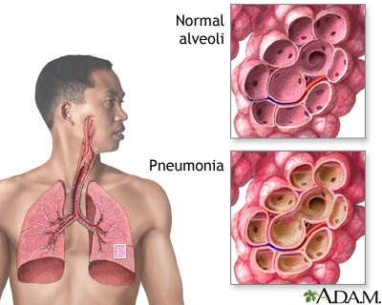
Pneumonia
A disease of the lungs causing the alveoli to inflame (swell) and fill with liquids.
This interferes with the alveoli’s normal ability to take in oxygen causing the body’s cells to starve for oxygen.
There are TWO (2) main types of Pneumonia
Lobar Pneumonia
▪ This is pneumonia that affects a lobe of a lung.
Bronchial Pneumonia
▪ This is pneumonia that affects patches throughout both lungs

Slide 43
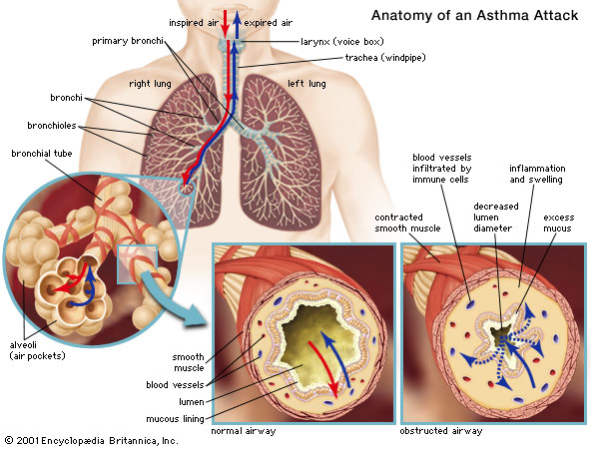
Asthma
A disease where the airways and lungs of a person can become obstructed because they narrow and cut off air flow.
Bronchioles can constrict (narrow) because of muscle spasms.
Can occur at any age.
Persons normally suffer from “Asthma Attacks”

Slide 44
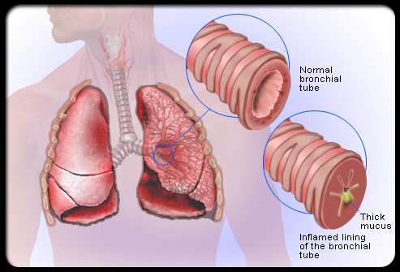
Bronchitis
A condition where the bronchioles become inflamed and filled with mucus resulting in a reduction of air flow into the lungs
It can be caused by smoking or infected from sickness, such as the cold or flu.
It is treated by antibiotics.

Slide 45
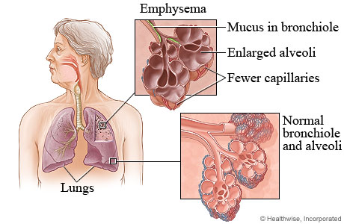
Emphysema
Activity: Can You Breath?
You will need a straw to perform this activity.
Run in place for 30 seconds.
Put the straw in your mouth and breathe ONLY through the straw, not your nose.
Resume normal breathing without the straw.
The effort needed to breathe through the straw resembles the characteristic shortness of breath caused by emphysema.
The swelling and scarring of alveoli in the lung resulting in loss of elasticity (cannot inflate and deflate) of the alveoli.
This causes some of them to burst resulting in a decrease of surface area for gas exchange.
Difficulty breathing is a result.
Smoking is usually the main cause for emphysema.
It can be cured if the person stops smoking and develops a healthier life-style.

Slide 46
How The Respiratory System Maintains Homeostasis
Homeostasis is maintained by the respiratory system in two ways: gas exchange and regulation of blood pH. Gas exchange is performed by the lungs by eliminating carbon dioxide (CO₂), a waste product given off by cellular respiration. As CO₂ exits the body, oxygen needed for cellular respiration enters the body through the lungs.
The body needs oxygen (O2) to provide energy released in the cellular respiration chemical reaction. Every cell in the body must have a continuous supply of oxygen. That oxygen is delivered to each cell by red blood cells in the circulatory system. Homeostasis is maintained by keeping a constant level of oxygen in the blood, supplied by the lungs.
The principle functions of the respiratory system are:
Ventilate the lungs
Extract oxygen from the air and transfer it to the bloodstream
Excrete carbon dioxide and water vapor
Maintain the acid base of the blood

Slide 47
Breathing/Feedback Mechanism
Breathing is clearly an involuntary process (you don't have to think about it), and like many involuntary processes (such as heart rate) it is controlled by a region of the brain called the medulla. The medulla and its nerves are part of the autonomic nervous system (i.e. involuntary).
The region of the medulla that controls breathing is called the respiratory center. The respiratory center transmits regular nerve impulses to the diaphragm and intercostal muscles to cause inhalation. Stretch receptors in the alveoli and bronchioles detect inhalation and send inhibitory signals to the respiratory centre to cause exhalation. This negative feedback system is continuous and prevents damage to the lungs.
Ventilation is also under voluntary control from the cortex, the voluntary part of the brain. This allows you to hold your breath or blow out candles, but it can be overruled by the autonomic system in the event of danger. For example, if you hold your breath for a long time, the carbon dioxide concentration in the blood increases so much that the respiratory center forces you to gasp and take a breath.

Slide 48
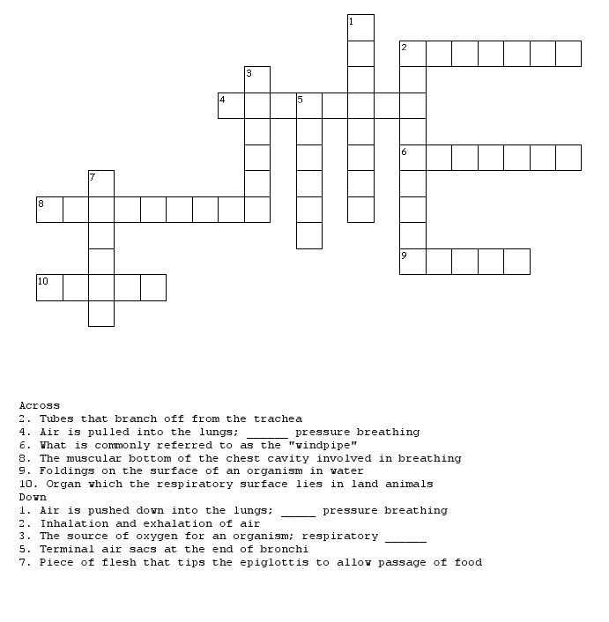
Activity: Crossword Puzzle

Slide 49
Fun Facts About The Respiratory System
When you are sleepy or drowsy the lungs do not take enough oxygen from the air. This causes a shortage of oxygen in our bodies. The brain senses this shortage of oxygen and sends a message that causes you to take a deep long breath---a YAWN.
Sneezing is like a cough in the upper breathing passages. It is the body's way of removing an irritant from the sensitive mucous membranes of the nose. Many things can irritate the mucous membranes. Dust, pollen, pepper or even a cold blast of air are just some of the many things that may cause you to sneeze.
Hiccups are the sudden movements of the diaphragm. It is involuntary --- you have no control over hiccups. There are many causes of hiccups. The diaphragm may get irritated, you may have eaten to fast, or maybe some substance in the blood could even have brought on the hiccups.
Human lungs have approximately 1500 miles of airways.
The right lung in humans is larger than the left lung in order to accommodate the heart.
The saying that ‘Laughter is the best medicine’ may have some truth to it. It is said that laughing helps boost the immune system.

Slide 50
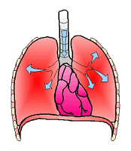
Source Page
Respiratory Basics Animation: http://www.wisc-online.com/objects/ViewObject.aspx?ID=AP15104
Diagram of Respiratory System:http://www.smm.org/heart/lungs/vascular.htm
Respiratory System Game:http://www.e-learningforkids.org/Courses/Liquid_Animation/Body_Parts/Respiratory_System/index.html
Lung Animation: http://www.innerbody.com/anim/lungs.html
Printable Notes About Circulatory/Respiratory Systems: http://kvhs.nbed.nb.ca/gallant/biology/circulation_respiration_notes.html

Slide 51
References
http://www.ambulancetechnicianstudy.co.uk/respsystem.html
http://hes.ucfsd.org/gclaypo/repiratorysys.html
http://www.brighthub.com/health/conditions-treatments/articles/57144.aspx
http://biology.clc.uc.edu/courses/bio105/respirat.htm
http://kidshealth.org/parent/general/body_basics/lungs.html
http://leavingbio.net/Respiratory%20System/THE%20RESPIRATORY%20SYSTEM.htm#parts

