Slide 1
Endocrine System
By Nadia Bhuyain, Steven Hernandez, and Walter Bryant
F Period

Slide 2
Parts of the Endocrine System
Hypothalamus
Pituitary Glands: Anterior and Posterior
Thyroid Gland
Parathyroid
Pancreas
Adrenal Gland
Pineal Glands
Reproductive Glands: Ovaries and Testes

Slide 3
Structures
Hypothalamus – The Hypothalamus is a collection of specialized cells that is located in the lower central part of the brain. It has a small, cone shaped structure which projects downward ending in the pituitary stalk.
Pituitary Glands: The pituitary gland is a little bigger than a pea and is nestled in a bony depression below the underside of the brain. pituitary gland is divided into two major lobes, the anterior lobe and the posterior lobe.
Thyroid Gland – The thyroid gland is shaped like a bow tie or butterfly with two lateral lobes that are connected by a narrow section called the isthmus.
Parathyroid Gland - The parathyroid glands are two small, oval-shaped glands, the cells that synthesize and secrete parathyroid hormone are arranged in rather dense cords or nests around abundant capillaries.

Slide 4
Structures (continued)
Pancreas - The pancreas is an elongated organ that contains both exocrine and endocrine tissues.
Adrenal Glands – The adrenal glands are small, triangular glands made of two parts: the outer region is called the adrenal cortex and the inner region is called the adrenal medulla.
Pineal Glands – The pineal body is made up of a lobular parenchyma of pinealocytes surrounded by connective tissue spaces. The gland's surface is covered by a pial capsule.
Reproductive Glands: The female ovaries are oval shaped and roughly the size of an almond. It is attached to the fimbria of the fallopian tube. The testes are oval organs about the size of large olives that lie in the scrotum, secured at either end by a structure called the spermatic cord.

Slide 5
Locations
Hypothalamus - The hypothalamus is located below the thalamus at the center of the brain, posterior to the optic chiasma.
Posterior Pituitary Gland - Located at the base of the hypothalamus.
Anterior Pituitary Gland - The anterior pituitary gland is situated at the base of the brain.
Thyroid Gland - Located in front of the neck below the larynx.
Parathyroid Glands – The parathyroid glands are located adjacent to the two thyroid gland lobes in the neck.
Pancreas – The pancreas is located at the middle of the upper stomach.
Adrenal Gland - Located on top of both kidneys.
Pineal Gland - The pineal gland is attached to the posterior wall of the third ventricle.
Ovaries - The female gonads, the ovaries, are located in the pelvis.
Testes - Located in the scrotum.

Slide 6
Functions
Hypothalamus - The main function of the hypothalamus is homeostasis. Nerve cells in the hypothalamus control the pituitary gland by producing chemicals that either stimulate or suppress hormone secretions from the pituitary.
Posterior Pituitary Gland - It is responsible for a function of the pituitary gland which releases the oxytocin hormone. This hormone is required after distension of the cervix and the vagina during labor.
Anterior Pituitary Gland – Secretes peptide hormones that act on target organs including the adrenal gland, liver, bone, thyroid gland, and gonads.
Parathyroid - Releases parathyroid hormone, which regulates the level of calcium in the blood with the help of calcitonin, which is produced in the thyroid.
Pancreas - The pancreas contains enzyme producing cells that secrete two hormones. The two hormones are insulin and glucagon. Insulin and glucagon are secreted directly into the bloodstream, and together, they regulate the level of glucose in the blood.

Slide 7
Functions (continued)
Adrenal Gland - Produces hormones that regulate body functions. The medulla produces norepinephrine and epinephrine, which regulate the body's reaction to stressful events. The cortex produces several hormones that affect blood pressure and blood sugar levels, growth, as well as some sexual characteristics.
Pineal Gland - Secretes melatonin, a hormone that may help regulate the wake-sleep cycle.
Ovaries - Produces eggs and secrete the female hormones estrogen and progesterone.
Testes - Secretes hormones called androgens, these hormones regulate body changes associated with sexual development.

Slide 8
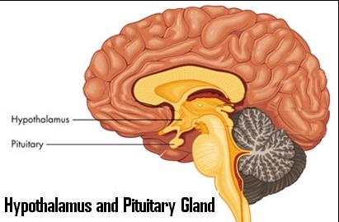
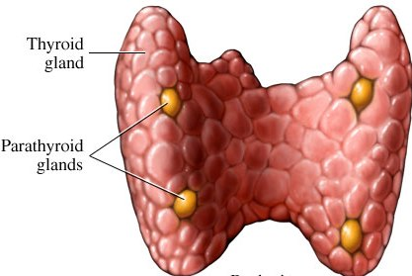
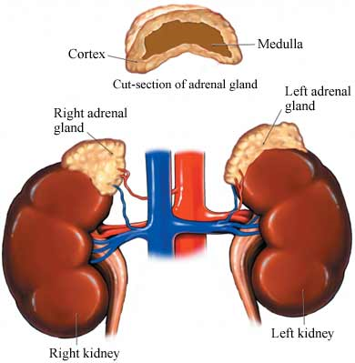
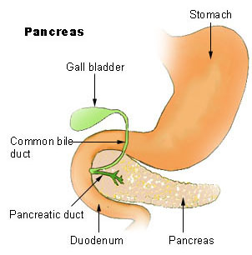
Photo References

Slide 9
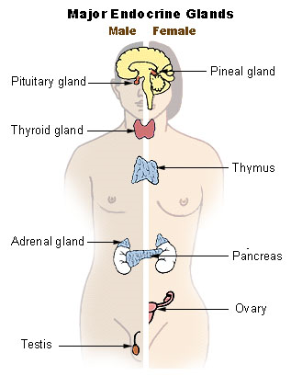
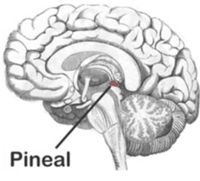
Photo References

Slide 10
Activities: Endocrine System Word Search
I T V J P T O R R K H B R Q D S
M E T S Y S E N I R C O D N E O
Q H Y V B C X B K E H X K X P V
A D R E N A L G L A N D O T N W
C P I N E A L G L A N D I N Z H
S E C R E T E R M D S L K E K V
D I O R Y H T A R A P H F C C R
D N A L G S U M Y H T U B G Q U
B L W Q D I O R Y H T R U K U B
D X P N S E B Y J N D W T L S T
S Z M Y V X P S E I R A V O A A
C V U V W S E T S E T T K H H L
U C H G B G V O X V I T S H X G
T C L S A E R C N A P N D Y C K
P I Z D J H O R M O N E S R D U
E Z P I T U I T A R Y G L A N D
adrenal gland pancreas secrete
endocrine system parathyroid testes
hormones pineal gland thymus gland
ovaries pituitary gland thyroid

Slide 11
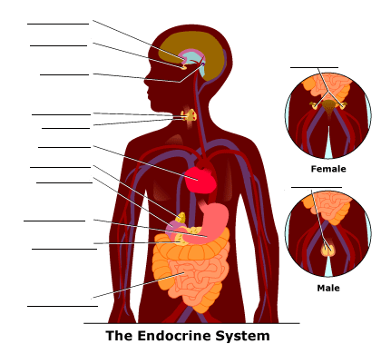
Activities: Name that Part!

Slide 12
Activities: Can You Guess the Organ?
I regulate things such as blood pressure, body temperature, fluid and electrolyte balance. What am I?
I'm located at the base of the hypothalamus
I contain three subdivisions including the pars distalis, pars intermedia and pars tuberalis.
I'm situated on the anterior side of the neck, lying against and around the larynx and trachea
I lie on the anterior side of the neck, lying against and around the larynx and trachea
Because of my deep location, tumors are rarely palpable on me. What am I?
I'm also known as a suprarenal gland.
I grow in size until about 1–2 years of age in humans. What am I?
I am the size and shape of an almond and sit just above the fallopian tubes.
I am the body's main source of male hormones, such as testosterone. What am I?

Slide 13
Answers to Endocrine System Word Search
I T V J P T O R R K H B R Q D S
M E T S Y S E N I R C O D N E O
Q H Y V B C X B K E H X K X P V
A D R E N A L G L A N D O T N W
C P I N E A L G L A N D I N Z H
S E C R E T E R M D S L K E K V
D I O R Y H T A R A P H F C C R
D N A L G S U M Y H T U B G Q U
B L W Q D I O R Y H T R U K U B
D X P N S E B Y J N D W T L S T
S Z M Y V X P S E I R A V O A A
C V U V W S E T S E T T K H H L
U C H G B G V O X V I T S H X G
T C L S A E R C N A P N D Y C K
P I Z D J H O R M O N E S R D U
E Z P I T U I T A R Y G L A N D

Slide 14
Answers to Name that Part!

Slide 15
Answers to Can You Guess the Organ?
Hypothalamus
Posterier Pituitary Gland
Anterior Pituitary Gland
Thyroid Gland
Parathyroid
Pancreas
Adrenal Gland
Pineal Gland
Ovaries
Testes

Slide 16
For more information check out:
http://www.medindia.net/know_ur_body/endocrine.asp
http://www.education.com/reference/article/Ref_Endocrine_System/

