Slide 1

. What does it mean to be holy?

Slide 2
SANCTITY
All Christians are called to Holiness (sanctity). “You, therefore, must be perfect as your heavenly Father is perfect” (Mt 5:48).

Slide 3
UNIVERSAL CALL TO HOLINESS
BECAUSE WE ARE MADE IN God’s image, we are called to reflect God to the world.

Slide 4
Sanctity (Holiness)
  Sanctity (Holiness) requires us to be obedient to the will of God in our lives. The Gospels and the Catholic Church provide the teachings and structure that, if followed, are obedient to the will of God.

Slide 5
Vocation
To live this universal call to holiness, one must realize the vocation to which he or she is called
LAITY
CLERGY

Slide 6
How do we live a life of holiness?
We are called the “Laity” and are called to a holy witness of Christ in all circumstances.
Laity are the faithful who, having been incorporated into Christ through Baptism, are made part of the people of God and the Church.
Laity have not received the Sacrament of Holy Orders, but are expected to receive other sacraments.

Slide 7
THE CLERGY
Clergy recognize their vocation to reflect God and serve the Church in their everyday lives, until death
Clergy receive the sacrament of Holy Orders
Clergy take vows
Poverty/chastity/ communal life, etc.

Slide 8
  The Catechism of the Catholic Church tells us:
“In order to reach this perfection the faithful should use the strength dealt out to them by Christ’s Gift, so that…doing the will of the Father in everything, they may wholeheartedly devote themselves to the glory of God and to the service of their neighbor. Thus the holiness of the People of God will grow in fruitful abundance, as is clearly shown in the history of the Church through the lives of so many saints.” (CCC 2013)

Slide 9
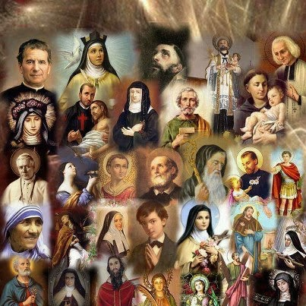
  The Latin word from which the word Saint comes from is Sanctus – Holy.

Slide 10
SAINTS
Saints are those who have lived a truly Holy life.
Saints are known for a particular occurrences or special reasons: patron saints

Slide 11
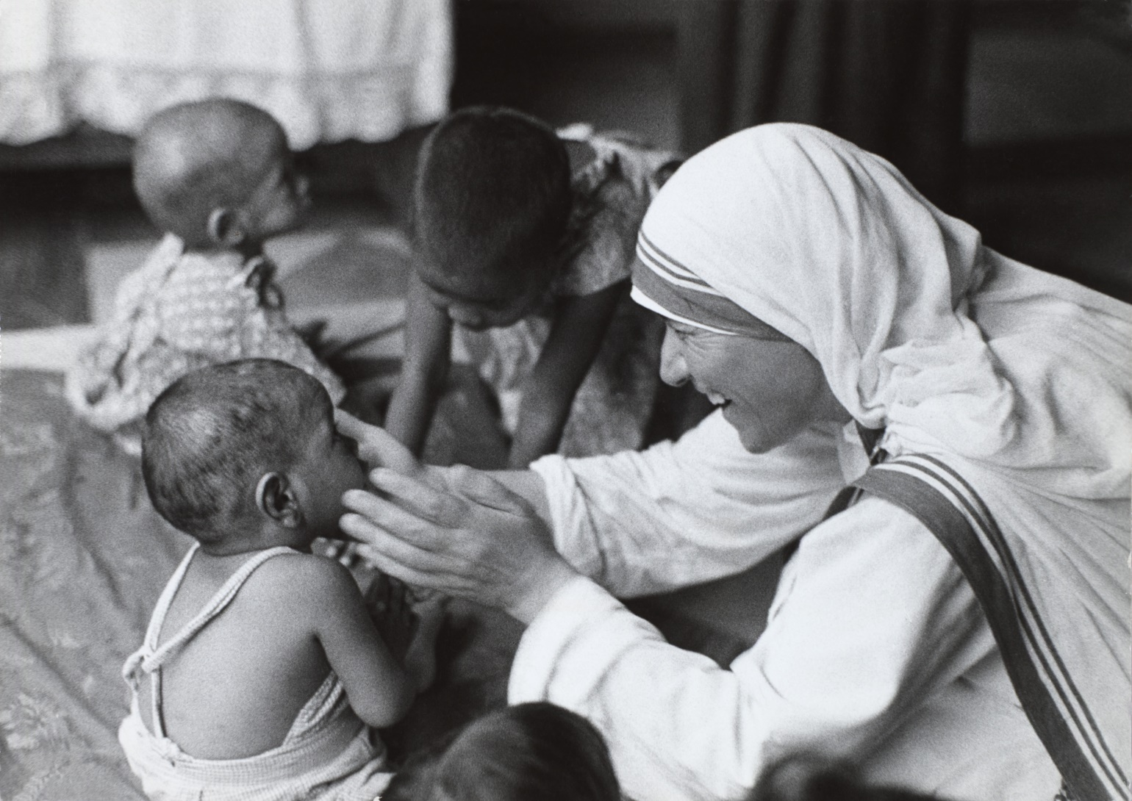
  OUR PURPOSE ON EARTH IS TO LIVE A LIFE OF PERSONAL SANCTITY OR HOLINESS.

Slide 12
HOLINESS=HAPINESS
https://youtu.be/GKC8NJGoCzc

Slide 13
ACTIVITY
Read I Corinthians 12: 12-28; Romans 12:4-8

Slide 14
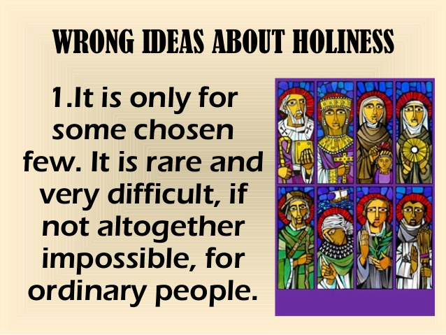
WRONG IDEAS ABOUT HOLINESS

Slide 15

WRONG IDEAS ABOUT HOLINESS

Slide 16

WRONG IDEAS ABOUT HOLINESS

Slide 17
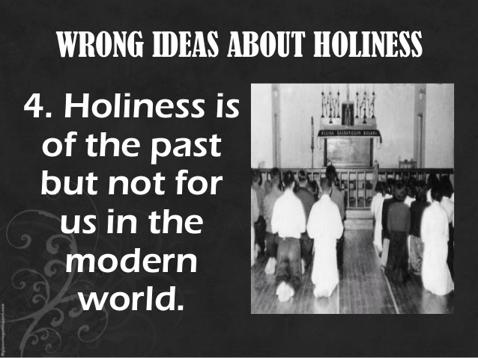
WRONG IDEAS ABOUT HOLINESS

Slide 18
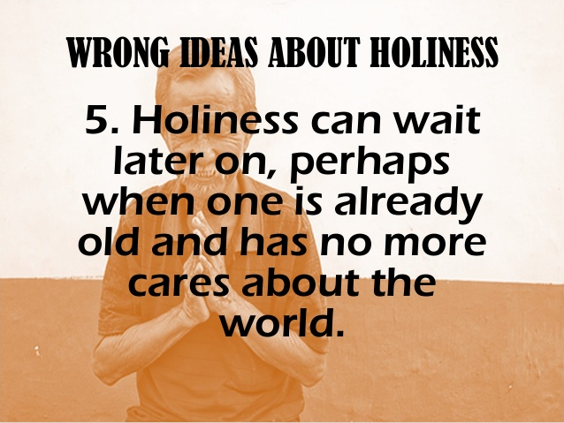
WRONG IDEAS ABOUT HOLINESS

Slide 19
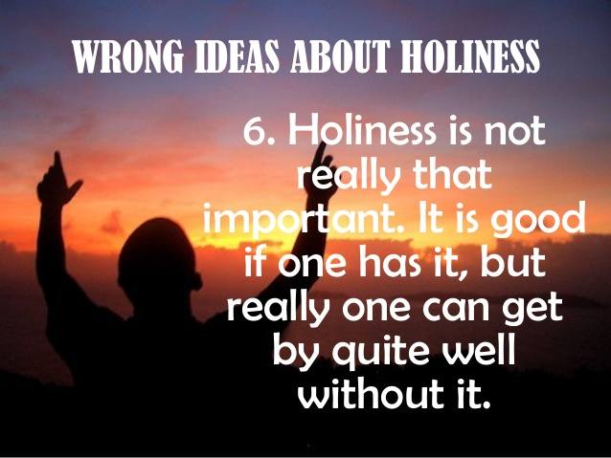
WRONG IDEAS ABOUT HOLINESS

Slide 20
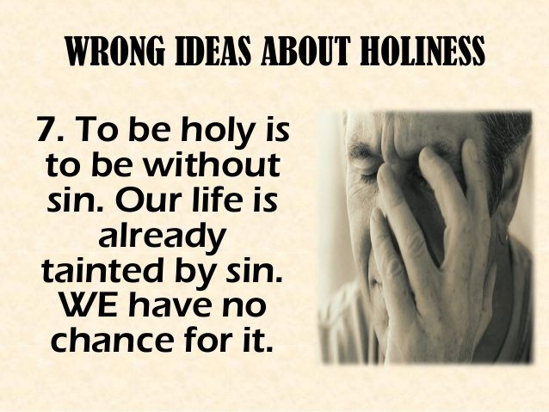
WRONG IDEAS ABOUT HOLINESS

Slide 21
WRONG IDEAS ABOUT HOLINESS
WRONG IDEAS ABOUT HOLINESS
It is only for some chosen few. It is rare and very difficult, if not altogether impossible, for ordinary people.
One needs to be a priest or a nun who will have the time and the training to be holy.
It is corny. One has to be goody-goody with one’s feet on the ground.
Holiness is of the past but not for us in the modern world.
Holiness can wait later on, perhaps when one is already old and has no more cares about the world.
Holiness is not really that important. It is good if one has it, but really one can get by quite well without it.
To be holy is to be without sin. Our life is tainted by sin. We have no chance for it.

Slide 22
MARTYRS
Martyrdom according to the Catechism is “the supreme witness given to the truth of the faith: it means bearing witness even unto death” (#2473). Rather than renounce his faith, the martyr bears witness with extraordinary fortitude to the belief that Christ suffered, died, and rose from the dead for our salvation, and to the truths of our Catholic faith. (The word martyr itself means “witness.”)

Slide 23
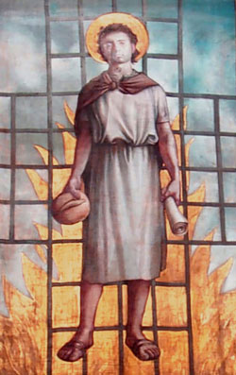
MARTYRS-ST. LAWRENCE

Slide 24
ST. LAWRENCE
Saint Lawrence was condemned to death by a greedy Prefect of Rome who wanted all the Church’s treasure. Lawrence brought him all the poor people of the area as the Church treasure. The angry Prefect condemned Lawrence to a slow, cruel death. The Saint was tied on top of an iron grill over a slow fire that roasted his flesh little by little, but Lawrence was burning with so much love of God that he almost did not feel the flames. In fact, God gave him so much strength and joy that he even joked. "Turn me over," he said to the judge. "I'm done on this side!"

Slide 25
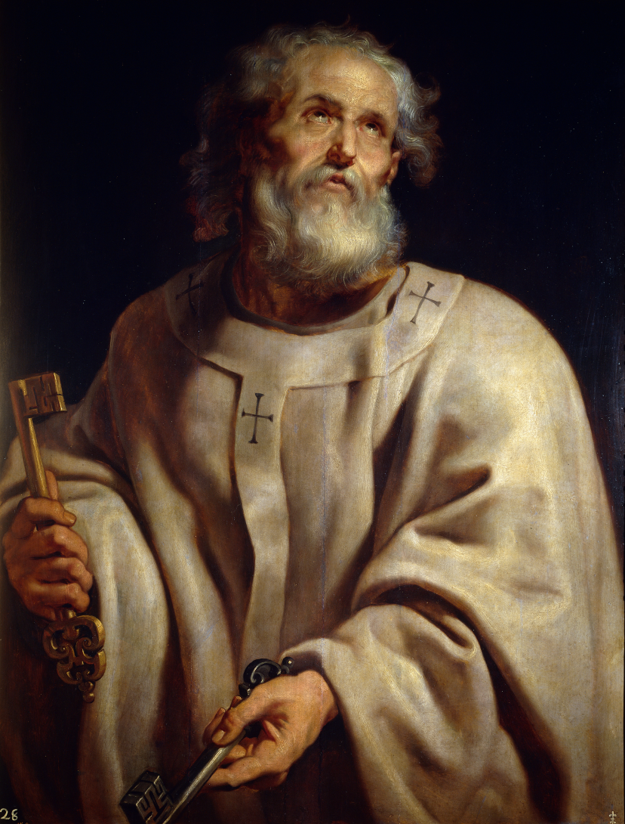
ST.PETER

Slide 26
ST. PETER
Peter died on 13 October AD 64 during the festivities on the occasion of the "dies imperii" of Emperor Nero. This took place three months after the disastrous fire that destroyed Rome for which the emperor (Nero) wished to blame the Christians. This "dies imperii" (regnal day anniversary) was an important one, exactly ten years after Nero ascended to the throne, and it was 'as usual' accompanied by much bloodshed. Traditionally, Roman authorities sentenced him to death by crucifixion. Peter asked to be crucified head down, because he was not worth to die in the same way that Christ died

Slide 27
MARTYRS OF THE 20TH & 21ST CENTURY
Maximilian Kolbe, Edith Stein, Oscar Romero, & Mexican Jesuit Miguel Pro
Ana Isabel Sanchez Torralba, Sister Barbara Ann Ford, Fr. Arley Arias Garcia, . Fr. Gopal

Slide 28
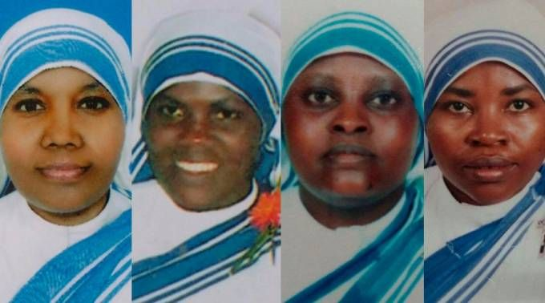
MARTYRS TODAY

Slide 29
PRESENT DAY MARTYRS
Rome, Italy, Mar 8, 2016 / 01:27 pm (CNA/EWTN News).- Sister Anslem, Sister Reginette, Sister Judith, and Sister Marguerite were serving as caretakers at the Missionaries of Charity's convent and nursing home in Aden, Yemen.
These sisters left their homes in India and Africa to serve the poor, elderly, and disabled in the war-torn country of Yemen. They worked together with volunteers at the convent's home care center, where they served around sixty to eighty patients of all religions.
“They were serving all poor people irrespective of their religion. Their duty was to help the poor,” a representative from the Apostolic Vicariate of Southern Arabia told CNA.
But on March 4, the convent was attacked by two gunmen who killed Sr. Anslem, Sr. Judith, Sr. Marguerite, and Sr. Reginette, along with sixteen other victims, including volunteers from Ethiopia and Yemen. Each victim was found handcuffed and shot in the head.

Slide 30
WHY IS IT DIFFICULT TO LIVE A LIFE OF HOLINESS IN OUR MODERN WORLD?
Moral Relativism-do whatever you want
Consumerism-get whatever you want
Religious Indifference-believe whatever you want

Slide 31
MORAL RELATIVISM
Summing up the relative moral philosophy, Friedrich Nietzsche wrote, “You have your way, I have my way. As for the right way, it does not exist.”
Many people do whatever they want with no care to how it may effect others

Slide 32

CONSUMERISM
GET WHATEVER YOU WANT:

Slide 33
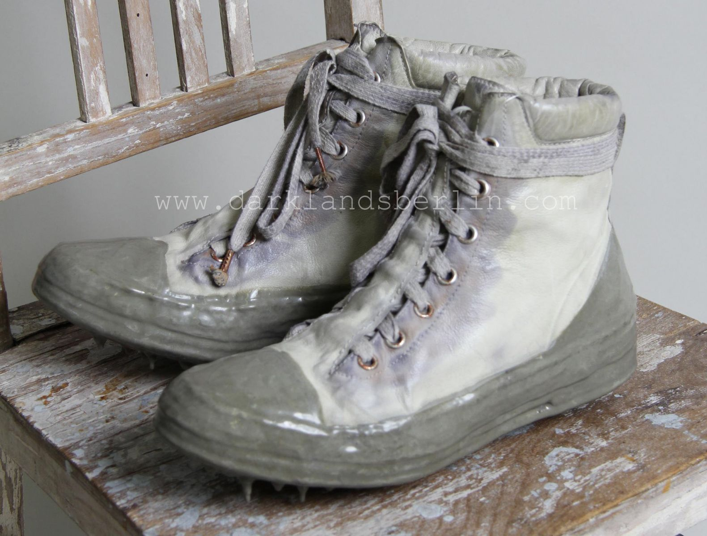

Slide 34
RELIGIOUS INDIFFERENCE
The attitude that all religions are equally good and equally capable of leading a person to his or her eternal destiny. In its most extreme form, the theory that there is no one form of religious belief, divine worship, or moral
behavior that has been revealed by God.
BELIEVE WHATEVER YOU WANT!

Slide 35

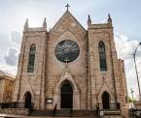
SANCTITY-HOLINESS
THE GOSPELS
THE CATHOLIC CHURCH

Slide 36
THE LAITY ARE CALLED TO HOLINESS BY GOD & BY THE CHURCH
THE SECOND VATICAN COUNCIL
1962-1965

Slide 37
COUNCIL
IS A FORMAL MEETING OF CHURCH LEADERS TO DELIBERATE, CLARIFY, STUDY, AND ENACT DECREES PERTAINING TO THE LIFE AND BELIEF OF THE CHURCH
THE FUNCTION OF THE COUNCIL IS TO SETTLE IMPORTANT QUESTIONS, EXPLAIN CHURCH TEACHINGS IN GREATER DETAIL AND PREVENT PROBLEMS FROM GETTING OUT OF HAND.

Slide 38
ECUMENICAL COUNCILS
First Council of Nicaea (325)
First Council of Constantinople (381)
Council of Ephesus (431)
Second Council of Ephesus (449)
Council of Chalcedon (451)
Second Council of Constantinople (553)
Quinisext Council, also called Council in Trullo (692)
Second Council of Nicaea (787)
Fourth Council of Constantinople (869-870)
First Council of the Lateran (1123)
Second Council of the Lateran (1139)
Third Council of the Lateran (1179)
Fourth Council of the Lateran (1215)
First Council of Lyon (1245)
Second Council of Lyon (1274).
Council of Vienne (1311â€“1312)
Council of Pisa (1409)
Council of Constance (1414â€“1418)
Council of Siena (1423â€“1424)
Council of Basel, Ferrara and Florence (1431â€“1445)
Fifth Council of the Lateran (1512â€“1514) addressed church reform.
Council of Trent (1545â€“1563,
First Council of the Vatican (1870; officially, 1870â€“1960)
Second Council of the Vatican (1962â€“1965)

Slide 39
DECREE ON LAITY
Official pronouncement announcing that the baptized are called to perfection of life and to evangelize all who they meet.
The Laity share in the priestly, prophetic and kingly office of Christ through their baptism.
The Lay apostolate is exercised when they work at the evangelization and SANTIFICATION of others by spreading the Spirit of Christ

Slide 40
SANCTIFICATION
The process of being made holy. This begins at Baptism and continues throughout the life of the Christian and is completed when a person enters heaven and becomes totally and irrevocably united with God.

Slide 41

SANCTIFYING GRACE
AT BAPTISM, WE RECEIVE SANCTIFYING GRACE(THE PRESENCE OF GOD IN THE PERSON) IN THE THEOLOGICAL VIRTUES OF FAITH, HOPE, AND CHARITY(LOVE).

Slide 42
GRACE
IS THE FREE AND UNDESERVED GIFT THAT GOD GIVES US TO RESPOND TO OUR VOCATION TO BECOME HIS ADOPTED CHILDREN!

Slide 43
ASSIGNMENT
1. HOW DO WE BECOME HOLY?
2. WHERE CAN WE LEARN WHAT WE MUST DO TO BE HOLY PEOPLE?
3. GIVE FIVE EXAMPLES OF HOLINESS.
4. NAME TWO WAYS IN WHICH YOU CAN HELP OTHERS TO BE HOLY?

