Slide 1
Rhythmic Notation
AP Music Theory
Mr. Silvagni

Slide 2
What is Rhythm?
Rhythm is how music moves
It is how close or far apart notes are played together
It makes music interesting

Slide 3
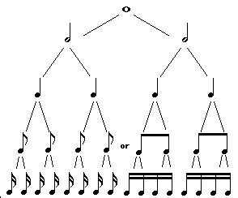
What are the notes?

Slide 4
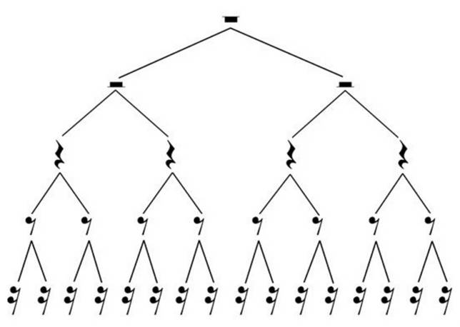
What are the rests?

Slide 5

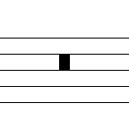
Breve or Double Whole Note

Slide 6
What do these notes mean?
Nothing…without a time signature
Time Signature: an indication of rhythm, following a clef, with the bottom number defining the beat and the top number giving the number of beats in each measure

Slide 7
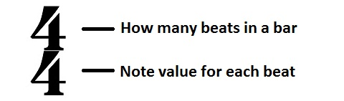
Time Signature

Slide 8
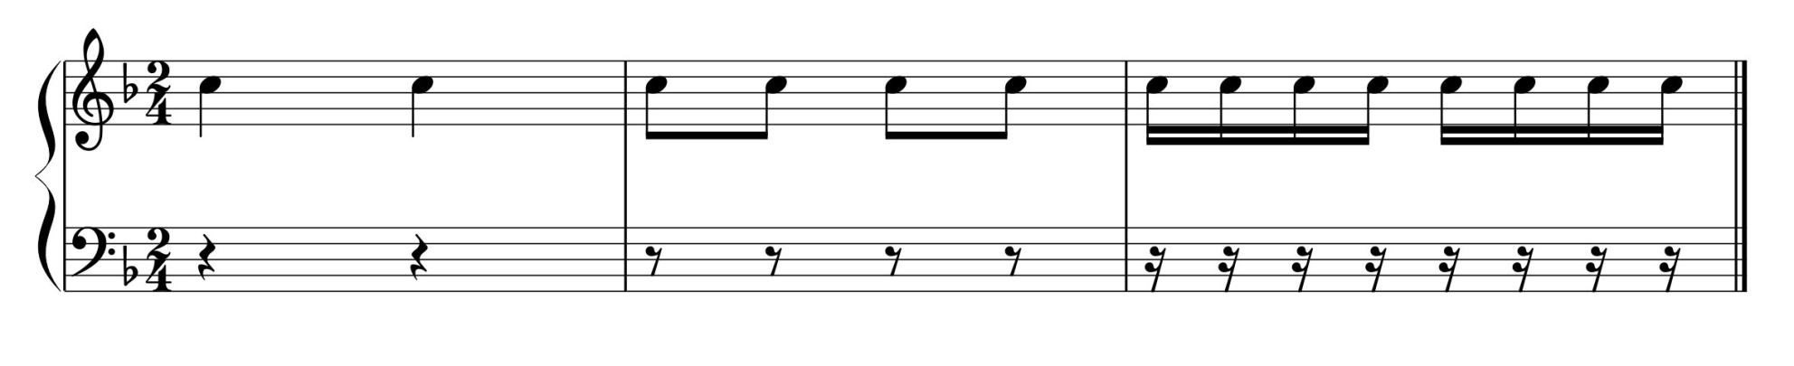
Example

Slide 9
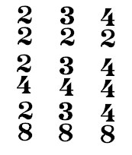
Other Time Signatures

Slide 10
Meter
Time signatures are defined into meter types
Meter describes not only how many beats, but how the music will feel
Simple Meter – the beat note will divide into 2 equal parts
Compound Meter – the beat note will divide into 3 equal parts
Complex Meter – the beat note will divide into both 2 and 3 parts

Slide 11
Meter Types
Duple Meter – there are two strong beats in a measure
Triple Meter – there are three strong beats in a measure
Quadruple Meter – there are four strong beats in a measure

Slide 12
Meter Types
Simple Duple – 2/4, 2/2, 2/8, 2/16, 2/1 (2)
Simple Triple – 3/4, 3/2, 3/8, 3/16, 3/1 (3)
Simple Quadruple – 4/4, 4/2, 4/8, 4/16, 4/1 (4)
Compound Duple – 6/4, 6/2, 6/8, 6/16, 6/1 (6)
Compound Triple – 9/4, 9/2, 9/8, 9/16, 9/1 (9)
Compound Quadruple – 12/4, 12/2, 12/8, 12/16, 12/1 (12)
Complex Duple – 5/4, 5/2, 5/8, 5/16, 5/1 (5)
Complex Triple – 7/4, 7/2, 7/8, 7/16, 7/1 (7)
Complex Quadruple – 10/4, 10/2, 10/8, 10/16, 10/1, 11/4, 11/2, 11/8, 11/16, 11/1 (10 and 11)

Slide 13
Beaming
From eighth notes and below, note beaming needs to show where the beats are
Simple meters: beam notes in groups of 2 or 4
Compound meters: beam notes in groups of 3 or 6
Complex meters: beam notes in groups depending on length of beats

