Slide 1
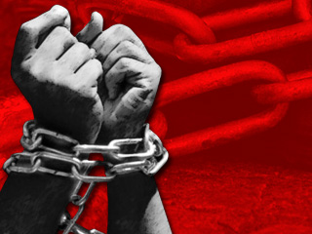
Slavery

Slide 2

How it all began:
The first Africans in America arrived in Jamestown, Virginia in 1619 as indentured servants. From 1619 to around1640, Africans were able to earn their freedom by working as artisans and labor workers for the European settlers.
But by 1640, Maryland became the first colony to institutionalize slavery.
From that time on African workers became chattel slaves, who could be bought and solely owned by their masters.
Slave owners thought of slaves as a piece of property not a person.

Slide 3
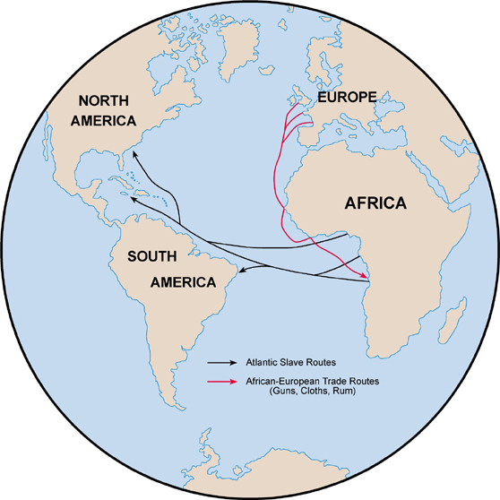
Many Europeans came to America to exercise their God fearing beliefs and to practice religious freedom. Slavery, on the other hand, was a form of persecution.
The Slave Trade
The Middle Passage
The Middle Passage has several names, consisting of the "triangle trade" or "circuit trade, and "transatlantic trade" routes.
The typical voyage for slaves taken by the British went south down the coast of Africa into the area adjacent to the Gulf of Guinea.
When the desired number of African slaves was met for shipping, the voyage of Middle Passage continued from Africa on the slave ships going across the Atlantic Ocean with a destination in one of several ports in the West Indies and Caribbean.
The Portuguese were the first to embark upon the slave trade starting around 1562.
The practice of slavery grewtremendously from 1646 up until 1790.
A vital area for slaves was on the west coast of Africa called the Sudan.
The main sources of exchange used by the Europeans to obtain their African slaves were ivory, guns, glass beads, and whiskey.
Trading countries had a greater demand for slaves due to the rising demand for coffee, cotton, tobacco and sugar.
Countries like Spain, France, the Dutch, and English competed for cheap or free labor guaranteed by slaves.

Slide 4
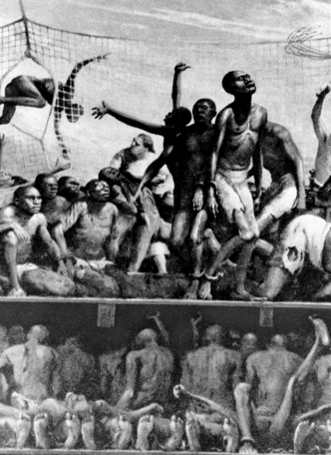
Experience the Journey
The journey for slaves to get to America was treacherous. An estimated 15 million Africans were transported to the Americas between 1540 and 1850. Slaves were kidnapped from their villages, separated from their families, and stripped of their clothes. The weak ones were thrown into the bottom of the boats, and the stronger ones were forced to work on the boat cleaning and sailing. Down under in the storage there was practically no living space. All the slaves were standing up or lying on the ground being suffocated and stepped on for months at a time. They slept standing up if they could even sleep due to the stench of corpses, blood and wastes that they were forced to live in. Children were forced to look at their deceased family members for months and watching them decay, stepped on and dismantled. The slaves were fed barely any food or given any water for the entire journey. Some slaves tried to escape slavery by jumping overboard; in this case they were either shot, or rescued and brought back on the boat for a severe whipping. Misbehaver was not tolerated, if so the slaves were scourged until they were gasping for their last breath of air and then thrown back under the ship. Most of the slaves died on the journey over to America due to famine, suffocation, beatings and disease; many were crippled for life because of the way they were chained to the ship.

Slide 5
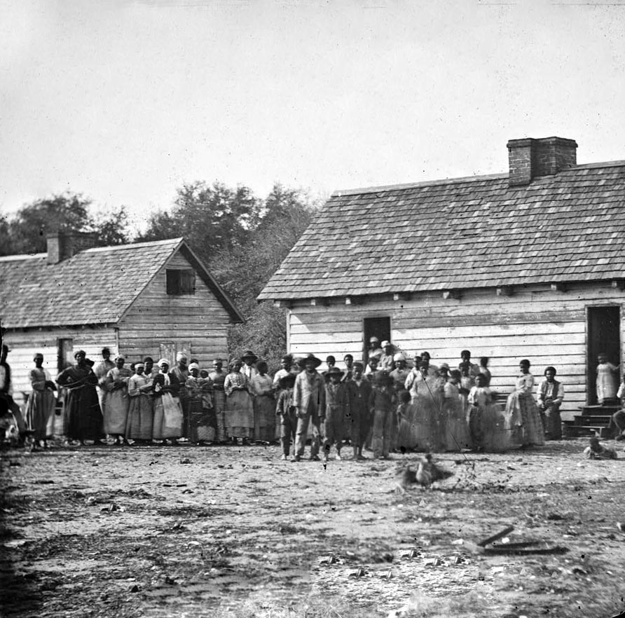
The Plantation System.
A plantation system is the division of the land, in the Americas being setting during the 17th century, into smaller units under private ownership.
This system started in Jamestown, Virginia it then spread to most of the New England colonies.
Crops grown on these plantations were sugar cane, rice, cotton, and tobacco. Slaves worked in the fields from sunrise to sunset every single day, and during harvest time 18 hour days, FOR FREE.
Women worked the same hours as the men.
Pregnant women were expected to continue working all day every day until their child was born.

Slide 6
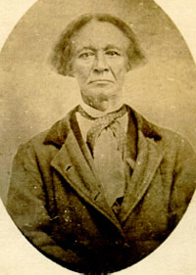
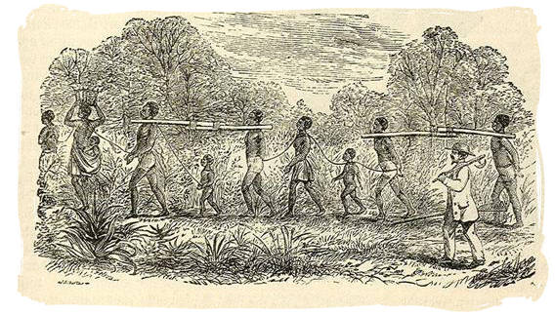
Slave Owners
Of he total southern white population of 8,099,760 in 1860,384,000 owned slaves, most of them owning 50 or more each.
It was calculated that about 88% of America's slave-owners owned twenty slaves or less.
The death rates for slaves began to rise. To replace their losses, plantation owners encouraged their slaves to have children.
Child bearing began around the age of 13, by the age of 20, women were expected to have up to 4 or 5 children.
To encourage women to have babies slave owners would promise the women freedom after they had 15 children.

Slide 7
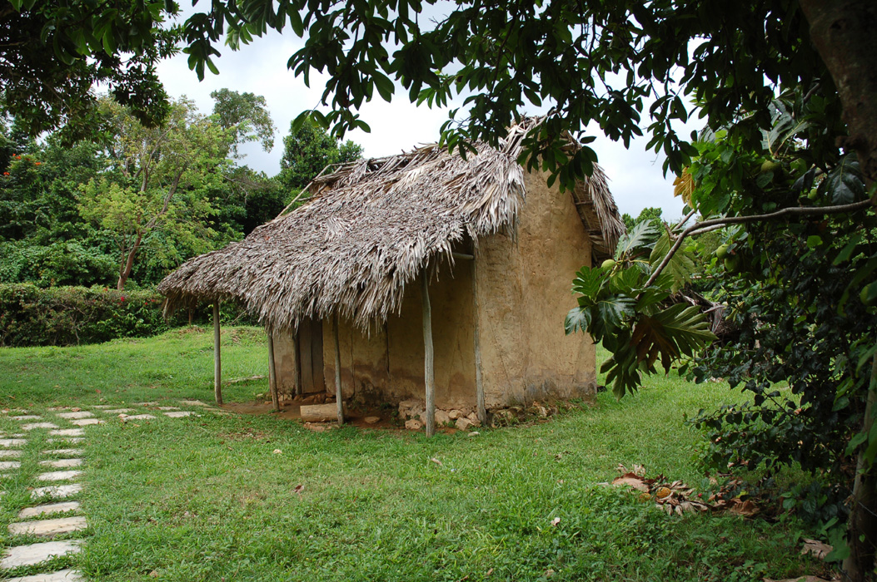
The Difference
Field Slaves
House Slaves
Slaves were in the fields from sunrise to sunset, during the harvest working 18 hours a day. Women pregnant or non-pregnant worked the same hours as men.
Their living accommodations consisted of, crowded, un-kept wooden sheds with dirt floors.
A slave by the name of, Josiah Henson wrote, "Wooden floors were an unknown luxury. In a single room were huddled, like cattle, ten or a dozen persons, men, women, and children. We had neither bedsteads, nor furniture of any description. Our beds were collections of straw and old rags, thrown down in the corners and boxed in with boards; a single blanket the only covering."
House slaves usually lived better than field slaves. They usually had better food and were sometimes givenhammy downs to wear.
However some were not so lucky, Harriet Jacobs reports that her mistress "would station herself in the kitchen, and wait till it was dished, and then spit in all the kettles and pans" to make sure that the slaves did not eat what was left over.
Their living conditions were somewhat better then field slaves also. In some cases the slaves were treated like the slave owners own children. Although it was illegal, some slaves got really lucky and were educated by the women in the house. Trustworthy slaves that never once tried to escape were sometimes promised freedom when their master dies…very few of these promises were kept.

Slide 8
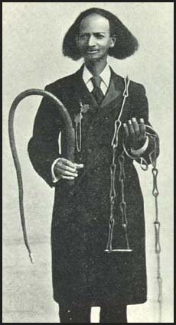
Cruel & Heinous Punishment
According to William Wells Brown, slaveowners in Virginia smoked slaves. This involved whipping slaves and putting them in a tobacco smoke house." Moses Roper claimed that in South Carolina they used to "drive nails into a hogshead so as to leave the point of the nail just protruding in the inside of the cask. Into this he used to put his slaves for punishment, and roll them down a very long and steep hill.” The most common punishments were a whipping, a branding.

Slide 9
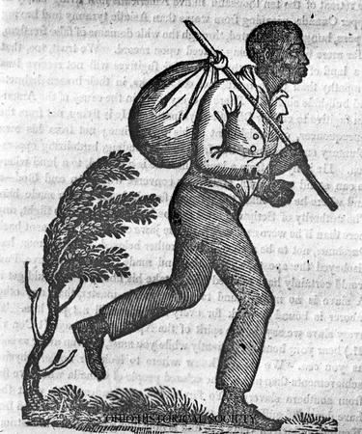
RUNAWAYS
Its clear that at slaves wanted freedom, and most probably contemplated escaping slavery, but very few were successful. Studies have shown that field slaves were more likely to try to escape because they were treated worse. Slave owners used bloodhounds to trace their slaves. It was difficult for runaways to find food and shelter. The absence of maps was also another factor in understanding why most slaves failed in their attempts for freedom. Most runaways were found and brought back to the plantation and heavily beaten. A slave by the name of Moses Roper received 200 whips, and was only stopped when the masters wife pleaded for his life to be spared. With these consequences to think about many slaves decided to just live in the life of slavery.

Slide 10
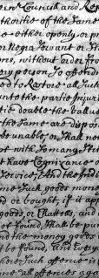
Black Codes
Black Codes was a name given to laws passed by southern governments established during the presidency of Andrew Johnson.
These laws imposed severe restrictions on freed slaves such as forbidding them to sit in on juries, limiting their right to testify against white men, prohibiting their right to vote, carrying weapons in public places and working in certain occupations.
Even with all of these restrictions on an African Americans daily life, anything is better then daily beatings, and withholding freedom.

Slide 11
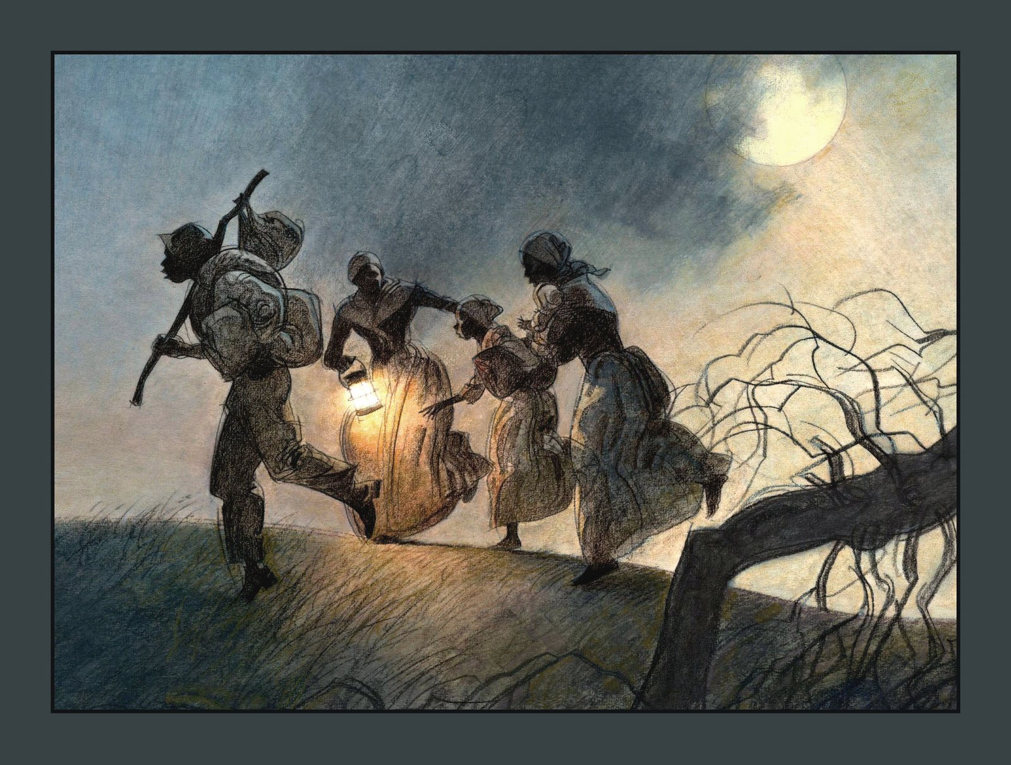
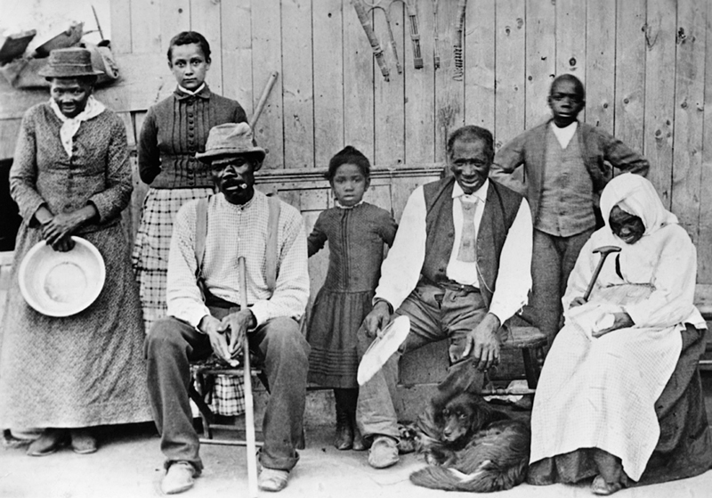
The Underground Railroad
The Underground Railroad was a immense network of people who helped fugitive slaves escape to the North and to Canada to be free. It consisted of many individuals, many whites but predominantly black. These people help to aid slaves along the route to their freedom, providing transportation, shelter, and food even though it was extremely illegal. This system effectively moved hundreds of slaves northward each year. According to a study, the South lost 100,000 slaves between 1810 and 1850.
Harriet Tubman- guided more than 300 slaves along the Underground Railroad.
A chain of homes and farms where escaped slaves could go for help. The chain of safe houses ran to Canada were the slaves could be free.

Slide 12
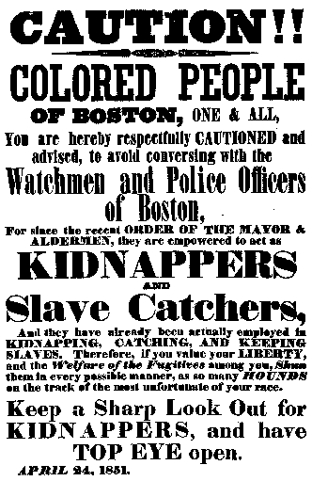
Noteworthy
Abolitionists
William Lloyd Garrison. In 1831 a Boston, Massachusetts newspaper called The Liberator was published. Garrison wrote the newspaper and used it to tell Congress and the world that slavery must be abolished.
Sojourner Truth. She was a slave who was freed in 1827. She began speaking about slavery, she was an extremely forceful speaker. Many people listened to her and were inspired by her. President Abraham Lincoln chose her to be a counselor to the freedmen in Washington.
Harriet Tubman. She was a former slave whom gained her freedom and guided more than 300 slaves along the Underground Railroad.
Frederick Douglass. He was was born a slave. He taught himself to read and write. He later ran away from his master. Douglass wrote and told of his life as a slave and gave lectures to groups of abolitionists.
Harriet Beecher Stowe.Stowe's father was an abolitionist. She visited a plantation in Kentucky. There she learned about slavery. Stowe wrote a book about the cruelty of slavery called Uncle Tom's Cabin. This book was published in 1852. It became a best-seller in the north. The book was banned in the southern states. She was another person who helped Americans become aware of the life of a slave. But it definitely made an impact on people and changed some opinions about slavery.
An abolitionist was a person who wanted completely end slavery, or just put a stop to selling of slaves. In the 1830's abolitionists began to speak out in public.

Slide 13
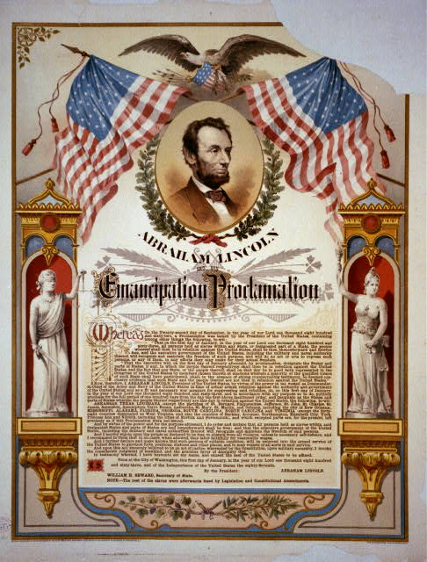
Emancipation Proclamation
January 1, 1863
President Abraham Lincoln issued the Emancipation Proclamation on January 1, 1863, during the midst of the Civil War. The proclamation declared "that all persons held as slaves" within the rebellious states "are, and hence forward shall be free.
Even though it states that African Americans are now free they still had many limitations. It applied only to states that had seceded from the Union. It also left out parts of the Confederacy that had already come under Northern control. Most importantly, the freedom it promised depended upon Union military victory.
Although the Emancipation Proclamation did not end slavery in the nation, it did capture the hearts of millions of Americans and transformed the character of the war. After January 1, 1863, every advance of federal troops expanded the domain of freedom.The Proclamation announced the acceptance of black men into military. By the end of the war, almost 200,000 black soldiers and sailors had fought for the Union and freedom.

Slide 14
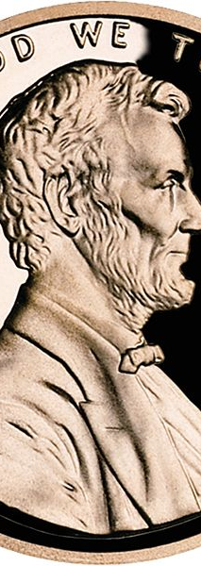
The Fourteenth Amendment
The Fourteenth Amendment of the Constitution was passed by both houses on 8th June and the 13th June, 1866. The amendment was designed to grant citizenship to and protect the rights of recently freed slaves. It did this by prohibiting states from denying the privileges of citizens of the United States, denying to any person within their jurisdiction the equal protection of the laws, or depriving any person of his life,liberty, or property without due process of law.

Slide 15
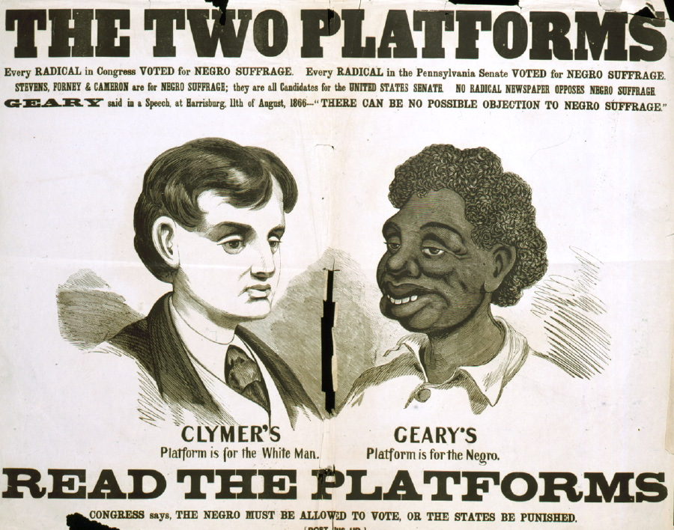
The fifteenth Amendment
This amendment which is often forgot about when speaking of the rights of African Americans, this small step to equal rights among African Americans gave them the right to Vote.

Slide 16
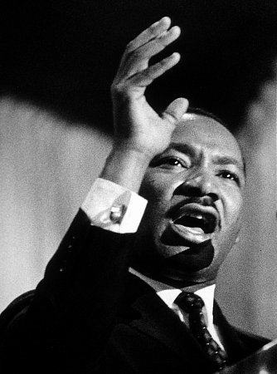
“I have a dream..”
Martin Luther King Jr.
Laws were passed to keep whites and blacks apart. In 1896, the Supreme Court decided that the "separate but equal” amenities legalized in the South did not violate the 14th Amendment.
After World War II, many more people felt that new laws were needed. In 1954, the Supreme Court ruled that blacks and whites could go to the same schools, saying that "separate but equal" schools were essentially unequal.
Between 1955 and 1968, Martin Luther King, Jr. helped change America. He brought to the world's attention how unfairly blacks were treated.
He had the help of millions of Americans, but his strong leadership and power of speech gave people the faith and courage to keep working peacefully even when others did not. This led to new laws that ended the injustices of separating whites from blacks.

Slide 17
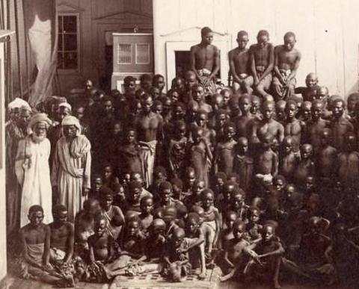
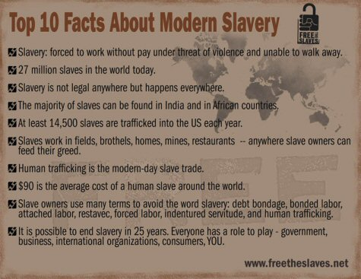
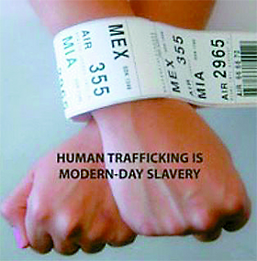
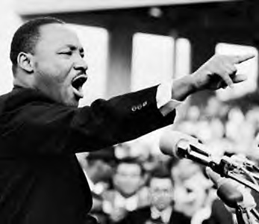
10 Facts about Slavery Today

Slide 18

Bibliography:
http://innercity.org/holt/slavechron.html
http://www.digitalhistory.uh.edu/modules/slavery/index.cfm
http://nobelprize.org/nobel_prizes/peace/laureates/1964/king-bio.html
http://www.utne.com/2008-07-01/Politics/More-Slave-Stories.aspx
http://www.liverpoolmuseums.org.uk/nof/slavery/
http://www.u-s-history.com/pages/h415.htm
http://www.14thamendment.us/
http://www.ourdocuments.gov/doc.php?flash=old&doc=43
http://ipoaa.com/black_codes_louisians_miss_ohio.htm
http://www.pbs.org/wgbh/aia/part4/4h1549.html
http://www.loc.gov/exhibits/african/afam005.html

