Slide 1
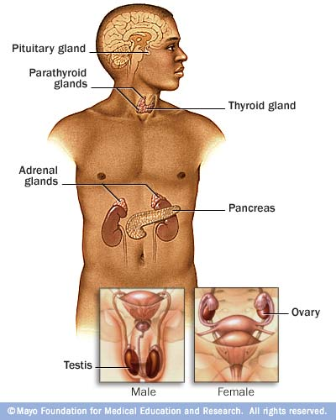
The Endocrine System
Danny Graham
Dierdre Mosbah
Elena Iannece
Marianna Catege

Slide 2
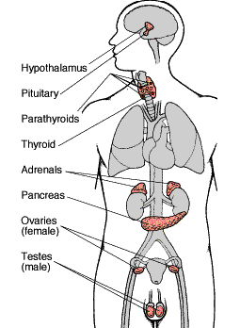
Overview
The endocrine system is a system of information signaling.
Its main objective is to release hormones into the bloodstream to maintain the balance of the body.

Slide 3
What is a Hormone?
A hormone is a chemical produced and secreted by endocrine glands. It travels through the bloodstream to control and regulate the activity of a group of cells, or organ.

Slide 4
Basic Functions of a Hormone
promote and enable mental, physical, and sexual development.
promote and enable the adjustment of performance levels of organs and organ systems.
keep some physiological parameters constant (Ex. blood glucose level).

Slide 5
How do Hormones Work?
After secretion, hormones flow through the blood, passing over millions of cells. They have specificity to certain cells so as to only affect certain cells.
The specificity of a hormone is determined by its chemical structure. It enters specific signal receptor proteins, either on the plasma membrane or in the cell nucleus.
This causes a signal transduction pathway to occur which results in a response by the cell.

Slide 6
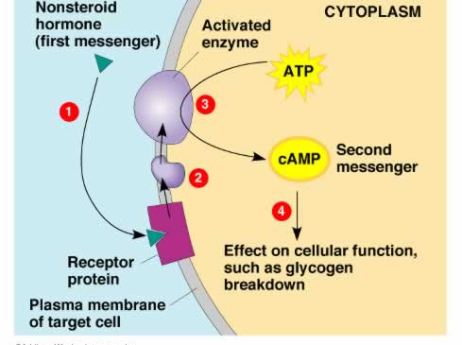
How a hormone works
In this example, a hormone enters its specific receptor protein located on the plasma membrane of the target cell. This causes a signal transduction pathway which leads to the production of cAMP for cellular functions.

Slide 7
What Produces a Hormone?
Glands are organs that synthesize a substance for secretion.
There are two kinds of glands in the animal body.
endocrine glands
exocrine glands

Slide 8
Endocrine vs. Exocrine Glands
Endocrine Glands
Secrete hormones only.
Do not have ducts for the release of products.
Hormones move to target cells through nearby capillaries.
Part of the endocrine system.
Exocrine Glands
Secrete sweat, oil, wax, enzymes, etc.
Have ducts that products are released into.
Products move through ducts to the surface.
Not part of the endocrine system.

Slide 9
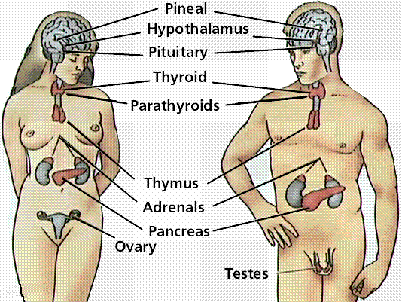
Endocrine Glands in the Human
pituitary gland
hypothalamus
thymus
pineal gland
testes/ovaries
thyroid
adrenal glands
parathyroid
pancreas

Slide 10
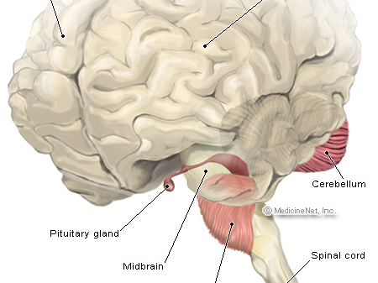
Pituitary Gland
The pituitary gland is a tiny organ, the size of a pea, found at the base of the brain. As the master gland of the body, it produces and secretes many hormones that travel through the body, directing certain processes and stimulating other glands to produce certain hormones.

Slide 11
Names of Hormones Secreted by the Pituitary Gland | Hormone Usage
Prolactin | * stimulates milk production from the breasts after childbirth to enable nursing * affects sex hormone levels from ovaries in women and from testes in men
Growth Hormone (GH) | * Stimulates growth in childhood and is important for maintaining a healthy body composition and well-being in adults * in adults it is important for maintaining muscle mass as well as bone mass
Adenocorticotropin (ACTH) | * Stimulates the production of cortisol by the adrenal glands *Cortisol, a "stress hormone" is vital to our survival. It helps to maintain blood pressure and blood glucose levels.
Thyroid Stimulating Hormone (TSH) | *Stimulates the thyroid gland, which regulates the body's metabolism, energy, growth, and nervous system activity; vital to our survival.
Antidiuretic Hormone (ADH) | * Also called vasopressin, regulates water balance. If this hormone is not released properly, it can lead to too little hormone (called diabetes insipidus), or too much hormone (called syndrome of inappropriate ADH).
Luteinizing Hormone (LH) | * Regulates testosterone in men and estrogen in women
Follicle Stimulating Hormone (FSH) | *Promotes sperm production in men and stimulates the ovaries to enable ovulation in women

Slide 12
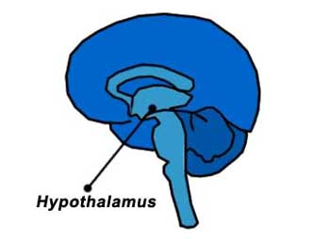
Hypothalamus
* The hypothalamus is part of the brain that is situated above the pituitary gland. It releases hormones that start and stop the release of pituitary hormones.
Controls hormone production in the pituitary gland through several releasing hormones.
The Gonadotropin-releasing hormone (GnRH) tells the pituitary gland to make luteinizing hormone (LH) and follicle stimulating hormone (FSH), which are important for normal puberty.

Slide 13
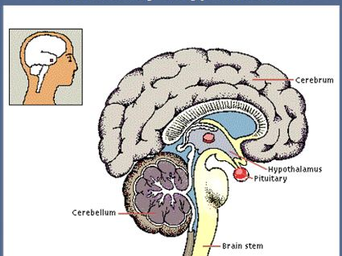
A View into the Hypothalamus
This picture depicts the hypothalamus situated next to the pituitary gland, which allows it to link the nervous system to the endocrine system.

Slide 14
The hypothalamus also regulates homeostasis. Homeostasis is the maintenance of a stable internal environment of a system.
It contains regulatory areas for the following:
Hunger
Thirst
Body Temperature
Water Balance
Blood Pressure

Slide 15
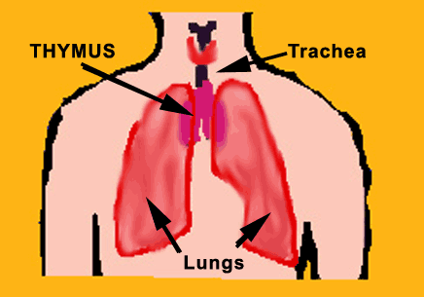
THYMUS
The thymus is a gland needed early in life for normal immune function.

Slide 16
What TO Know:
The thymus is very large just after a child is born and weighs its greatest when a child reaches puberty. Once puberty is reached, the tissue is replaced by fat.
The thymus gland secretes hormones called humoral factor which allow the development of the lymphoid system, which is a system throughout the body that helps it to reach a mature immune response in cells. This allows protection from invading bodies such as bacteria.

Slide 17
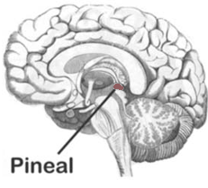
The Pineal Gland
This gland is small and weighs a little more than 0.1 gram. In humans, it is about 1 cm in length. It lies between the two cerebral hemispheres of the brain, above the third ventricle of the spinal column. It has a large supply of adrenergic nerve fibers which influence its secretions. On a microscopic level, the gland is composed of pinealocytes (rather typical endocrine cells except for extensions that associate with those of adjacent cells) and glial cells.

Slide 18
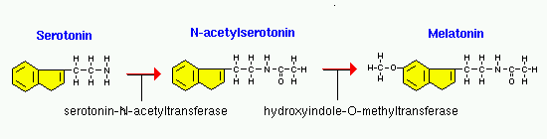
Pineal Gland Functions
The only hormone the pineal gland secretes is melatonin, an amino acid. Within the pineal gland, the hormone serotonin is first acetylated and then methylated to yield melatonin.
Melatonin essentially communicates information about environmental lighting to different parts of the body. It has the ability to entrain biological rhythms. It also has important effects on reproductive functions of many animals. The pineal gland is sometimes called the “third eye” because of this light-transducing ability.
Melatonin is stimulated by darkness and is suppressed by light. It maintains the body's circadian rhythm, the internal 24-hour “clock” that plays a crucial role to when we fall asleep and when we wake up. In darkness, melatonin production increases; in light, the melatonin production decreases. Exposure to bright lights in the evening or little light during the day can disrupt the body’s normal melatonin cycles. For example, jet lag, shifted work cycles, and poor vision can disturb melatonin cycles. The fact that melatonin production is stimulated by darkness is the reason we want sleep at night instead of during the daytime.

Slide 19
Functions of Melatonin
Melatonin transduces signals from the nervous system (light exposure to the retina) into a hormonal signal.
The target cells of melatonin are in a pair of brain structures called the suprachiasmatic nuclei (SCN), which function as a biological clock. Melatonin decreases the activity of neurons in the SCN, which may be related to its role in influencing the circadian rhythm.
This hormone also helps control the timing and release of female reproductive hormones. Melatonin helps determine when a woman starts to menstruate, the frequency and duration of the menstrual cycles, and when a woman begins menopause.
Some hypotheses pertaining to melatonin suggest that melatonin levels may be related to aging. For example, young children have the highest levels of nighttime melatonin above all age levels. Some researchers believe these levels drop as we age. Other hypotheses suggest that the lower levels of melatonin may explain why some older adults have sleep problems and tend to go to bed earlier and wake up earlier than when they were younger. These are just theories, however, and are being tested with newer research.
Melatonin also has strong antioxidant effects. Some evidence suggests that it can even help strengthen the immune system.

Slide 20
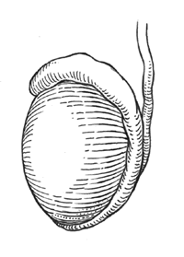
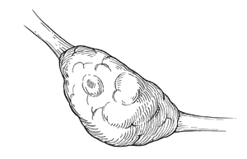
The gonads
Testes Ovaries

Slide 21
The Testes
The testes are two grape-sized organs that maintain the health of the male reproductive system.
They are two egg shaped organs that hang behind the penis in a pouch of skin outside the male’s body called the scrotum. Although the location of the testes makes them subject to injury, they must be outside the body because they need a cooler environment for healthy sperm production.
The testes secrete the hormone testosterone which is vital to the development of male characteristics and sperm production.
Testosterone is considered the primary androgen, or substance that stimulates and maintains masculine development.
During puberty, testosterone is associated in many of the processes that transition a boy into manhood such as healthy development of the sex organs, growth of facial and body hair, lowering of the voice, increase in height, increase in muscle mass, and growth of the Adam’s apple.
Testosterone is also important for other functions such as maintaing libido, sperm production, maintaining muscle strength and mass, and promoting healthy bone density.

Slide 22
Other Glands Also Affect Testosterone Production…
The amount of testosterone produced and secreted by the testes is controlled by the hypothalamus and the pituitary gland.
The hypothalamus sends a signal to the pituitary gland to release gonadtrophic substances (follicle stimulating hormone and luteinizing hormone).
Luteinizing hormone, or LH, stimulates testosterone production.
In the case that there is too much testosterone production, the hypothalamus sends a signal to the pituitary gland to make less LH.

Slide 23
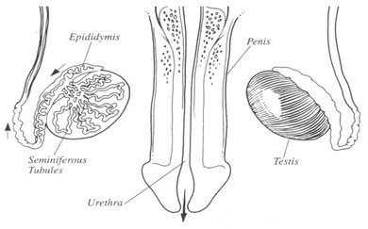
Anatomy of the Testes
The testes consist of highly coiled tubes (the seminiferous tubules) surrounded by several layers of connective tissue.
The seminiferous tubules are the sites where sperm form.
Leydig cells are scattered between the seminiferous tubules and produce testosterone and other androgens.
The testes develop high in the abdominal cavity and descend into the scrotum before birth.
The sperm produced in the seminiferous fibers are then passed into the epididymis.

Slide 24
The Ovaries
The ovaries are located in the abdominal cavity, on either side, and attached to the uterus.
The ovaries are about 4 cm. in length, 2 cm. in width, and about 8 mm. in thickness. They weigh about 2- 3.5 gm.
The ovaries are enclosed in a tough protective cover and contains many follicles.
A follicle consists of an egg cell surrounded by one or more layers of follicle cells, which protect and nourish the developing egg cell.
The cells of the follicles produce estrogens, the main female sex hormones.
The process of ovulation is when the egg cell is expelled from the follicle. The remaining follicular tissue grows within the ovary and forms a solid mass known as the corpus luteum.
The corpus luteum secretes more estrogens and progesterone, the hormone that helps maintain the uterine lining during pregnancy.

Slide 25
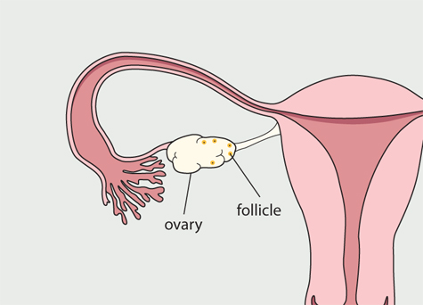
Hormones Secreted by the Ovaries
Estrogens maintain the female reproductive system and are responsible for the development of female secondary sex characteristics.
Among estrogens, the most important is estradiol.
Progestins, which include progesterone, are mostly involved in preparing and maintaining the uterus.
Estrogen synthesis is controlled by gonadotropins (FSH and LH) from the pituitary gland.

Slide 26
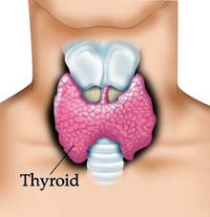
The Thyroid

Slide 27
The thyroid consists of two lobes located on the ventral surface of the trachea.
The thyroid gland produces two hormones that are very similar and both derive from the amino acid tyrosine: triidothyronine (T3), which consists of three iodine atoms, and tetraiodothyronine, or thyroxine (T4), which has four iodine atoms.
Both hormones are bound by the same receptor protein located in the cell nucleus, but the receptor has a greater affinity for T3 than T4. Therefore, mostly T3 brings about responses in target cells.
The hypothalamus and the pituitary gland control the secretion of thyroid hormones.
The thyroid plays an important role in vertebrate development and maturation, maintains normal blood pressure, heart rate, muscle tone, digestion, and reproductive functions.
Throughout the entire body, T3 and T4 generally increase the rate of oxygen consumption and cellular metabolism.
Too much or too little of these hormones can result in serious metabolic disorders such as hypothyroidism or hyperthyroidism.
Iodine is needed for the thyroid gland to synthesize adequate amounts of T3 and T4.

Slide 28
A Continuation of the Thyroid
The thyroid also contains endocrine cells that produce calcitonin, a hormone that acts in conjunction with parathyroid hormone in maintaining calcium homeostasis.
Homeostatic control of the blood calcium is necessary because calcium ions are essential to the normal functioning of all cells.
If blood calcium ion level falls below a certain point, the parathyroid hormone (PTH) is released. PTH is produced by four structures called the parathyroid glands embedded in the surface of the thyroid.
PTH raises the level of blood calcium ions. In bone, PTH induces osteoclast cells to decompose the mineralized matrix of bone and release calcium ions into the blood. In kidneys, PTH stimulates the reabsorption of calcium ions.
A increase in calcium ions above a certain point promotes calcitonin release from the thyroid gland. This hormone exerts effects on bone and kidneys opposite to those of PTH and lowers the calcium ion level.
Calcitonin and PTH together balance each other out and regulate and maintain homeostasis.

Slide 29
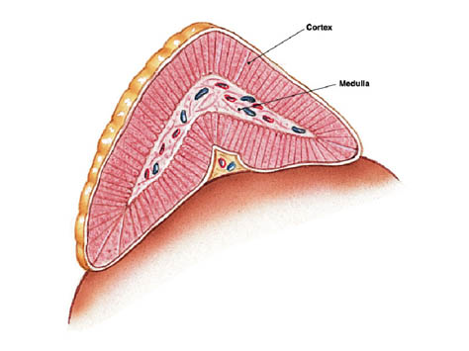
Adrenal Glands

Slide 30
The two adrenal glands are located immediately anterior to the kidneys, beneath the peritoneum.
There are two parts in the gland that have different embryological origins and are functionally different endocrine organs: The Medulla and the Cortex.
The hormones secreted from the Medulla have the same effect on the organs as the sympathetic nervous system. The most common stimuli for the secretion of epinephrine and norepinephrine are exercise, hypoglycemia, hemorrhage and stress.
The Cortex synthesizes and secretes three classes of hormones: glucocorticoids, mineralocorticoids and androgens
.Glucocorticoids affect metabolism and help raise the level of blood glucose. In addition, they are widely used in therapy since they have anti-inflammatory and immunosuppressive properties.
Mineralocorticoids affect mineral metabolism.
Aldosterone is a steroid which targets the distal tubule of the kidney and stimulates re-uptake of sodium and potassium.
Androgens such as testosterone are secreted by the adrenal cortex.

Slide 31
A Continued Look at the Adrenal Glands
Excessive production of adrenal androgens can cause premature puberty in young boys and masculine pattern of body hair in females.
Cortisol and other glucocorticoids are released in response to adrenocorticotropic hormone secreted from the anterior pituitary which, in turn, is controlled and regulated by a hypothalamic peptide corticotrophin-releasing hormone.
The adrenal cortex produces other hormones necessary for fluid and electrolyte (salt) balance in the body such as cortisone and aldosterone.
The adrenal cortex also makes sex hormones but this only becomes important if overproduction is present.
The adrenal glands are orange-colored endocrine glands
which are located on the top of both kidneys.

Slide 32
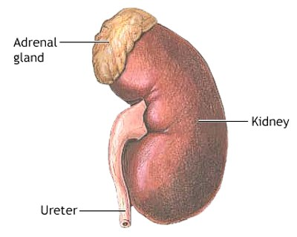
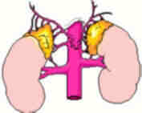
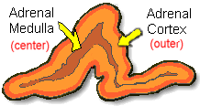
Pictures of the Adrenal Glands

Slide 33
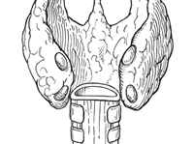
The Parathyroid Glands
*Note: The parathyroid glands are the four small oval shapes located on the thyroid.

Slide 34
Introduction to the Parathyoid Glands
Parathyroid glands are small glands located in the neck
behind the thyroid.
There are four parathyroid glands which are normally the size and shape of a grain of rice. Occasionally they can be as large as a pea and still be normal.
Normal parathyroid glands are the color of spicy yellow mustard. The light blue tube running up the center of the picture is the trachea (wind pipe).
The voice box is the pink structure at the top of the picture sitting on top of the trachea.
The carotid arteries are shown on both sides of the thyroid running from the heart up to the brain.

Slide 35
Function of the Parathyroid
The sole purpose of the parathyroid glands is to control calcium within the blood
In doing so, parathyroids also control how much calcium is in the bones, and therefore, how strong and dense the bones are.
Although the parathyroid glands are located next to the thyroid gland, they have no related function.
The thyroid gland regulates the body’s metabolism and has no effect on calcium levels while parathyroid glands regulate calcium levels and have no effect on metabolism.
Calcium is the element that allows the normal conduction of electrical currents along nerves--its how our nervous system works and how one nerve 'talks' to the next. Our entire brain works by fluxes of calcium into and out of the nerve cells. Calcium is also the primary element which causes muscles to contract.
Knowing these two major functions of calcium helps explain why people can get a tingling sensation in their fingers or cramps in the muscles of their hands when calcium levels drop below normal. A sudden drop in the calcium level can cause patients to feel "foggy", "weird" or "confused like my brain isn't working correctly".
The brain DEMANDS a normal steady-state calcium level, so any change in the amount of calcium can cause the brain to feel un-loved and the patient to feel bad.
Likewise, too much parathyroid hormone causes too high a calcium level--and this can make a person feel run down, cause them to sleep poorly, make them more irritable than usual, and even cause a decrease in memory.
In fact, the most common symptoms for patients with parathyroid disease are related to the brain, and include depression and lack of energy

Slide 36
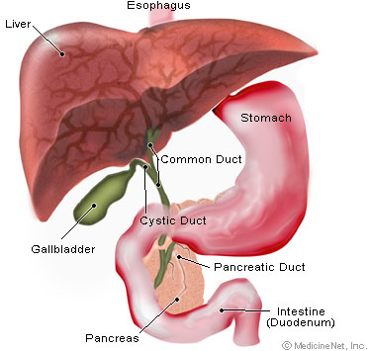
The Pancreas is…
A fish-shaped spongy grayish-pink organ about 6 inches (15 cm) long that stretches across the back of the abdomen, behindthe
stomach. The head of the pancreas is on the right side of the abdomen and is connected
to the duodenum (the first section of the Small intestine). The narrow end of the pancreas, called the tail, extends to the left side of the body.

Slide 37
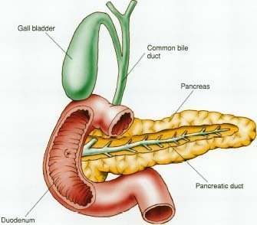
The Pancreas Continued
The pancreas makes pancreatic juices and hormones, including insulin.
The pancreatic juices are enzymes that help digest food in the small intestine.
Insulin controls the amount of sugar in the blood. As pancreatic juices are made, they flow into the main pancreatic duct.
This duct joins the common bile duct, which connects the pancreas to the liver and the gallbladder.
The common bile duct, which carries bile (a fluid that helps digest fat), connects to the small intestine near the stomach.
The pancreas is thus a compound gland. It is "compound" in the sense that it is composed of both exocrine and endocrine tissues.

Slide 38
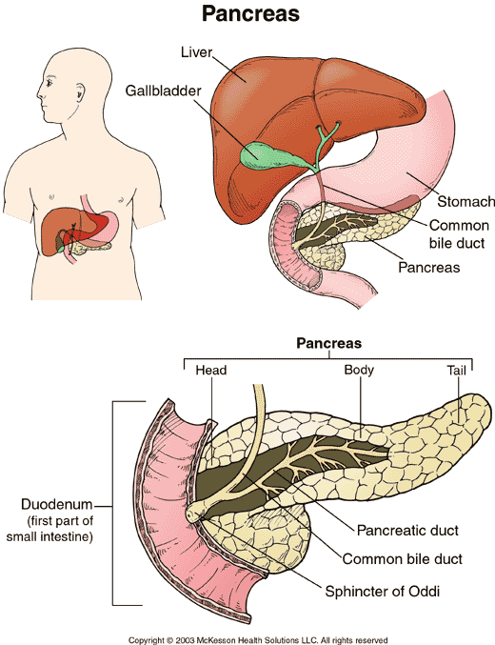
The exocrine function of the
pancreas involves the synthesis
and secretion of pancreatic
juices.
The endocrine function resides in the million or so cellular islands embedded between the exocrine units of the pancreas.
Beta cells of the islands secrete insulin, which helps control carbohydrate metabolism.
Alpha cells of the islets secrete glucagon that counters the action of insulin.

Slide 39
How to Study…
The Endocrine System:
http://www.hormone.org/Endo101/page2.cfm#CP_JUMP_832
http://kidshealth.org/parent/general/body_basics/endocrine.html
http://www.youtube.com/watch?v=HrMi4GikWwQ
The Pituitary Gland and the Hypothalamus:
http://www.youtube.com/watch?v=hLeBNyB1qKU&feature=related
The Thymus:
http://www.becomehealthynow.com/article/bodyimmune/961
The Pineal Gland:
http://www.becomehealthynow.com/article/bodyendocrine/737
The Gonads and the Pancreas:
http://www.youtube.com/watch?v=FEsTIOIufiQ
The Thyroid:
http://www.youtube.com/watch?v=7V0HB4cKIMw
The Adrenal Glands:
http://www.youtube.com/watch?v=06jbq3bxKE0
The Parathyroid Glands:
http://www.youtube.com/watch?v=Vn9crOgnGgs

Slide 40
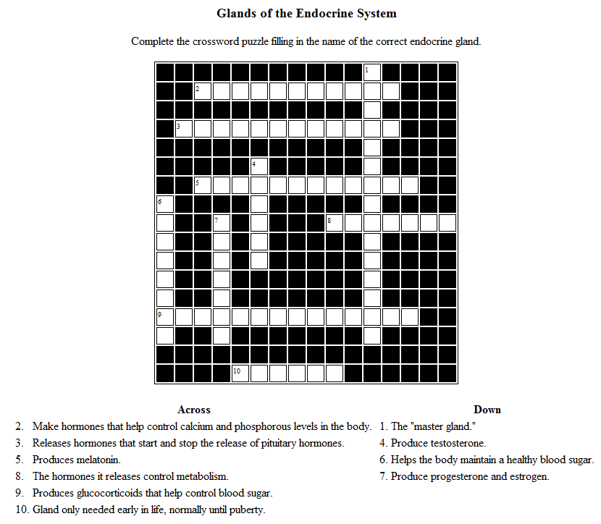
Review

Slide 41
MINI QUIZLET
Questions: | Your Answer:
1. What hormone produces milk in the mother’s breasts after childbirth? | 1. __________
2. The thymus is situated between your _______. | 2. __________
3. The hypothalamus links the nervous system to the ________ system. | 3. ___________
4. Stimulates growth in childhood and allows a healthy composition of the body. | 4. _________ ________
5. Type of gland found at the base of the brain. | 5. _________ _________

Slide 42
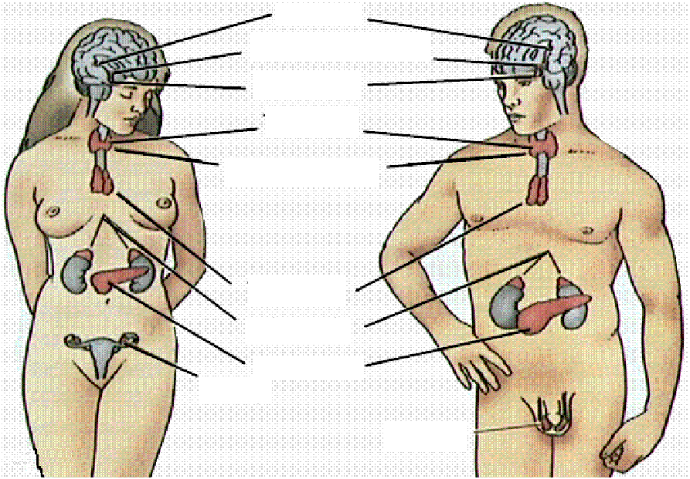
Label the Diagram with the Names of the Glands in the Endocrine System

Slide 43
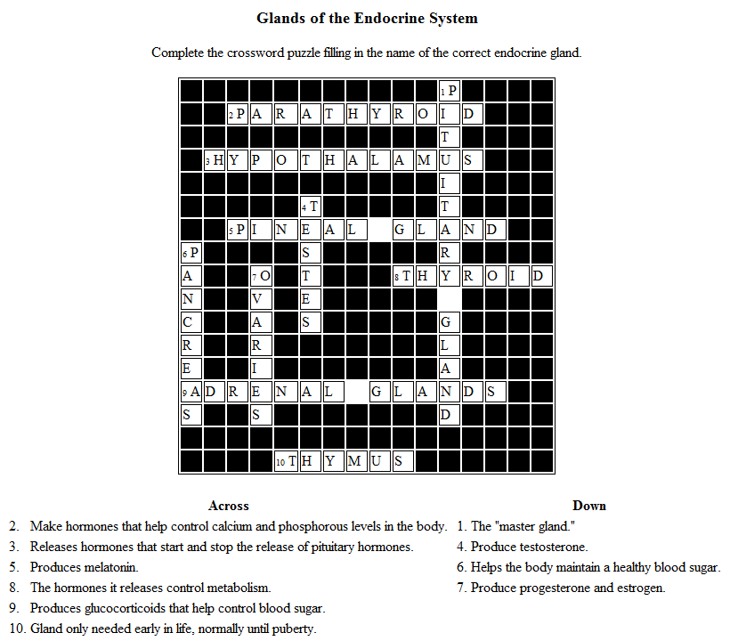
Review #1 Answers

Slide 44
Quizlet Answers
1. Proclactin
2.Lungs
3.Endocrine
4.Growth Hormone
5.Pituitary Gland

Slide 45
Answers to Labeling Activity

