Slide 1
FORMS OF PRAYERS
CATHOLIC PRAYERS

Slide 2
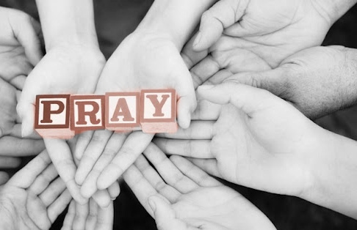
LET US PRAY!

Slide 3
HOW DO WE PRAY?
WE START WITH MEMORIZED PRAYER
AS YOU MATURE YOU FIND YOUR OWN WAY TO TALK TO GOD.
APPROACH PRAYER AS TALKING TO GOD.
BESIDES TALKING TO GOD WE NEED TO LISTEN TO GOD
PRAYER IS RAISING ONE’S MIND AND HEART TO GOD.

Slide 4
WHY DO WE PRAY?
TO BUILD OUR RELATIONSHIP WITH GOD
WE NEED TO BE HONEST ABOUT WHO WE ARE AS WE PRAY.
WE NEED TO ACKNOWELEDGE OUR WEAKNESSES AND OUR GIFTS
GOD IS BUILT IN US; WE ARE CALLED TO ENCOUTER HIM IN PRAYER.
GOD REVEALS HIMSELF TO US AND WE LEARN ABOUT OURSELVES

Slide 5
FORMS OF PRAYER
BLESSING & ADORATION
PETITION
INTERCESSION
THANKSGIVING
PRAISE

Slide 6
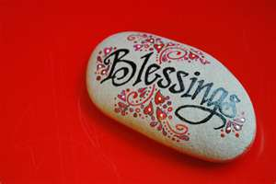
BLESSING
A PRAYER ASKING THAT GOD CARE FOR A PARTICULAR PERSON, PLACE, OR ACTIVITY.
WE SHOULD RESPOND WITH GRATITUDE & JOY!

Slide 7
BLESSING FORMAL PRAYER
Bless us, Oh Lord,
and these thy gifts which
we are about to receive from thy bounty,
through Christ, Our Lord.
Amen.

Slide 8

ADORATION
THE PRAYERFUL ACKNOWLEDGEMENT THAT GOD IS GOD AND CREATOR OF ALL THAT IS!

Slide 9
ADORATION PRAYER
The 'Glory Be' Prayer
Glory Be To The Father (Gloria Patri)
Glory be to the Father,
and to the Son,
and to the Holy Spirit.
As it was in the beginning,
is now,
and ever shall be,
world without end.
Amen.

Slide 10
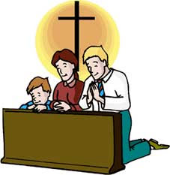
PETITION
A PRAYER FORM IN WHICH ONE ASKS GOD FOR HELP OR FORGIVENESS.

Slide 11
PETITION PRAYERS
For the people of this land, and of all nations, that we may be guided in the ways of justice and peace; that we would honor one another and serve the common good, we pray to the Lord:
Lord Hear Our Prayer
For our Advent celebration, that it would be a time of reflection on the coming of Christ, and that it would be filled with prayer, repentance, and love for God and neighbor, we pray to the Lord:
Lord Hear Our Prayer
For all the sick and suffering, the homeless, the unemployed, those suffering from addictions, and anyone in any kind of distress, we pray to the Lord:
Lord Hear Our Prayer
For those whose lives are closely linked with ours, that we may serve Christ in them, and love one another as Christ loves us, we pray to the Lord:
Lord Hear Our Prayer

Slide 12

INTERCESSION
A PRAYER ON BEHALF OF ANOTHER PERSON OR GROUP.

Slide 13
INTERCESSION PRAYERS
Father God, in whose love we live and move,
we pray for a world crying out to feel loved,
wanted, cherished and unique.
Heavenly Father, source of all love
We pray for a world torn apart by conflict and war.
A world that lives uneasily in a climate of fear
with no clear vision for future days
Heavenly Father, source of all hope
We pray for a world that thinks less of others than of self.
A world where division between nations, race, religion
neighbour and family leads to distrust
Heavenly Father, source of all peace

Slide 14

THANKSGIVING
A PRAYER OF GRATITUDE FOR THE GIFT OF LIFE AND THE GIFTS OF LIFE.

Slide 15
THANKSGIVING PRAYER
O God, of Whose mercies there is no number, and of Whose goodness the treasure is infinite; we render thanks to Your most gracious majesty for the gifts You have bestowed upon us, evermore beseeching Your clemency, that as You grant the petitions of them that ask You, You will never forsake them, but will prepare for the reward to come. Through Christ our Lord.
Amen.

Slide 16
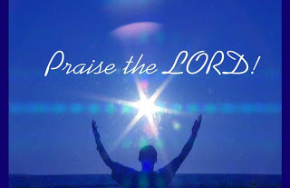
PRAISE
A PRAYER OF ACKNOWLEDGEMENT THAT GOD IS GOD, GIVING GLORY TO GOD NOT FOR WHAT HE DOES, BUT SIMPLY BECAUSE HE IS.

Slide 17
PRAYER OF PRAISE
Blessed be God. Blessed be His Holy Name. Blessed be Jesus Christ, true God and true Man. Blessed be the Name of Jesus. Blessed be His Most Sacred Heart. Blessed be His Most Precious Blood. Blessed be Jesus in the Most Holy Sacrament of the Altar. Blessed be the Holy Spirit, the Paraclete. Blessed be the great Mother of God, Mary most Holy. Blessed be her Holy and Immaculate Conception. Blessed be her Glorious Assumption. Blessed be the Name of Mary, Virgin and Mother. Blessed be St. Joseph, her most chaste spouse. Blessed be God in His Angels and in His Saints.

Slide 18
EXPRESSIONS OF PRAYER
VOCAL PRAYER
MEDITATION PRAYER
CONTEMPLATIVE PRAYER

Slide 19
VOCAL PRAYER
Vocal prayer is an essential element of the Christian life.
Vocal prayer is an external expression of words addressed to God. Verbal prayer can be formal and informal.
- Formal prayer (eg Our Father, Hail Mary, Creed, etc)
- Informal prayer where we pray simply using our own words

Slide 20
EXAMPLE OF VOCAL PRAYER
OUR FATHER:
Our Father, Who art in Heaven, hallowed be Thy name; Thy Kingdom come, Thy will be done on earth as it is in Heaven. Give us this day our daily bread; and forgive us our trespasses as we forgive those who trespass against us; and lead us not into temptation, but deliver us from evil. Amen.
HAIL MARY:
Hail Mary full of Grace, the Lord is with thee. Blessed are thou among women and blessed is the fruit of thy womb Jesus. Holy Mary, Mother of God, pray for us sinners now and at the hour of our death. Amen.
GLORY BE TO THE FATHER:
Glory be to the Father and to the Son and to the Holy Spirit.

Slide 21
MEDITATION PRAYER
Meditation is a quiet and reflective personal conversation with God. In this form of prayer we engage our thought, imagination, emotion, and desire. Often people meditate on Scripture texts and spiritual writings, songs, icons and so forth. Meditation requires attentiveness.

Slide 22
MEDITATIVE PRAYER
What you’ll need
You only need a few simple things to start a lifetime of rich Christian meditation:
A small amount of time
A quiet place
A Bible
Start by taking just 5 or 10 minutes, alone and in quiet. Early in the day is best, but if that’s not possible for you, find another time.
Give yourself a set time, and stick to it. Consistency is very important: don’t cut prayer short if you’re “dry” one day, and likewise don’t prolong it if you’re feeling wonderful.
You also need to find some written or visual material to use as the basis of your Christian meditation. The Gospels are the best choice. Pick one and read a part each day, or just use the daily Mass readings. You can read the daily Gospel passage in your Bible.
The daily readings are good because they’re brief. You’re reading for depth here, not length.
You can use many things as the source material for Christian meditation: Scripture, especially the Gospels, spiritual writings, liturgical texts, and even the “fingerprints of God” visible in the natural world itself.
Pick your reading beforehand, so you don’t waste your prayer time finding a suitable passage in the Bible.

Slide 23
CONTEMPLATIVE PRAYER
Contemplative prayer is silent presence with God, an awareness of God. In contemplative prayer the person enters into a silence and is attentive in the presence of God. It is a prayer of being with God. In the words of St Teresa, “Contemplative prayer in my opinion is nothing else than a close sharing between friends, it means taking time frequently to be alone with him who we know loves us.”

Slide 24
CONTEMPLATIVE PRAYER
Contemplative prayer is the ultimate meditation. This practice literally involves clearing the mind of all thoughts to rest in God’s presence. The word practice is used with meditation and with spiritual disciplines because they take practice! Contemplative practices are not something that you just do with ease. It can be very difficult to clear the mind from clutter.

Slide 25
CONTEMPLATIVE PRAYER/SACRED WORD
Contemplative prayer uses what is called the sacred word. The idea is that when thoughts start to come into your mind that you focus on the sacred word to bring you back to just resting in God. The word is not spoken. The word is in your mind. Examples of words are: Jesus, grace, peace, stillness, mercy.

Slide 26
CONTEMPLATIVE PRAYER
The ultimate goal is to empty one’s self and be in God’s presence. This does not involve listening to God. It is to just be. Answers are to be sought outside of contemplative prayer.

Slide 27
PRAYER: INFORMAL & FORMAL
Prayer can be formal or informal, verbal or nonverbal, active or contemplative. Prayer is communicating with God. Just as we talk and share with our best friends what is happening in our lives, so we talk and share with God. Just as we listen to our friends, so we listen to God.

