Slide 1
RECONSTRUCTION ERA 1865-1877

Slide 2
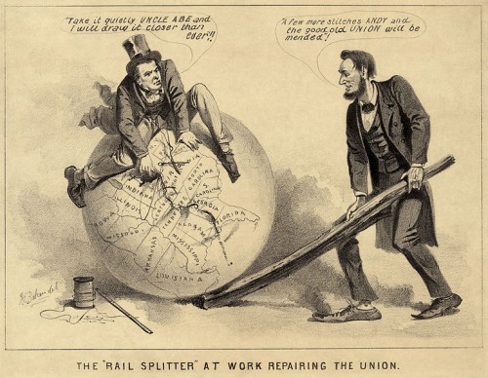
LINCOLN’S RECONSTRUCTION PLAN

Slide 3
LINCOLN’S PLAN
OFFERED A PARDON TO ANY CONFEDERATE WHO WOULD TAKE AN OATH OF ALLEGIANCE TO THE UNION AND ACCEPT FEDERAL POLICY ON SLAVERY
DENIED PARDONS TO ALL CONFEDERATE MILITARY AND GOVERNMENT OFFICIALS AND ANY SOUTHERNER WHO HAD KILLED AFRICAN AMERICAN WAR PRISONERS
ALLOWED EACH STATE TO HOLD A CONVENTION TO CREATE A NEW STATE CONSTITUTION ONLY AFTER 10% OF VOTERS IN THE STATE HAD SWORN ALLEGIANCE TO THE UNION
STATES COULD THEN HOLD ELECTIONS AND RESUME FULL PARTICIPATION IN THE UNION

Slide 4
JOHNSON’S RECONSTRUCTION PLAN
PARDONED SOUTHERNERS WHO SWORE ALLEGIANCE TO THE UNION
PERMITTED EACH STATE TO HOLD A CONSTITUTIONAL CONVENTION (WITHOUT LINCOLN’S 10% REQUIREMENT)
STATES WERE TO VOID SECESSION, ABOLISH SLAVERY, AND REPUDIATE THE CONFEDERATE DEBT
STATES COULD THEN HOLD ELECTIONS AND REJOIN THE UNION

Slide 5
BOTH LINCOLN’S AND JOHNSON’S PLANS WERE LENIANT.
JOHNSON’S PLAN OFFICIALLY DENIED PARDONS TO ALL CONFEDERATE LEADERS, IN REALITY JOHNSON OFTEN ISSUED PARDONS TO THOSE WHO ASKED HIM PERSONALLY.
JOHNSON PARDONED 13,000 SOUTHERNERS.
BY ABOLISHING SLAVERY EACH STATE RATIFIED THE 13TH AMENDMENT.

Slide 6
THE TASTE OF FREEDOM
FREEDOM OF MOVEMENT:
MANY SLAVES HAD WALKED AWAY FROM PLANTATIONS UPON HEARING THAT A NORTHERN ARMY WAS APPROACHING.
THIS ALLOWED TO GET AS CLOSE TO FREEDOM AS THEY COULD AND TO HUNT FOR MEMBERS OF THEIR FAMILY.

Slide 7
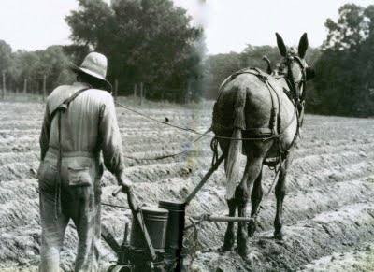
FREEDOM TO OWN LAND

Slide 8
FREED TO OWN LAND:
FREED PEOPLE URGED THE GOVERNMENT TO REDISTRIBUTE SOUTHERN LAND.
PROPOSALS TO GIVE FREEDMEN WHITE-OWNED LAND GOT LITTLE POLITICAL SUPPORT.
GENERAL SHERMAN HAD SET UP A LAND-DISTRIBUTION EXPERIMENT IN SOUTH CAROLINA:
DIVIDED LAND INTO 40 ACRE PLOTS AND GAVE THEM TO BLACK FAMILIES.
RUMORS SPREAD THAT THE GOV’T WAS GOING TO GIVE EVERY FREEDMAN 40 ACRES AND A MULE.

Slide 9
SHERMAN’S PLAN WAS SHORT-LIVED.
JOHNSON GAVE MUCH OF THE LAND BACK TO THE ORIGINAL OWNERS.
SOME INFORMAL PLANS DID EXIST:
AMOS MOREL (1871) A FREEDMAN, USED HIS WAGES TO BUY MORE THAN 400 ACRES AND THEN RESOLD IT TO OTHER FREEDMEN .

Slide 10
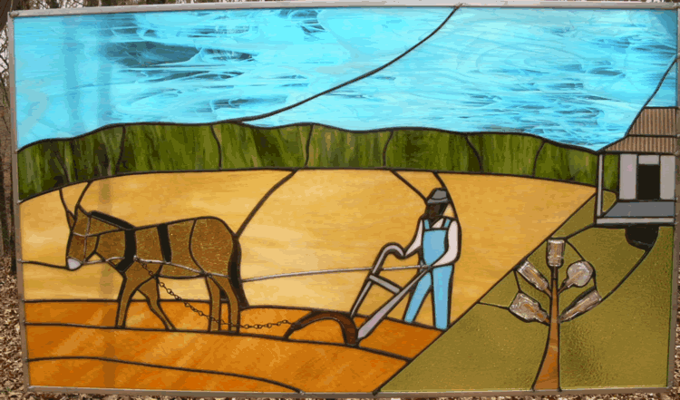
LARGE WINDOW TITLED “FORTY ACRES AND A MULE”

Slide 11
FREEDOM TO WORSHIP:
NEW BLACK ORGANIZATIONS FORMED IN THE SOUTH. THE MOST VISIBLE WERE CHURCHES.
FREEDOM TO LEARN:
IN 1860, ESTIMATES SAY THAT 90% OF BLACK ADULTS WERE ILLITERATE.
HELP CAME FROM SEVERAL DIRECTIONS.
WHITE TEACHERS, OFTEN YOUNG WOMEN, WENT SOUTH TO START SCHOOLS.
MANY FREEDMEN TAUGHT THEMSELVES AND ONE ANOTHER.
BETWEEN 1865-1870, 30,000 BLACK COLLEGES WERE FOUNDED

Slide 12
FREEDMEN’S BUREAU
CREATED BY CONGRESS IN 1865.
GOAL WAS TO HELP BLACK SOUTHERNERS ADJUST TO FREEDOM.
IT GAVE OUT :
FOOD
CLOTHING
MEDICAL SUPPLIES,
AND SCHOOLING(GREATEST ACCOMPLISHMENT)
LACKED STRONG SUPPORT IN CONGRESS AND WAS FILLED WITH GRAFT. DISMANTLED IN 1869.
SPENT 17MILLION

Slide 13
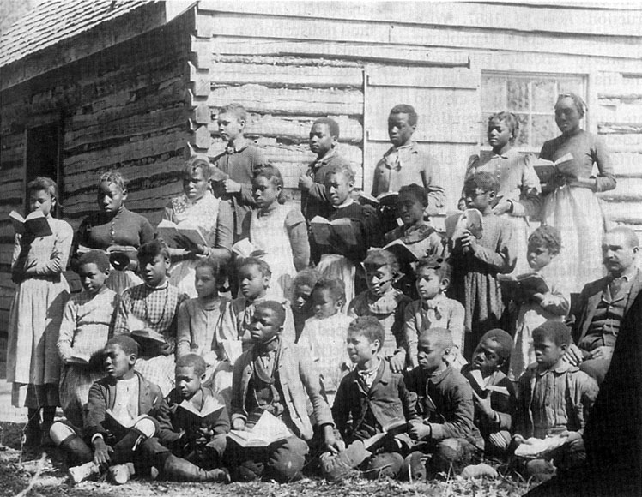
FREEDMAN SCHOOL

Slide 14
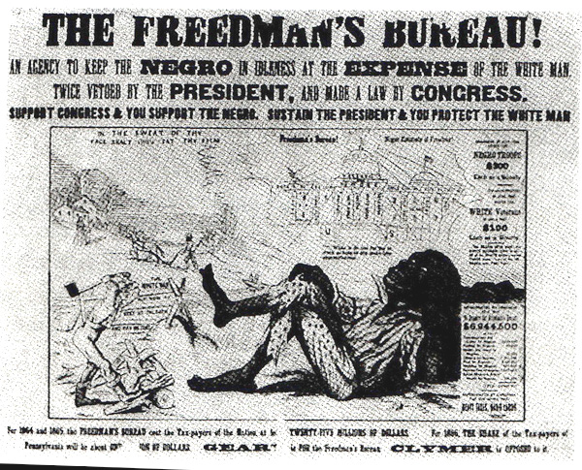
CRITICISM OF FREEDMEN’S BUREAU

Slide 15
BLACK CODES:
THE FIRST ORDER OF BUSINESS IN THE NEW WHITE-RUN GOVERNMENTS WAS TO ENACT BLACK CODES, LAWS THAT RESTRICTED FREEDMEN’S RIGHTS.
CURFEWS: BLACK PEOPLE COULD NOT GATHER AFTER SUNSET
VAGRANCY LAWS: FREEDMEN CONVICTED OF VAGRANCY COULD BE:
WHIPPED
FINED
OR SOLD FOR A YEAR’S LABOR

Slide 16
LABOR CONTRACTS: FREEDMEN HAD TO SIGN AN AGREEMENT IN JANUARY FOR A YEAR OF WORK.
IF THEY QUIT IN THE MIDDLE OF THE YEAR, THEY LOST ALL THE WAGES THEY HAD EARNED.
LAND RESTRICTIONS: FREED PEOPLE COULD RENT LAND OR HOMES IN ONLY RURAL AREAS. THIS RESTRICTION FORCED THEM TO LIVE ON PLANTATIONS.
FIREARMS: FREEDMEN COULD NOT OWN FIREARMS.
JURIES: FREEDMEN COULD NOT SERVE ON JURIES.
TRAVEL: FREEDMEN COULD NOT TRAVEL WITHOUT A PERMIT.

Slide 17
CONGRESSIONAL RECONSTRUCTION PLAN
LATE 1865 – RADICAL REPUBLICANS SWEEP AWAY JOHNSON’S PLAN.
GOALS OF CONGRESSIONAL PLAN:
ESTABLISH DEMOCRACY IN THE SOUTH
ENSURE VOTING RIGHTS FOR EVERYONE
CONFISCATE AND REDISTRIBUTE LAND
2 & 3 WERE NOT ACCOMPLISHED.

Slide 18
FINAL PLAN
MILITARY RECONSTRUCTION PLAN OF 1867
U.S. MILITARY CONTROL OVER FIVE DISTRICTS – CONTROL WAS TO LAST UNTIL NEW GOV’TS. CAN BE ESTABLISHED.
FORMER SLAVES GUARANTEED THE RIGHT TO VOTE IN STATE ELECTIONS.
HAD TO RATIFY 14TH AMENDMENT
RATIFY (EACH STATE) A CONGRESSIONALLY APPROVED STATE CONSTITUTION.

Slide 19
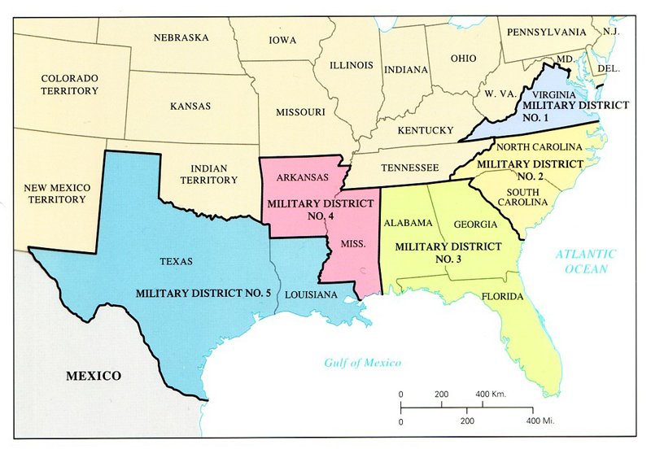
FIVE MILITARY DISTRICTS

Slide 20
IMPEACHMENT AND TRIAL OF ANDREW JOHNSON
THE CONTEST WAS A TEST OF WILLS BETWEEN THE PRESIDENT AND CONGRESSIONAL ADVERSARIES.
IT WAS ALSO A POWER STRUGGLE BETWEEN THE EXECUTIVE AND LEGISLATIVE BRANCHES.
CRISIS BEGAN IN 1868, WHEN JOHNSON FIRED SECRETARY OF WAR EDWIN STANTON, A LINCOLN APPOINTEE.
WAS IN DEFIANCE OF THE TENURE OF OFFICE ACT.

Slide 21
TENURE OF OFFICE ACT
CONGRESS PASSED THE TENURE OF OFFICE ACT IN
MARCH 1867.
LAW SAID THAT A PRESIDENT HAD TO SEEK CONGRESSIONAL APPOVAL TO REMOVE ANY APPOINTED OFFICIAL.
ACT WAS PASSED BECAUSE THEY KNEW JOHNSON WOULD BREAK IT AND THAT WOULD GIVE THEM THE POWER TO IMPEACH HIM.
ON FEBRUARY 24, 1868, HOUSE VOTED 126 TO 47 TO IMPEACH HIM.

Slide 22
SENATE TRIED PRESIDENT JOHNSON FOR “HIGH CRIMES AND MISDEMEANORS”
A 2/3 VOTE WAS NEEDED IN ORDER TO FIND JOHNSON GUILTY.
HE MISSED THE 2/3RDS VOTE BY ONE VOTE, THUS RETAINING HIS JOB.
THE CRISIS SETS THE PRECEDENT THAT ONLY THE MOST SERIOUS CRIMES, AND NOT MERELY A PARTISAN DISPUTE WITH CONGRESS, COULD REMOVE A PRESIDENT FROM OFFICE.
THE TENURE OF OFFICE ACT WAS REPEALED IN 1887 AND RULED UNCONSTITUTIONAL IN 1922.

Slide 23
ULYSSES S. GRANT ELECTED PRESIDENT IN 1868.
HE HAD BEEN THE HEAD OF THE UNION ARMY DURING THE CIVIL WAR.
UNDER GRANT CONGRESS AND THE PRESIDENT WERE ALLIES.
FIFTEENTH AMENDMENT:
RATIFIED IN FEBRUARY 1869.
“NO ONE CAN BE DENIED THE RIGHT TO VOTE . . .ON ACCOUNT OF RACE, COLOR, OR PREVIOUS CONDITION OF SERVITUDE.”
IN 1869 – TEXAS V WHITE COURT RULED A STATE COULD NOT SECEDE

Slide 24
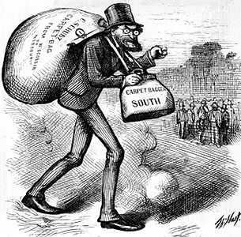
RECONSTRUCTION GOVENMENTS – SOUTHERN STATES
CONTROLLING POLITICAL GROUPS:
CARPETBAGGERS
WHITE NORTHERNERS WHO WENT SOUTH AFTER THE WAR
MIXED MOTIVES
HELP BLACKS ADJUST
FURTHER OWN FORTUNES
DOMINATE GOVERNMENT

Slide 25
SCALAWAGS
SOUTHERN WHITES
PRO-UNION DURING THE WAR
COOPERATED WITH THE CARPETBAGGERS
MANY WERE POOR AND RESENTED THE POWER OF THE FREEDMEN
BLACKS
MOST WERE ILLITERATE
INEXPERIENCED
NEVER CONTROLLED ANY SOUTHERN GOVERNMENTS.

Slide 26
CRITICISM OF RECONSTRUCTION GOVERNMENTS
GRAFT
CORRUPTION
WILD SPENDING
INCREASED PUBLIC DEBT
HEAVY TAXATION
DEFENSE
FRAMED LIBERAL STATE CONSTITUTIONS
B. GUARANTEED
CIVIL LIBERTIES
UNIVERSAL MALE SUFFRAGE
REAPPORTIONED LEGISLATIVE DISTRICTS FAIRLY

Slide 27
DEFENSE, CON’T.
BEGAN TO REBUILD THE SOUTH
INTRODUCED FREE, CUMPOLSORY PUBLIC EDUCATION IN THE SOUTH

Slide 28
RECONSTRUCTION GOV’TS IN THE SOUTH, CON’T.
THE POINT OF VIEW OF NORTHERN POLITICIANS
REPUBLICAN VICTORIES - FREED BLACKS VOTED REPUBLICAN
EXTRAVAGANT USE OF PUBLIC FUNDS - WAS SUPPOSED TO BE USED FOR REBUILDING THE SOUTH BUT MUCH OF IT WENT INTO THE HANDS OF LEGISLATORS
THE POINT OF VIEW OF SOUTHERN BLACKS
ECONOMIC HOPES – BLACKS THOUGHT THEY WOULD GET 40 ACRES AND A MULE
POLITICAL HOPES – THOUGHT THE U.S. GOV’T WOULD PROTECT THEIR RIGHTS
ECONOMIC AND POLITICAL REALITY – NEITHER HAPPENED

Slide 29
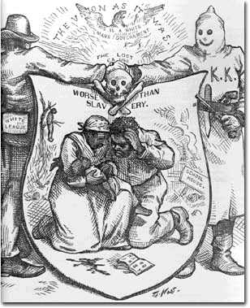
PARTICIPATION IN RECONSTRUCTION GOVERNMENTS – SOME BLACKS WERE ELECTED
AFRICAN AMERICAN IN CONGRESS – 14 WERE ELECTED TO CONGRESS
3. THE POINT OF VIEW OF SOUTHERN WHITES
THEY HATED “CARPETBAGGERS” AND “SCLAWAGS”
FORMATION OF THE KKK – TRIED TO INTIMIDATE BLACKS

Slide 30
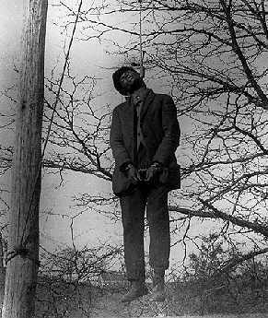
WHITES REGAIN CONTROL OF SOUTHERN GOVERNMENTS
KU KLUX KLAN
FOUNDED IN 1866
SECRET SOCIETY
OPERATED TO INTIMIDATE
ACTIONS:
THREATENED BLACKS
BURNED THEIR HOMES
FLOGGED THEM
LYNCHED THEM

Slide 31
INCREASED NUMBER OF WHITE SOUTHERN VOTERS
WANING NORTHERN INTEREST IN THE PROBLEMS OF THE BLACKS:
GREW WEARY OF RECONSTRUCTION
WANTED TO END SOCIAL AND POLITICAL TURMOIL
REFORMERS TURNED INTERESTS TO OTHER CAUSES
FELT SOUTHERNERS SHOULD WORK OUT THEIR OWN PROBLEMS
CORRUPTION – FELT RECONSTRUCTION GOVERNMENTS AND GRANT’S ADMINISTRATION REPRESENTED CORRUPTION
ECONOMIC DOWNTURN IN 1873

Slide 32
END OF RECONSTRUCTION – 1877
DYING INTEREST
ELECTION OF 1876 – HAYES ELECTED
COMPROMISE OF 1877 - NORTHERNERS AGREED TO REMOVE TROOPS FROM THE SOUTH, IF THE DEMOCRATS SUPPORT HAYES
SUPREME COURT LIMITS SCOPE OF AMENDMENTS
SLAUGHTERHOUSE CASES IN 1873
U.S. V CRUIKSHANK IN 1876
NARROWLY INTERPRETED THE 14TH AND 15TH AMENDMENTS AND PLACED CONTROL OF CIVIL RIGHTS IN THE HANDS OF THE STATES

Slide 33
SUCCESSES OF RECONSTRUCTION
UNION IS RESTORED
SOUTH’S ECONOMY GROWS AND NEW WEALTH IS CREATED IN THE NORTH
14TH AND 15TH AMENDMENTS - CITIZENSHIP, EQUAL PROTECTION UNDER THE LAW, SUFFRAGE
FREEDMENS BUREAU – GIVES AID TO AFRICAN AMERICANS
ESPECIALLY IN EDUCATION
5. SOUTHERN STATES ADOPT A POLICY OF MANDATORY EDUCATION

Slide 34
FAILURES OF RECONSTRUCTION
LEGACY OF HATRED ON PART OF SOME SOUTHERNERS
SOUTH SLOW TO INDUSTRIALIZE
AFRICAN AMERICANS DENIED THE RIGHT TO VOTE AFTER FEDERAL TROOPS LEAVE THE SOUTH
MANY BLACK AND WHITE SOUTHERNERS REMAIN CAUGHT IN A CYCLE OF POVERTY
RACIST ATTITUDE TOWARD AFRICAN AMERICANS CONTINUE, IN BOTH THE SOUTH AND THE NORTH

