Slide 1
Global Change
April 20, 2015
Mr. Alvarez

Slide 2
Global Change
Global change- any chemical, biological or physical property change of the planet. Examples include cold temperatures causing ice ages.
Global climate change- changes in the climate of the Earth.
Global warming- one aspect of climate change, the warming of the oceans, land masses and atmosphere of the Earth.

Slide 3
The Greenhouse Effect
When radiation from the sun hits the atmosphere, 1/3 is reflected back.
Some of the UV radiation is absorbed by the ozone layer and strikes the Earth where it is converted into low-energy infrared radiation.
The infrared radiation then goes back toward the atmosphere where it is absorbed by greenhouse gasses that radiate most of it back to the Earth.

Slide 4
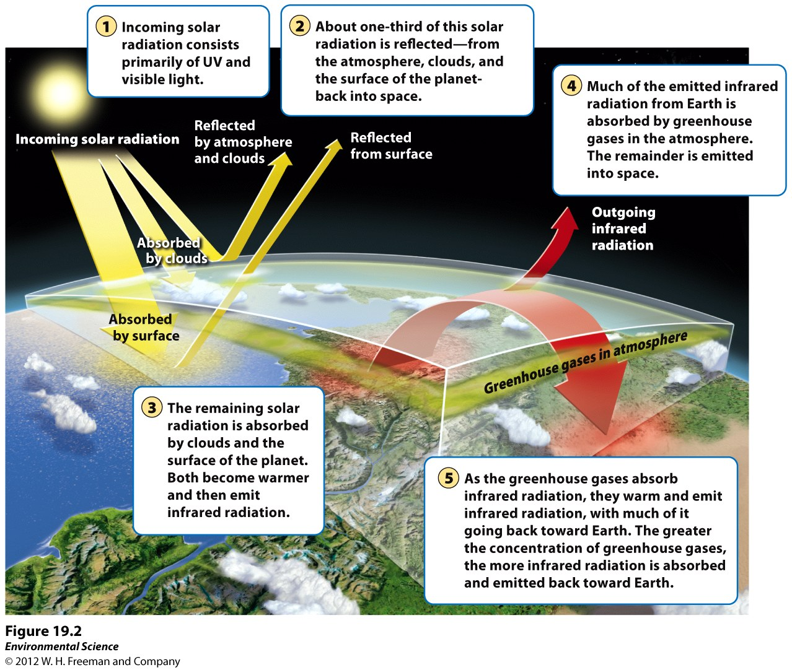

Slide 5
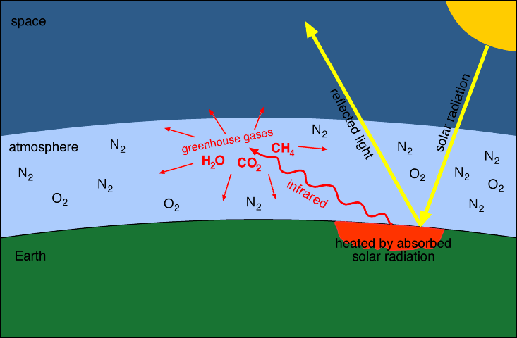
The Greenhouse Effect is important for life on Earth

Slide 6
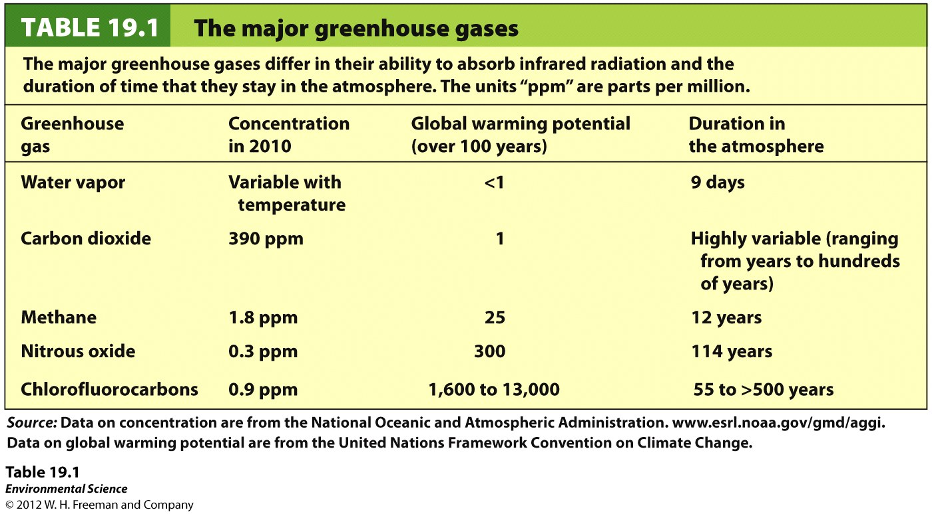

Slide 7
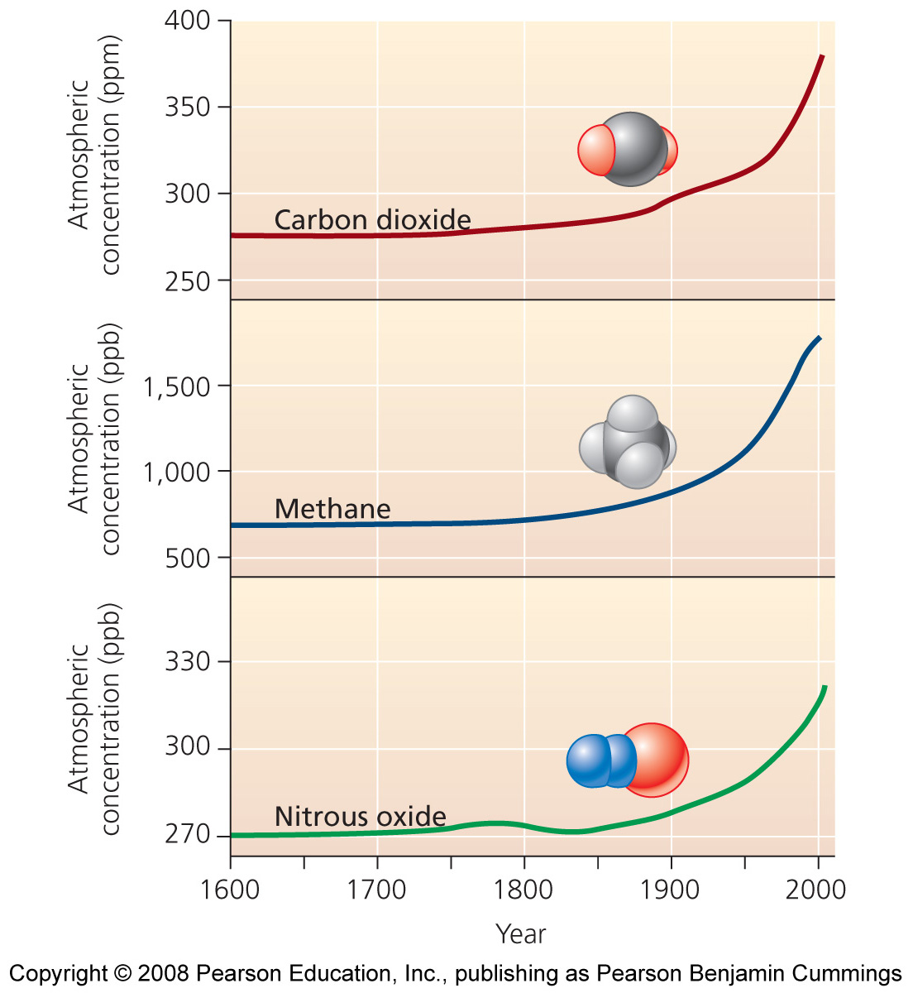
18_02.JPG
Notes:
Figure 18-02
Title:
Increasing concentrations of greenhouse gases.
Caption:
Since the start of the industrial revolution, global atmospheric concentrations of (a) carbon dioxide, (b) methane, and (c) nitrous oxide have increased markedly. Data from Intergovernmental Panel on Climate Change. 2007. Fourth assessment report.
Notes:
Keywords:
atmosphere, global warming, climates, greenhouse gases, carbon dioxide, methane, nitrous oxide

Slide 8
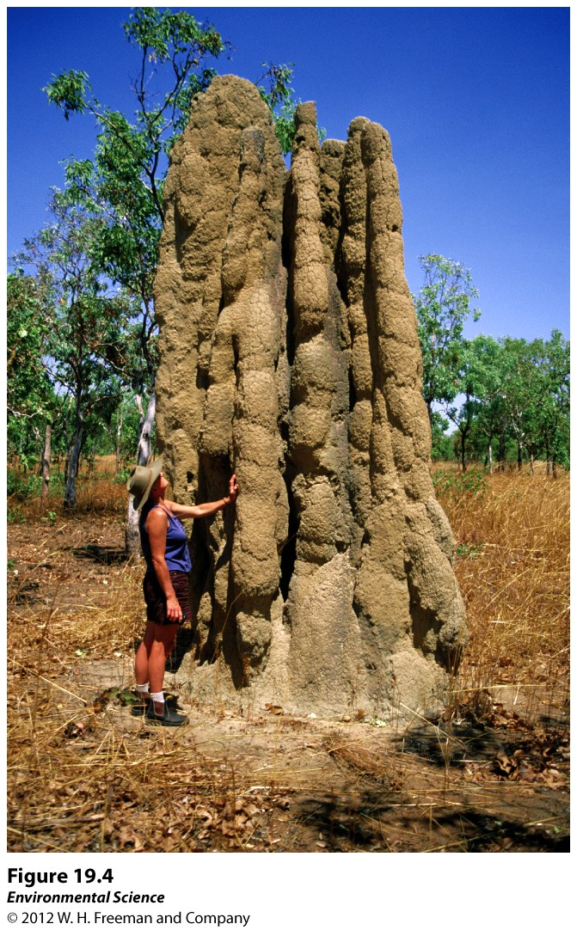
Methane (Natural Sources)
Anaerobic decomposition (anoxic conditions)
Wetlands
Termites
Livestock

Slide 9
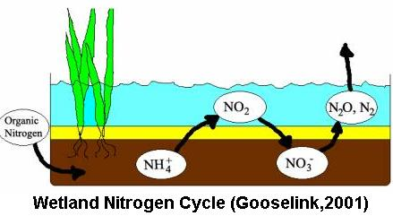
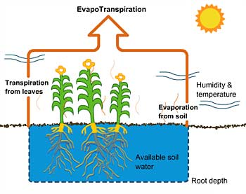
N₂O and H₂O
Denitrification
Evapotranspiration

Slide 10
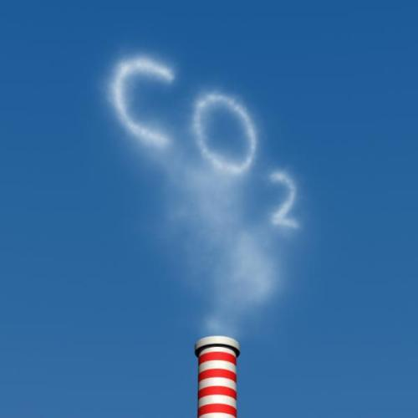
Anthropogenic Sources of GG’s
Burning of Fossil Fuels
Agricultural Practices
Deforestation
Landfills
Industrial Production (CFC’s & HCFC’s)

Slide 11
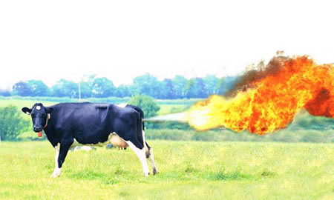
Agricultural Practices
Rice Farming (CH₄)
Fertilzers: excess nitrates →denitrified (N₂O)
Livestock (CH₄)
Manure Lagoons (CH₄)

Slide 12
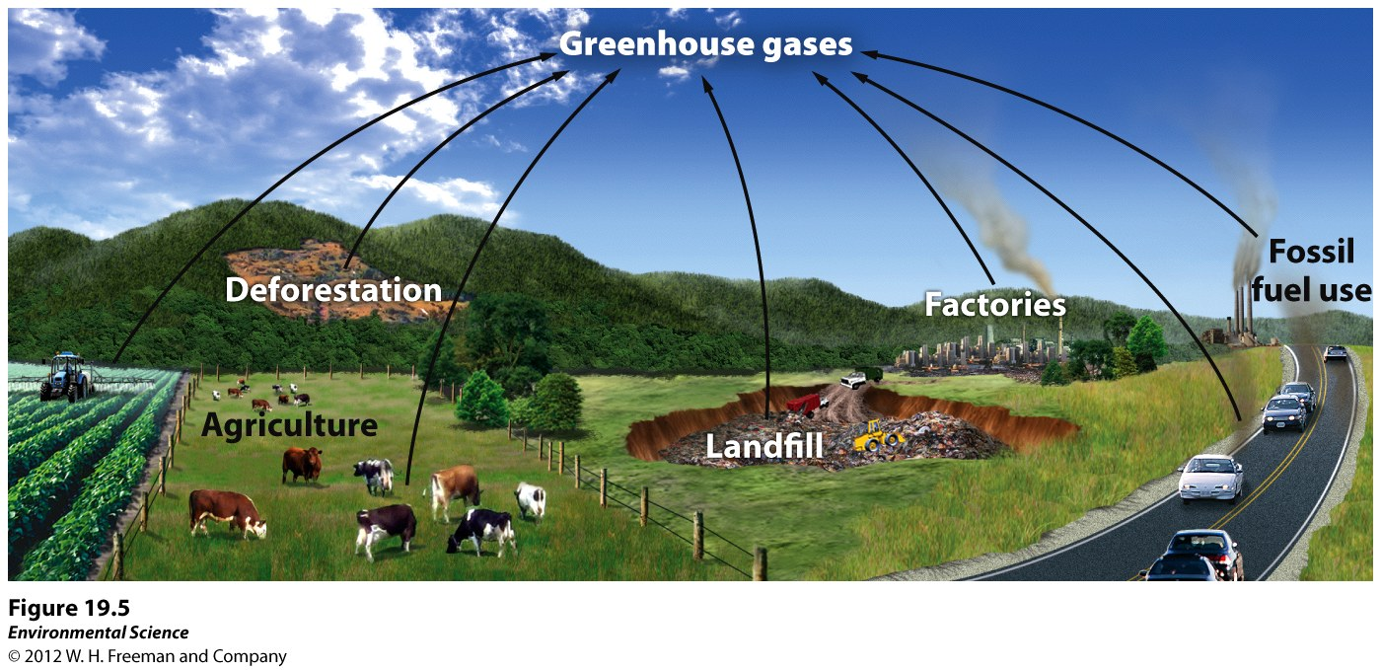

Slide 13
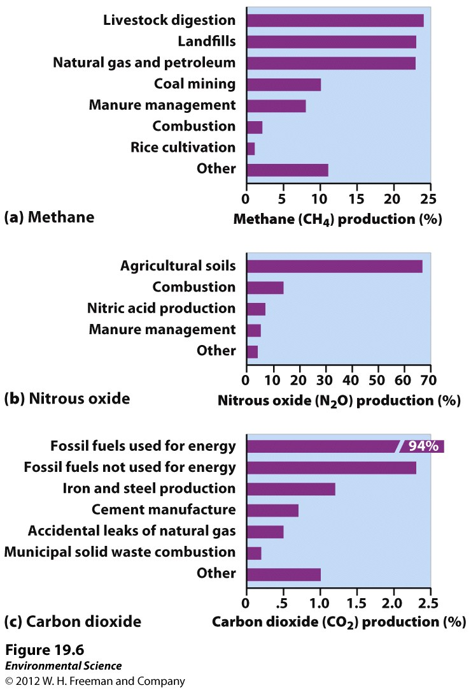
Anthropogenic Sources

Slide 14
GW Consequences
Melting
Polar Ice Caps
Glaciers
Permafrost
Rising Sea levels
Increased Heat Waves
Decreased Cold Spells
Altered Precipitation Patterns
Increased Storm Intensity
Changes to Ocean Currents
Wild Organisms/Plants
Missed Circadian Rhythms
Increased range
Decreased Range
Increased Pests
Humans
Emerging Diseases
Economics
Timber
Tourism
Cultural
S. Pacific
Inuit

Slide 15
Carbon Dioxide Increase Over Time
1000 AD --- 180 ppm (0.018%)
1800 AD --- 280 ppm (0.028%)
2010 AD --- 390 ppm (0.039%)
2050 AD --- 450 ppm* (0.045%)
2100 AD --- 550 ppm (0.055%)

Slide 16
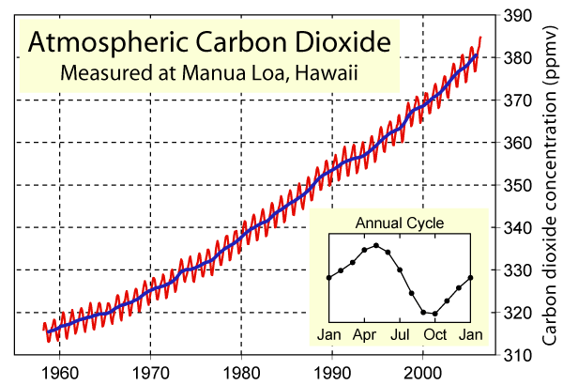
Evidence: Direct Measurement
David Keeling

Slide 17
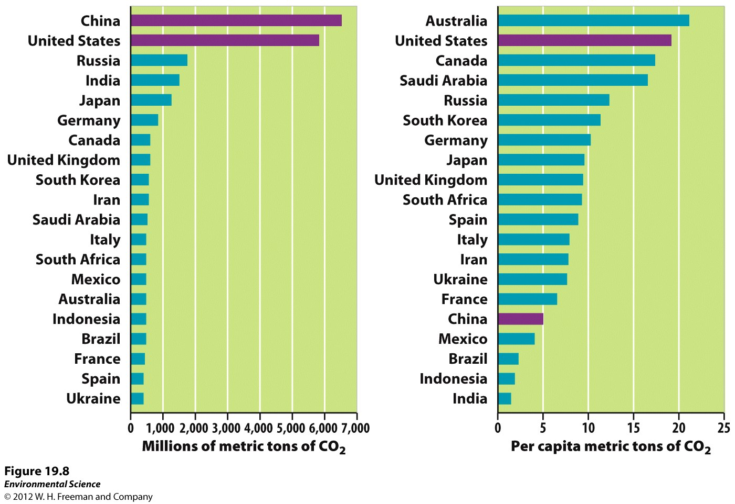
Emissions from the Developed and Developing World

Slide 18
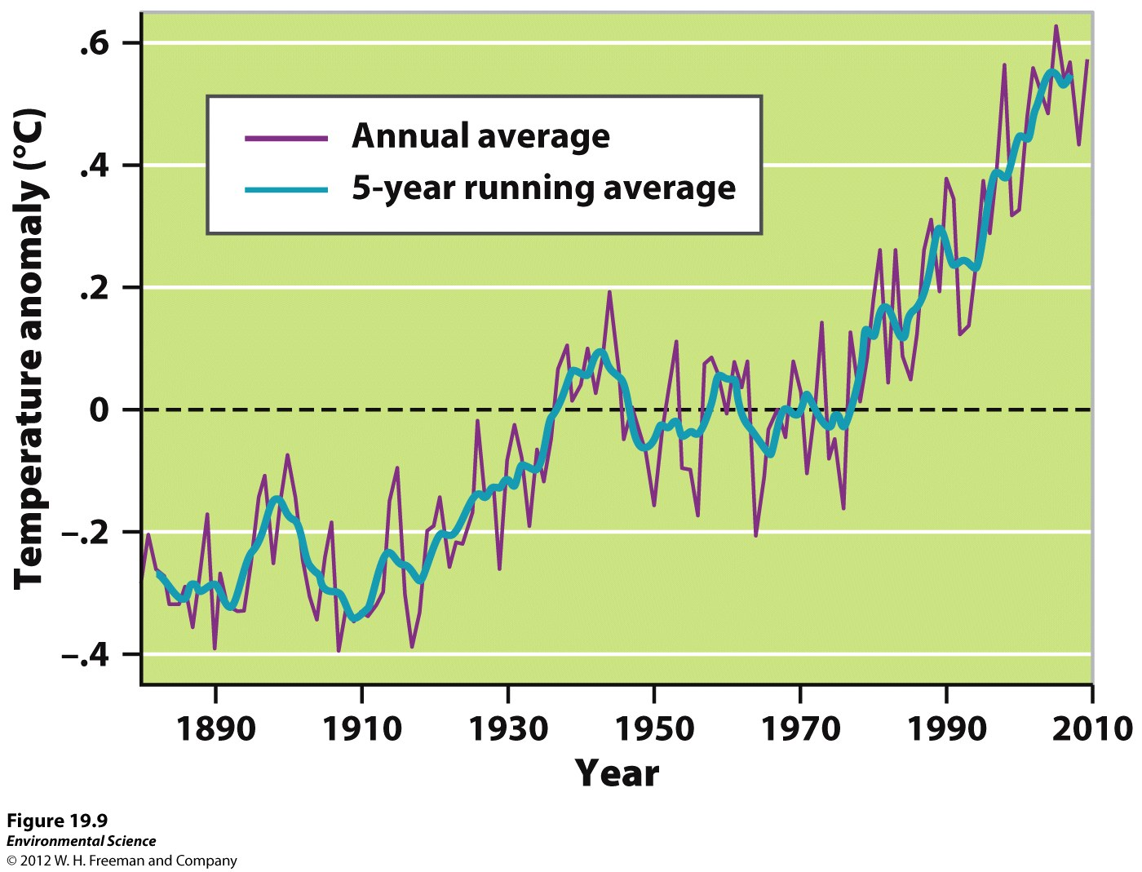
Global Temperatures since 1880
Since 1880 temperatures have increased 0.8°C.

Slide 19
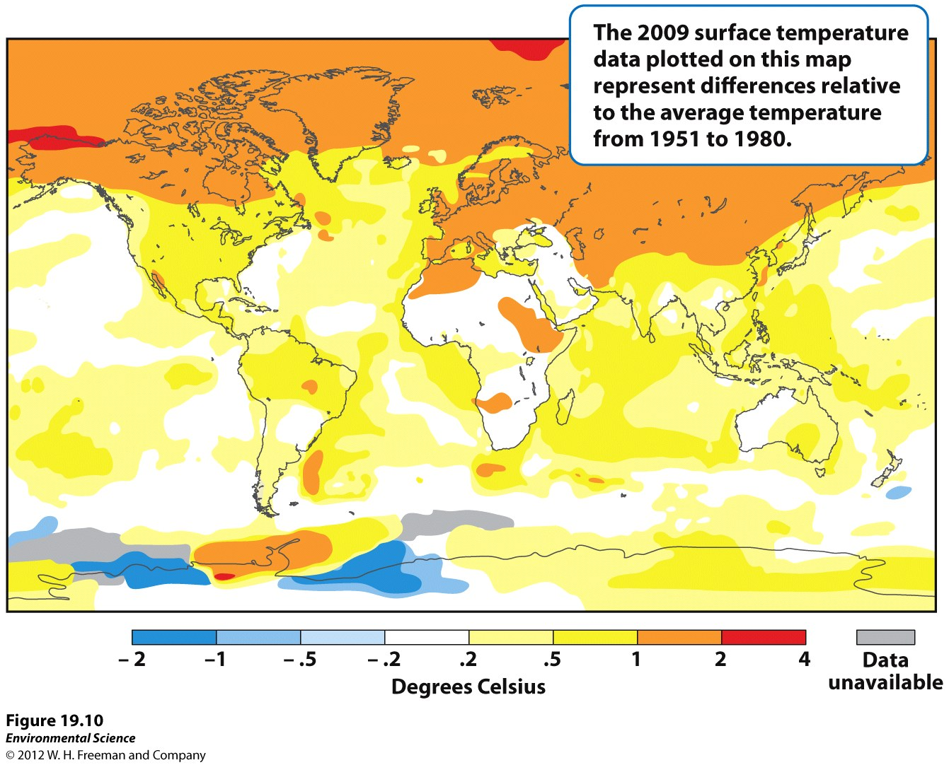

Slide 20
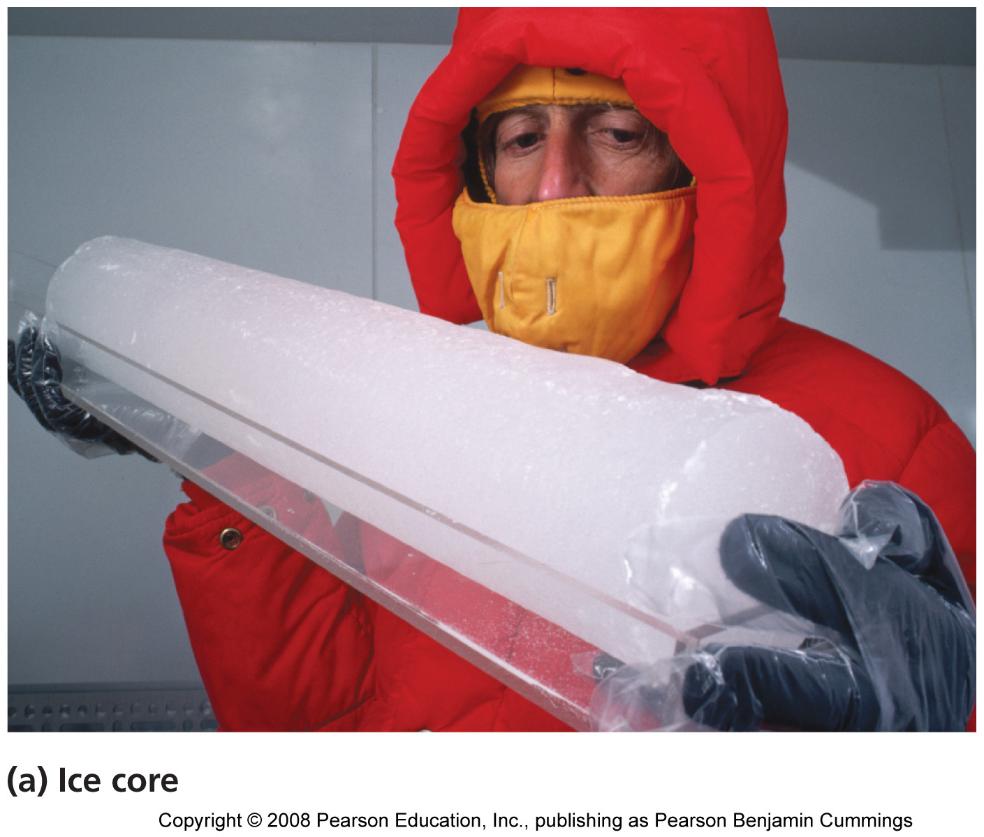
Evidence: Ice Core Sampling (gas bubbles)
Notes:
Figure 18-08a
Title:
Ice cores.
Caption:
In Greenland and Antarctica, scientists have drilled deep into ancient ice sheets and removed cores of ice like this one (a), held by Dr. Gerald Holdsworth of the University of Calgary, to extract information about past climates.
Notes:
Keywords:
atmosphere, global warming, climates, glaciers, glacial ice

Slide 21
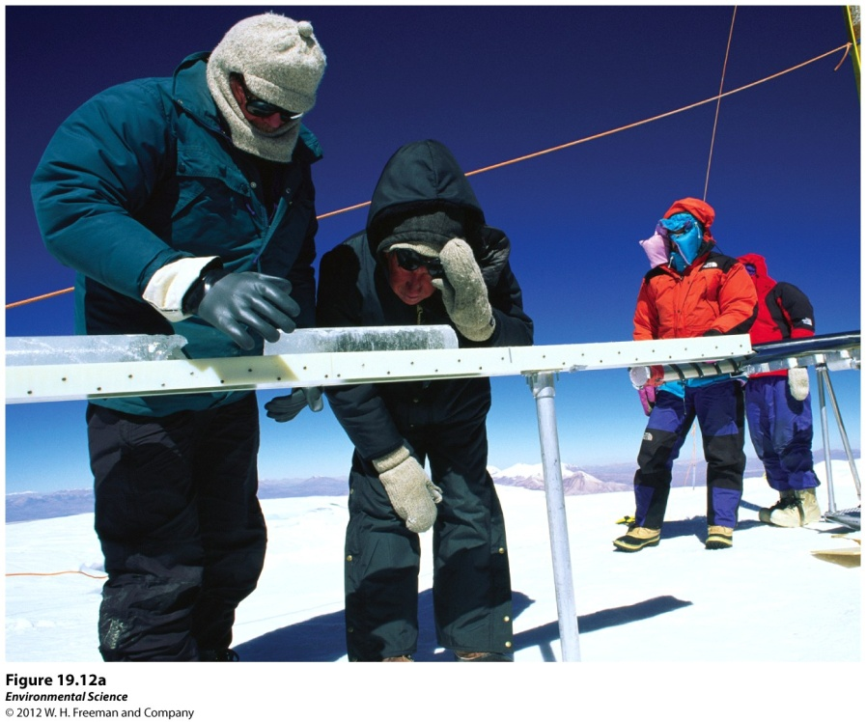
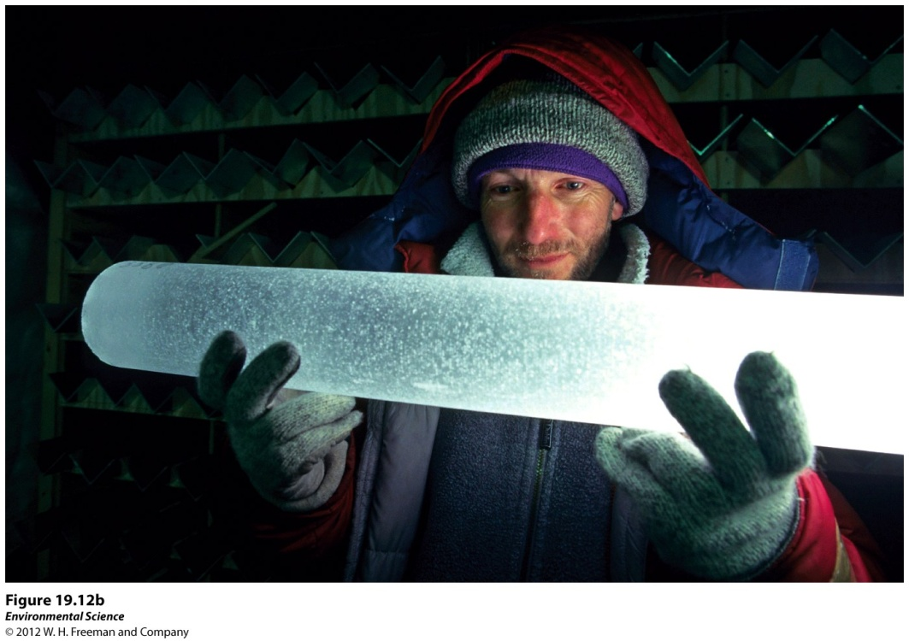
Temperatures and Greenhouse Gas Concentrations in Past 400,000 Years
No one was around thousands of years ago to measure temperatures so we use other indirect measurements. Some of these are
Changes in species compositions
Chemical analyses of ice

Slide 22
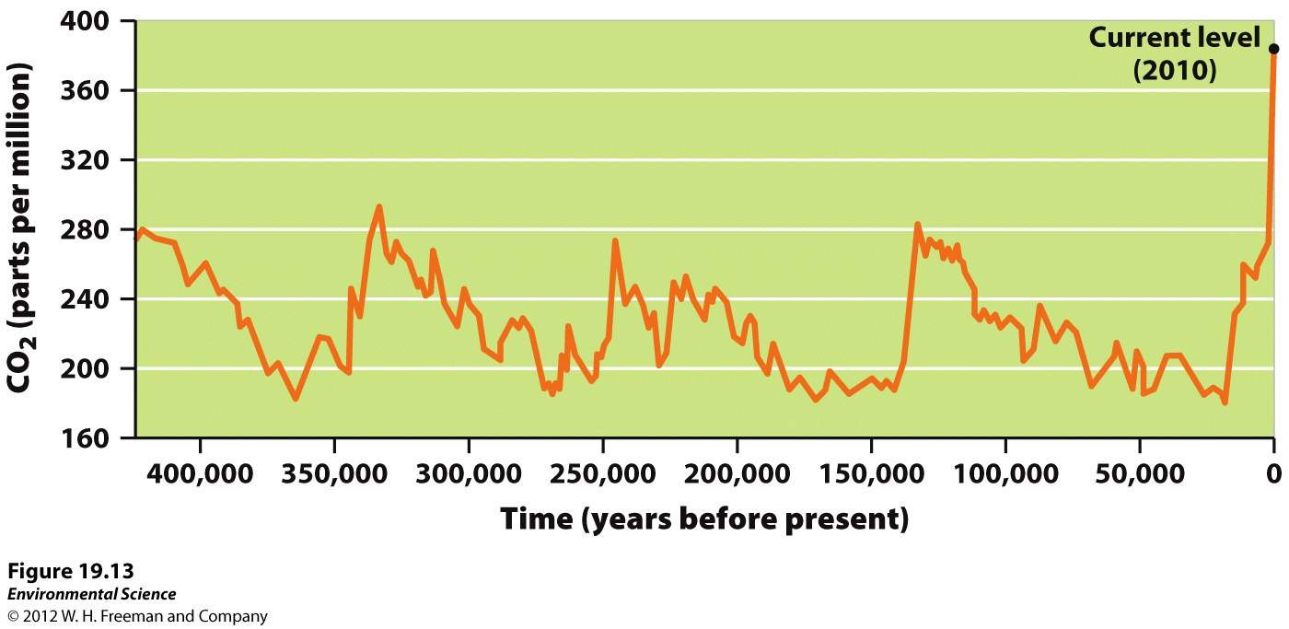

Slide 23
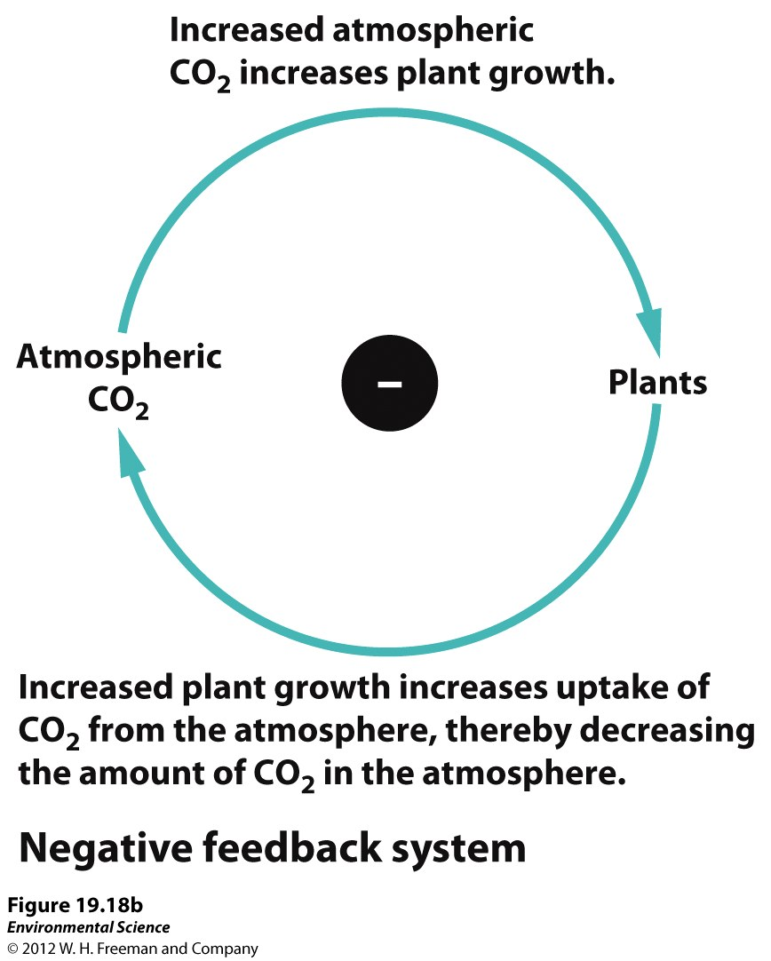
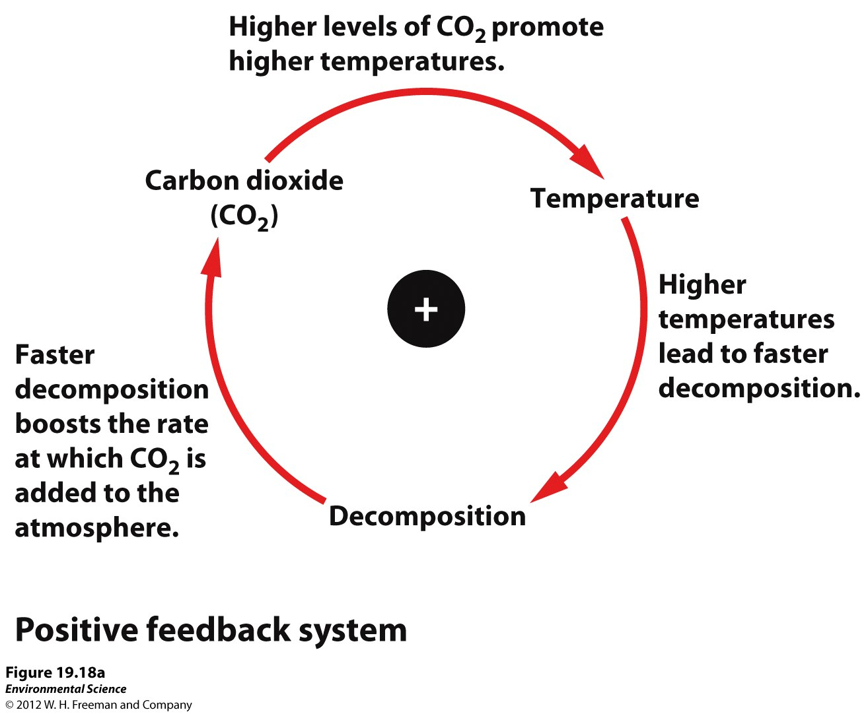
Feedbacks

Slide 24
Evidence: RATE OF TEMPERATURE INCREASE
The global temperature is presently increasing at the rate of 0.2 ° C per decade.
Total temperature anomaly ~ 1° C since industrial revolution began
11 of the 12 hottest years on record have occurred in the last twelve years (!!!!!)
The 20th Century was the warmest century in the past 1000 years.

Slide 25
Prediction: CRITICAL CONCENTRATION OF CARBON DIOXIDE – The “tipping point”
Scientists believe that a concentration greater than 450 ppm of carbon dioxide in the Earth’s atmosphere will lead to a runaway greenhouse effect (positive feedback loop) with catastrophic consequences for life on Earth.

Slide 26
Effect: OCEAN WARMING
The Earth’s ocean has warmed 0.5 to 1.0 degrees Fahrenheit since 1906.
Ocean is also becoming more acidic (~26% more acidic since beginning of industrial revolution)

Slide 27
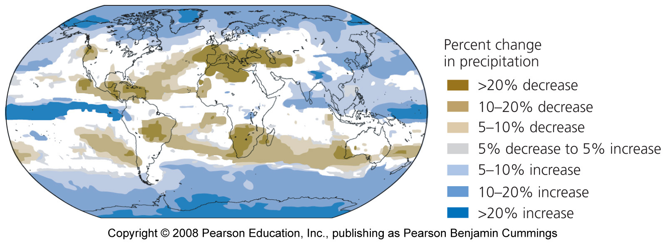
Effect: Changes in Precipitation
Notes:
Figure 18-16
Title:
This map shows projected changes in June-August precipitation for the decade 2090-2099, relative to precipitation levels in 1980-1999.
Caption:
Browner shades indicate less precipitation, and bluer shades indicate more precipitation. White indicates areas for which models could not agree. This map was generated using an emission scenario that is intermediate in its assumptions, involving an average global temperature rise of 2.8°C (5.0° F) by 2100. Data from Intergovernmental Panel on Climate Change. 2007. Fourth assessment report.
Notes:
Keywords:
atmosphere, global warming, climates, coupled general circulation models, CGCMs, Intergovernmental Panel on Climate Change, IPCC

Slide 28
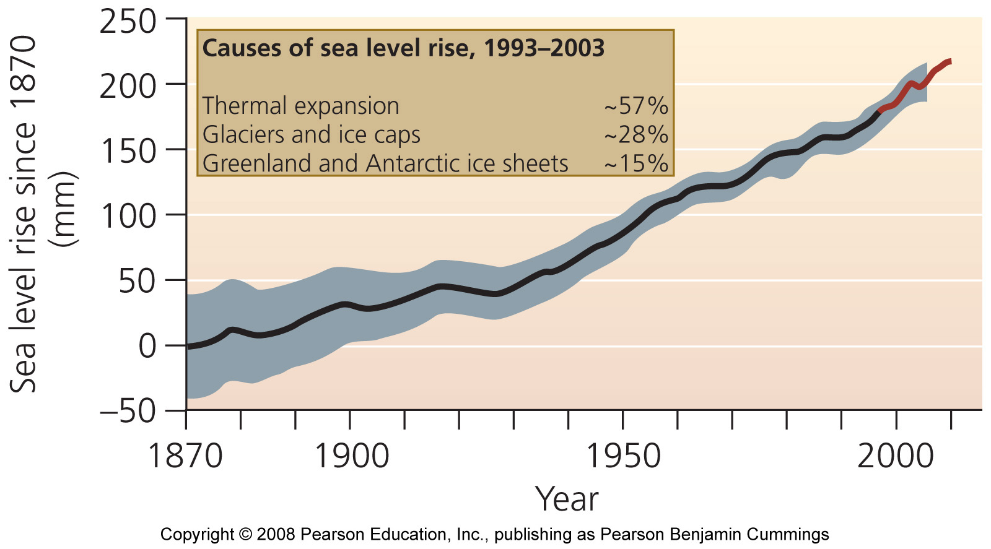
Effect: Sea Level Rise
Notes:
Figure 18-18
Title:
Rise in sea levels.
Caption:
Data from tide gauges (black line) and satellite observations (red line) show that global average sea level has risen about 200 mm (7.9 in.) since 1870. Gray shaded area indicates range of uncertainty. Thermal expansion of water accounts for most sea-level rise. Data from Intergovernmental Panel on Climate Change. 2007. Fourth assessment report.
Notes:
Keywords:
atmosphere, global warming, climates, oceans, sea levels, Intergovernmental Panel on Climate Change, IPCC, glaciers, glacial ice

Slide 29
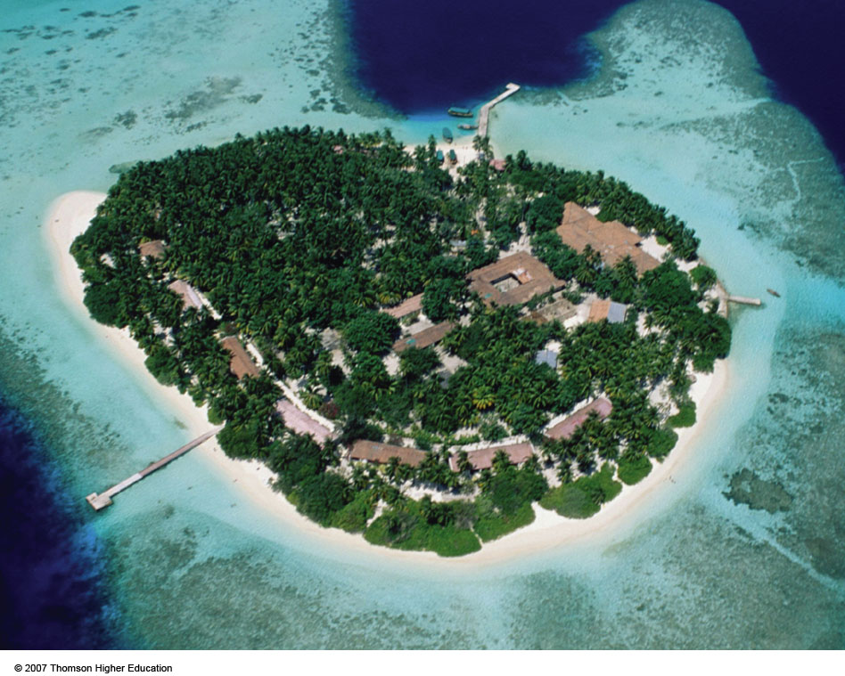
Effect: Rising Sea Levels
If seas levels rise by 18 – 75cm during this century, most of the Maldives islands and their coral reefs will be flooded.
Figure 20-11

Slide 30
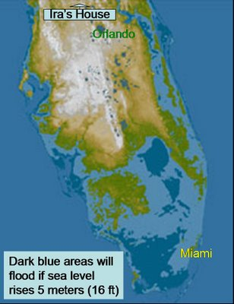
A significant ocean rise will put a large portion of Florida under water

Slide 31
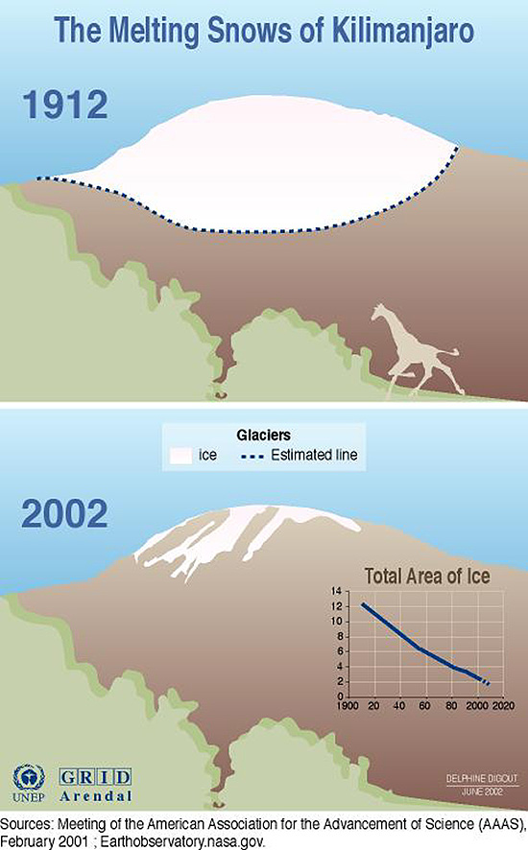
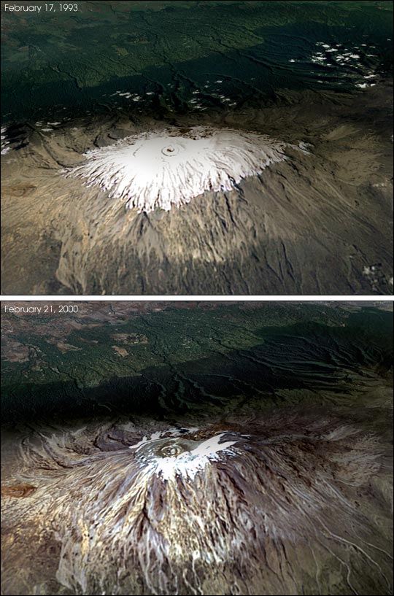
Effect & Evidence: Melting Glaciers

Slide 32
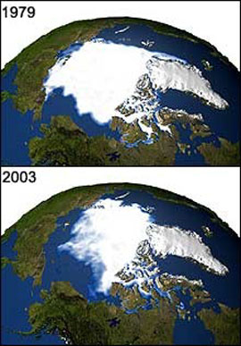
Evidence & Effect: Melting Arctic Ice

Slide 33
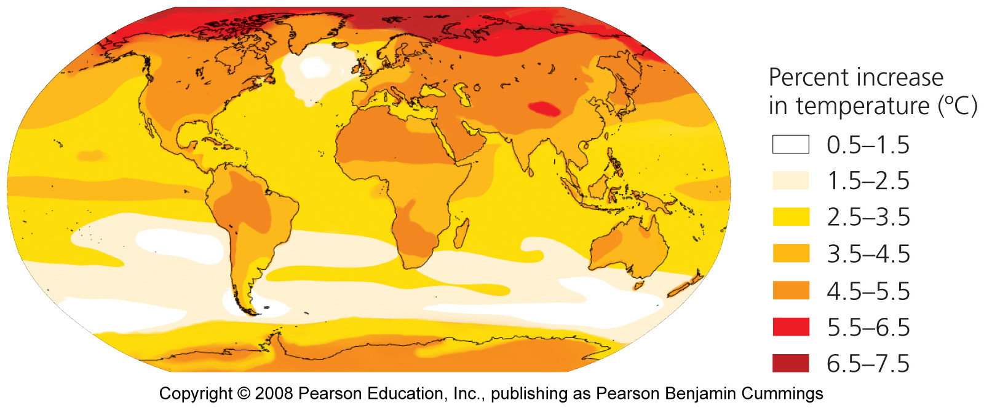
Effects: Arctic Will Warm MOST
Notes:
Figure 18-15
Title:
This map shows projected increases in surface temperature for the decade 2090-2099, relative to temperatures in 1980-1999.
Caption:
Land masses will warm more than oceans, and the Arctic will warm the most, up to 7.5° C (13.5° F). The IPCC uses multiple climate models when predicting regional variation in how temperature will change, and this map was generated using an emission scenario that is intermediate in its assumptions, involving an average global temperature rise of 2.8° C (5.0° F) by 2100. Data from Intergovernmental Panel on Climate Change. 2007. Fourth assessment report.
Notes:
Keywords:
atmosphere, global warming, climates, coupled general circulation models, CGCMs, temperatures, Intergovernmental Panel on Climate Change, IPCC

Slide 34
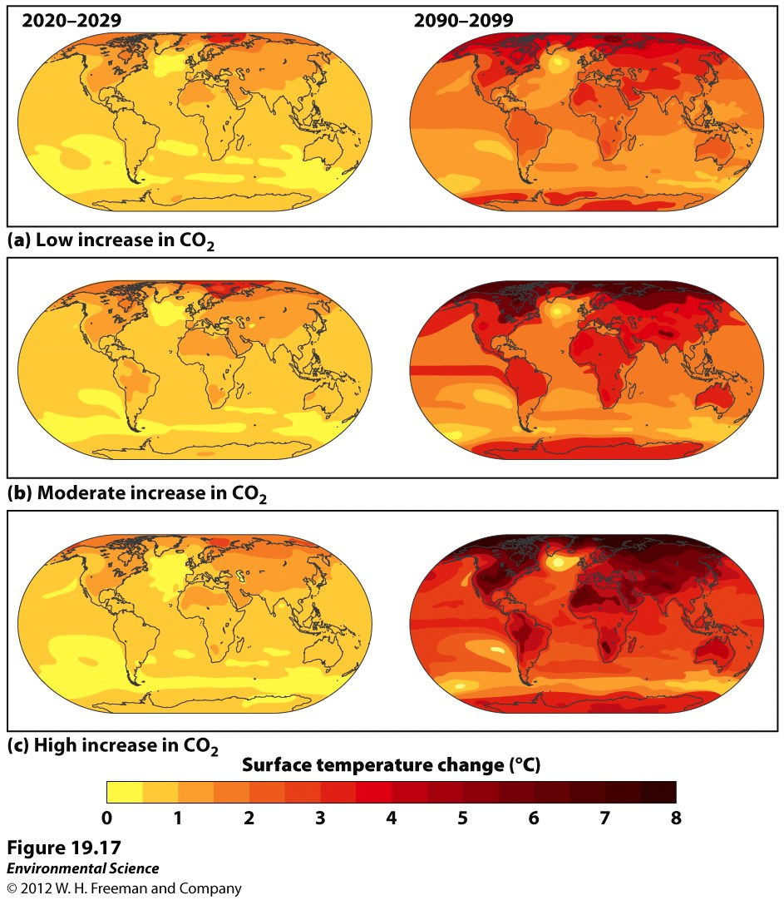

Slide 35
Increasing temperature is melting the permafrost that supports the surface of Arctic lands
Much of the permafrost in Alaska is just below freezing; and as it warms, it weakens and then collapses as it rises above freezing, releasing Methane to atmosphere (pos feedback loop!)
Melting permafrost has caused phone poles to sag and collapse, trees to collapse, highways to buckle and homes to sink costing billions of dollars.

Slide 36
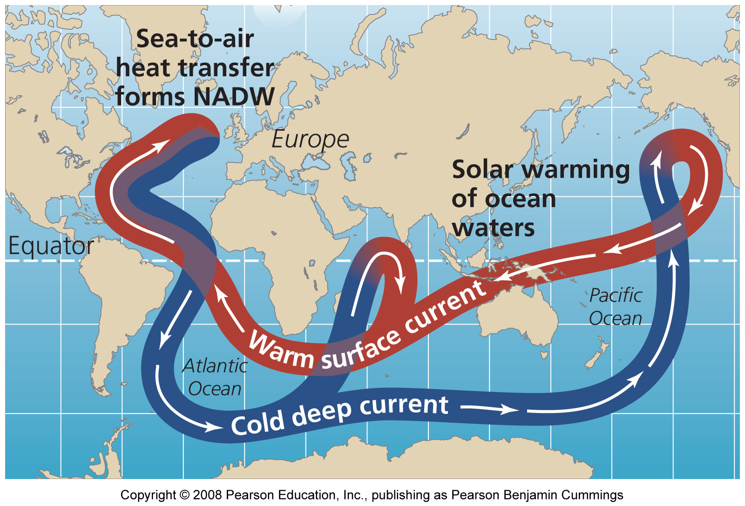
Effect: Disruption to Thermohaline Circulation
Notes:
Figure 18-07
Title:
Global ocean currents.
Caption:
Warm surface currents carry heat from equatorial waters of the ocean north toward Europe and Greenland, where they release heat into the atmosphere and then cool and sink, forming the North Atlantic Deep Water. Scientists debate whether rapid melting of Greenland's ice sheet could interrupt the flow of heat from equatorial regions and cause Europe to cool dramatically.
Notes:
Keywords:
atmosphere, global warming, climates, oceans, surface currents

Slide 37
If the salinity of the ocean current were to become diluted by melting ice, the current would not sink near arctic and the Gulf Stream current could shut down

Slide 38
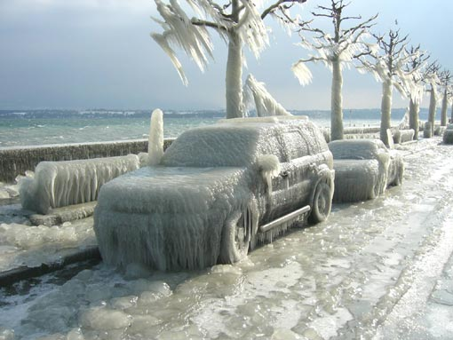
Europe would become much colder without the Gulf Steam current

Slide 39
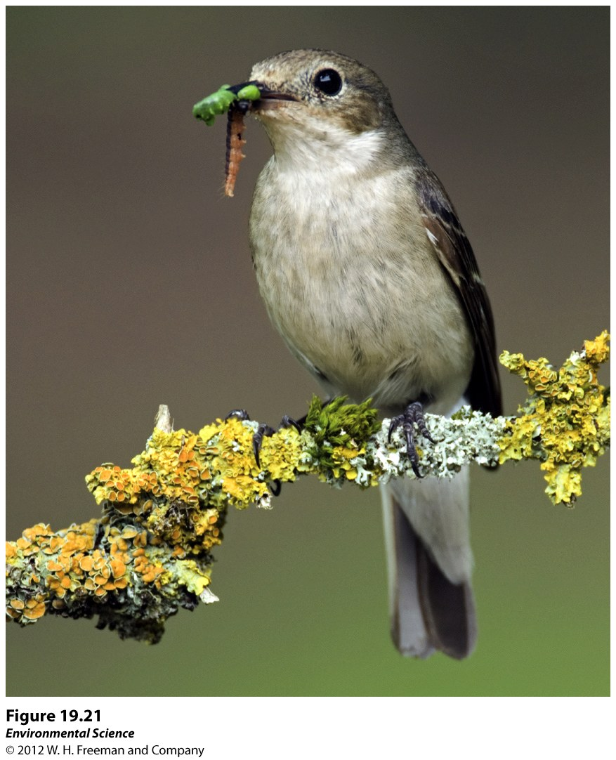
Consequences to Living Organisms
Pied Flycatcher
Ficedula hypoleuca

Slide 40
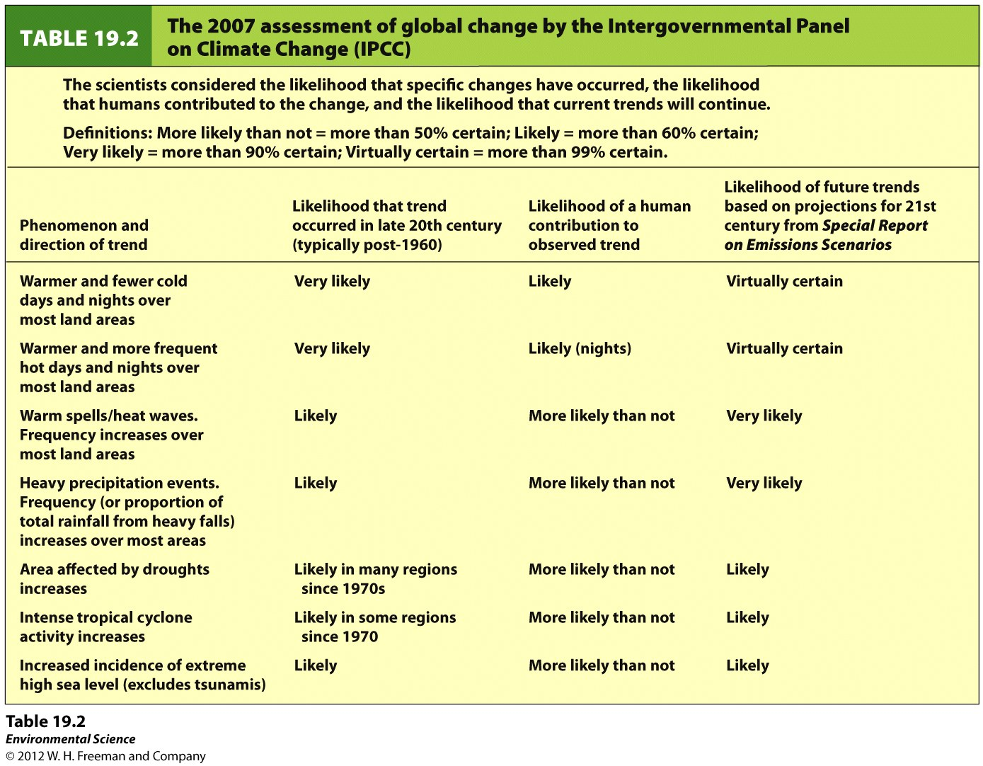

Slide 41
The Kyoto Protocol
In 1997, representatives of the nations of the world went to Kyoto, Japan to discuss how best to control the emissions contributing to global warming.
The agreement was that emissions of greenhouse gases from all industrialized countries will be reduced to 5.2% below their 1990 levels by 2012.
Developing nations did not have emission limits imposed by the protocol.

Slide 42
Carbon Sequestration
An approach involving taking CO₂ out of the atmosphere.
Some methods include storing carbon in agricultural soils or retiring agricultural land and allowing it to become pasture or forest.
Researchers are looking at cost-effective ways of capturing CO₂ from the air, from coal-burning power stations, and from other emission sources.
This captured CO₂ would be compressed and pumped into abandoned oil wells or the deep ocean.

Slide 43
